Slide 1
Indigo, Azure, Aqua Year 1/2
Miss Dymond
Miss Miles
Mrs Jackson
Mrs Wilcox
Mrs Bailey
Miss Stokes
Mrs Owen
Mrs Ellis
Mrs Evans

Slide 2
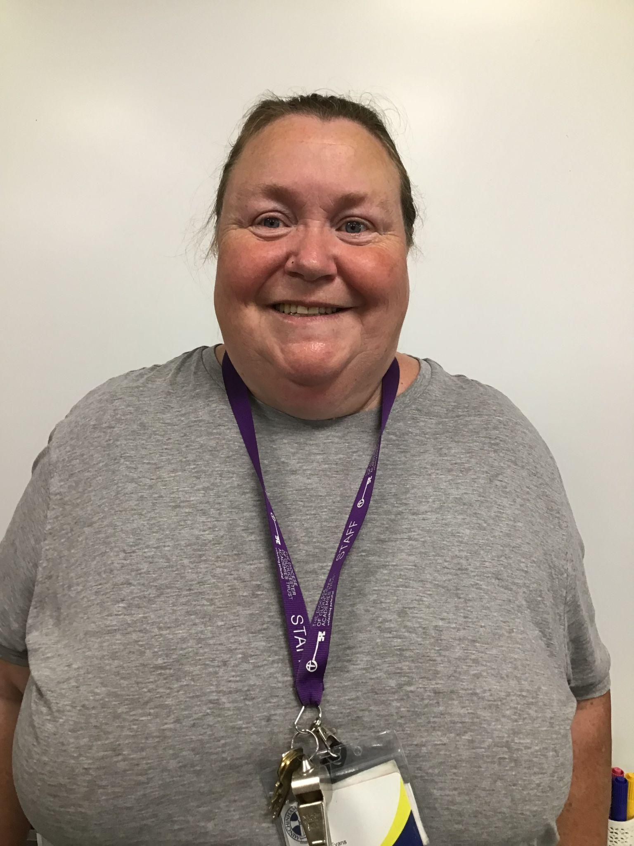
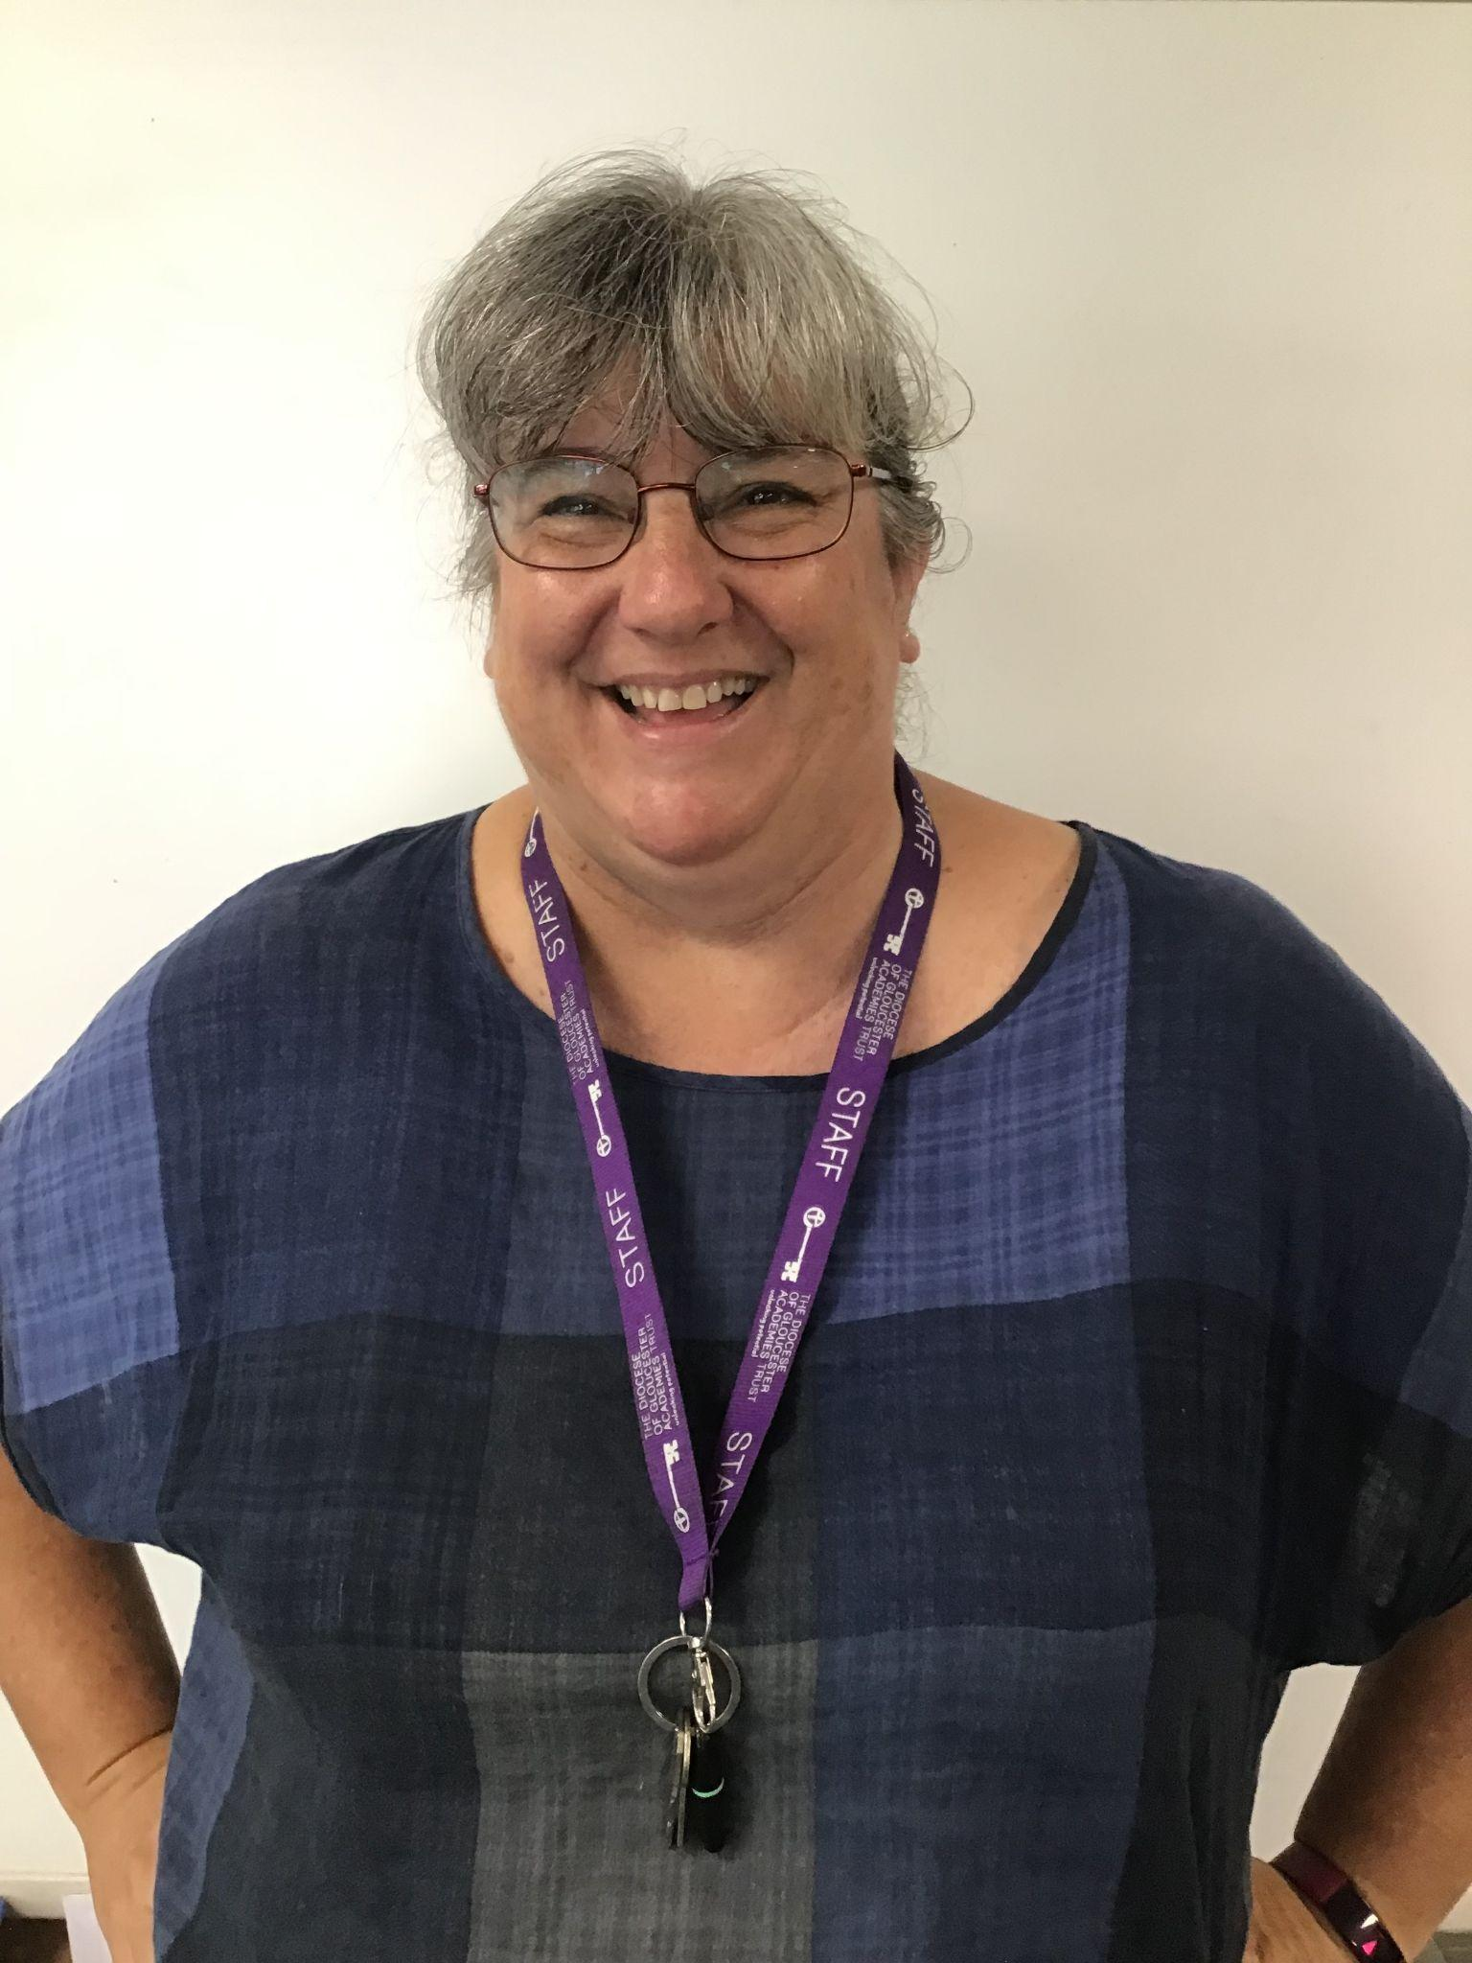
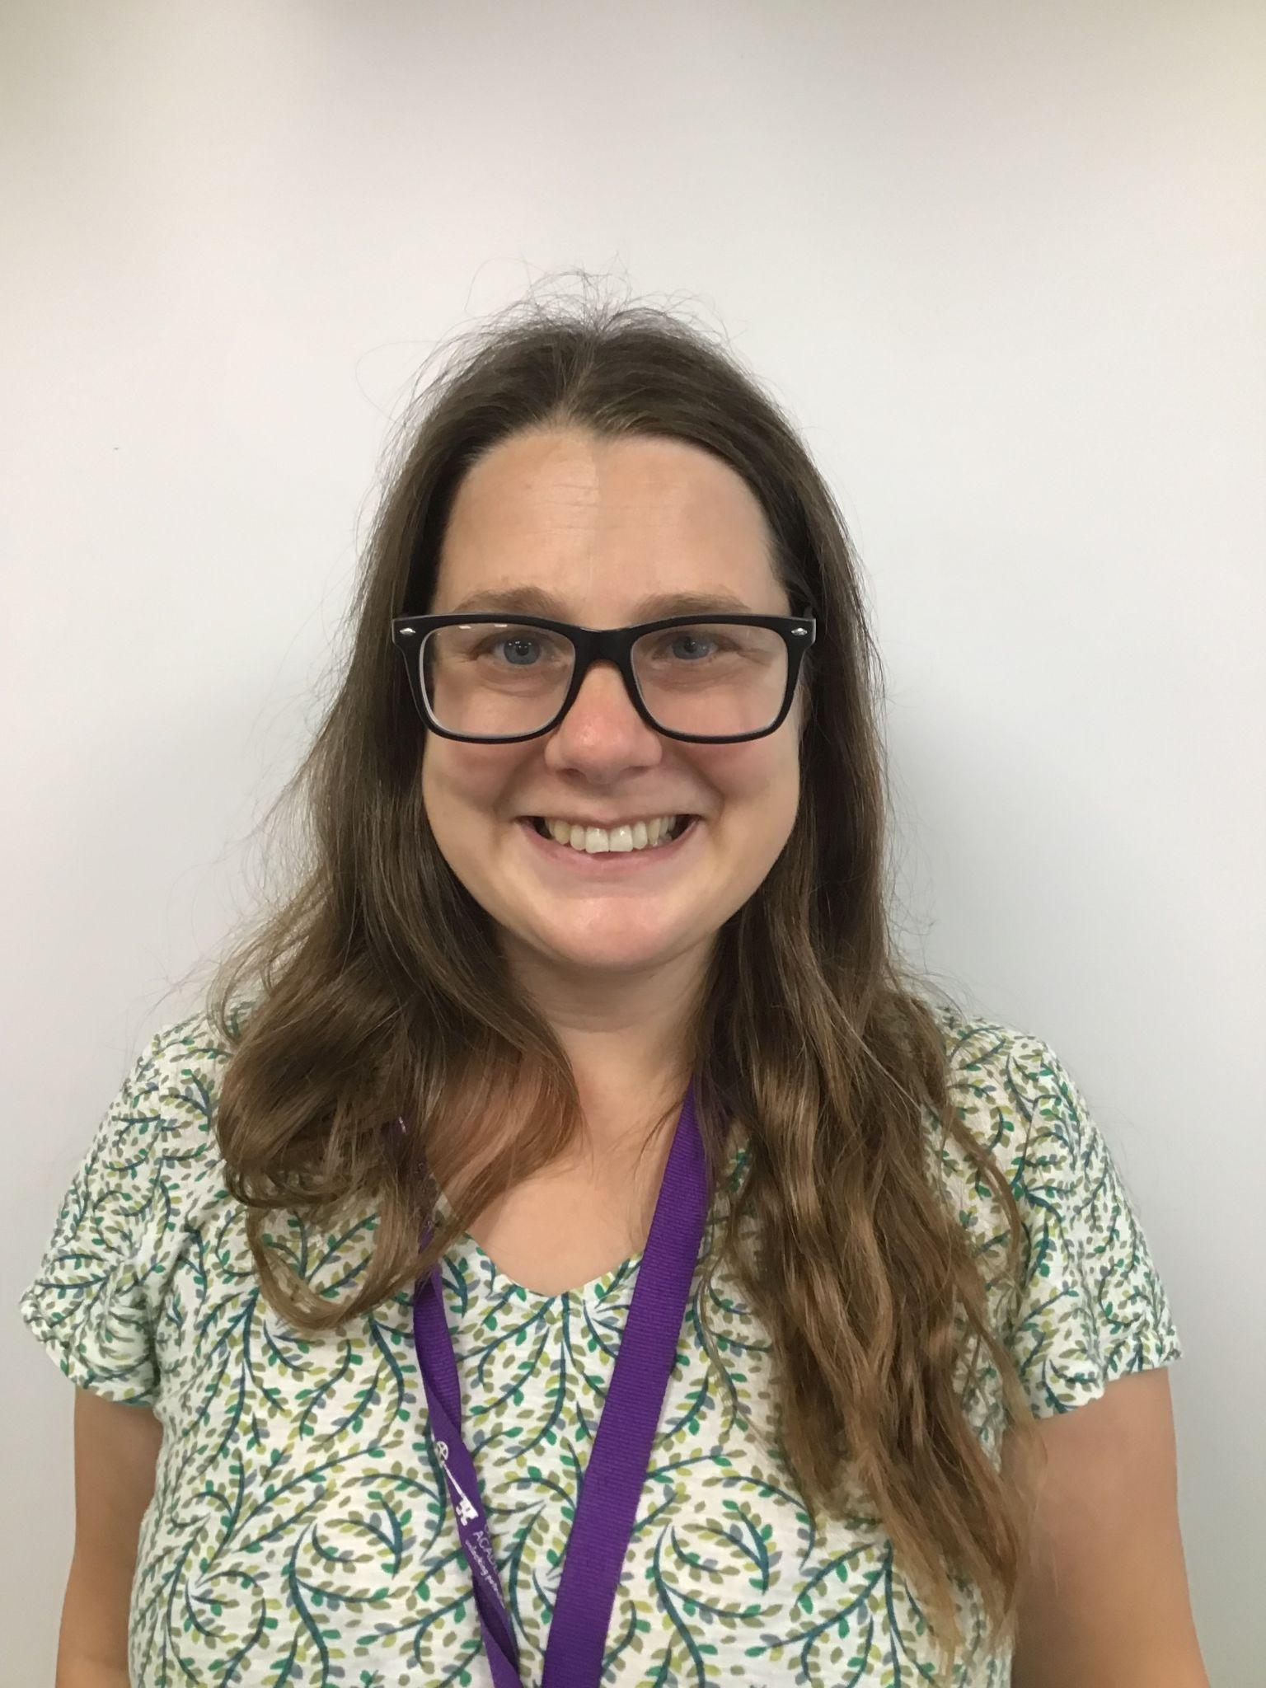
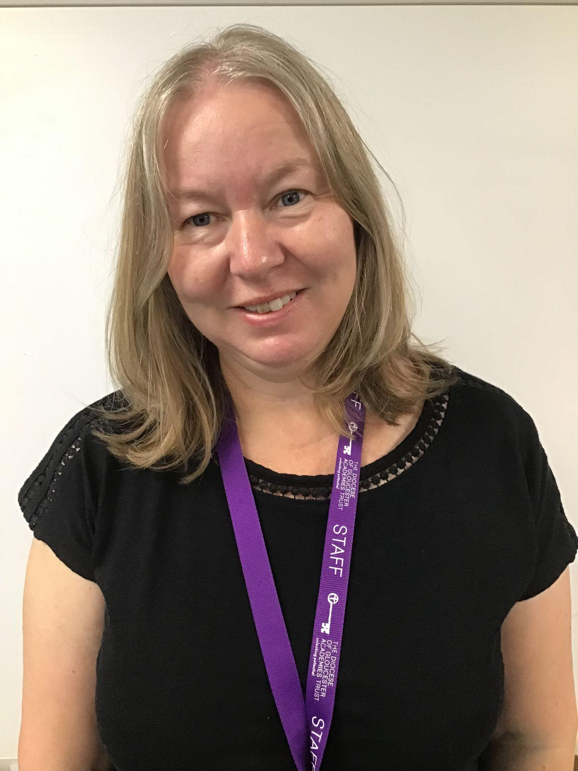
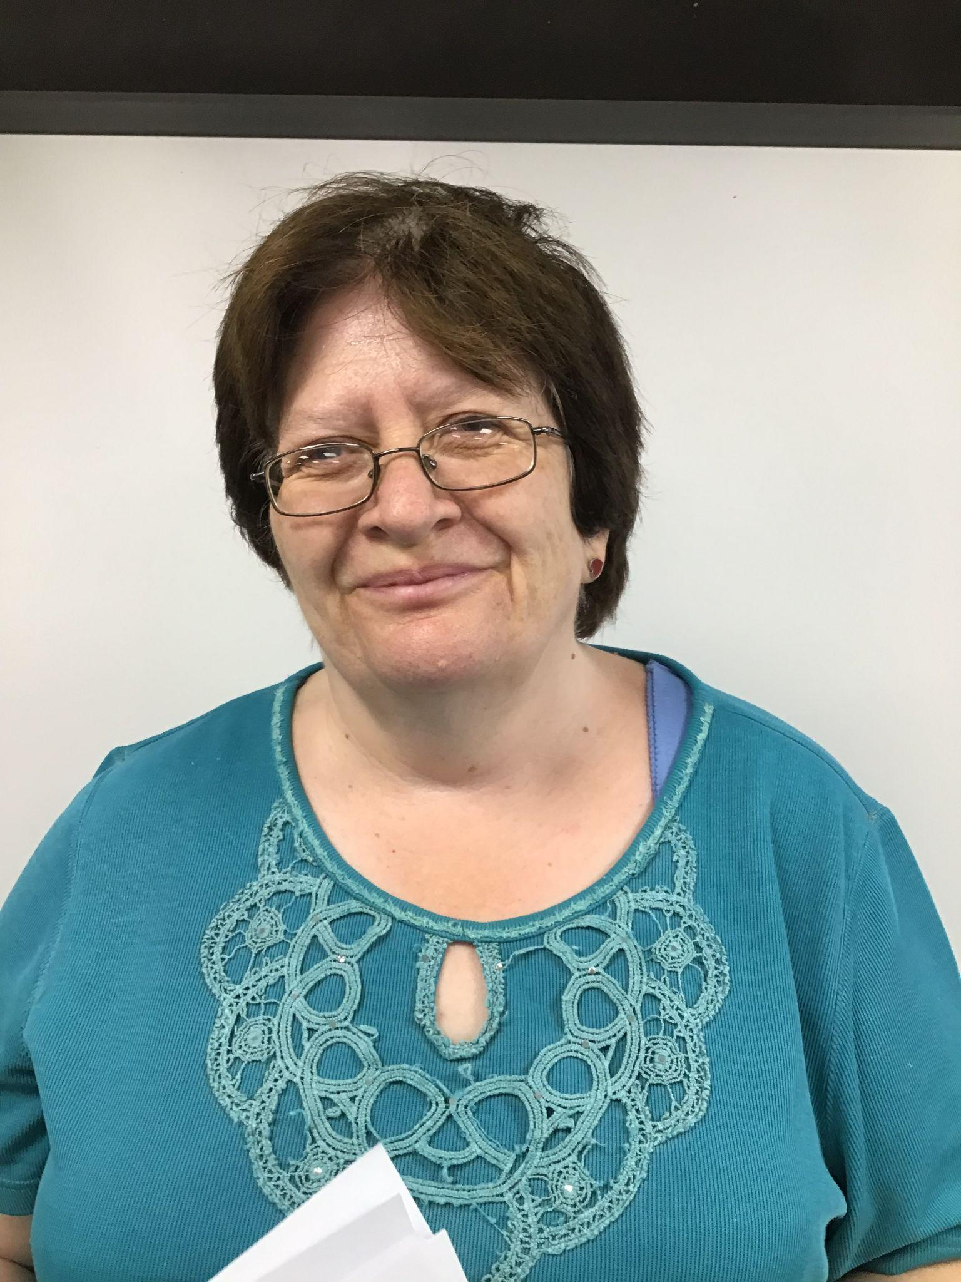
Classroom TAs
Miss Evans
Mrs Bailey
Miss Stokes
Mrs Owen
Mrs Ellis

Slide 3
Indigo, Azure, Aqua
Monday, Tuesday, Wednesday will be Miss Miles in Azure. Thursday, Friday will be Mrs Jackson
Monday, Tuesday, Thursday, Friday will be Miss Dymond in Indigo. Every other Wednesday morning will be Mrs Jankoska

Slide 4
English
In English, we enjoy re-telling stories, acting out the story and writing our own versions. We love to use descriptive language as we devise our own character descriptions and settings. We write poems and explore a wide variety of genre. We teach through ‘Talk for Writing’ and the ‘Power of Reading’.
We teach spelling through ‘Phonics Bug’ and the ‘Letters and Sounds’ curriculum.
We will look at sentence construction and will encourage your child to have a go at independent writing.

Slide 5
Reading
Children will read to an adult at least once a week in school. Initially this may be individually but will soon include guided reading
Each child will have their reading books changed twice a week or as necessary.
Please make sure that you write in your child’s reading record book at least 4 times a week. Either them reading or you reading to them.
Your child will also bring home a book corner book of their choice.

Slide 6
Reading
Please engage with your child’s reading for ten minutes every day and write a comment in their reading record book daily.
If your child is too tired to read, then it is perfectly fine to read to them. Again, please write in that you have read with your child.
Please make sure books are in book bags every day.

Slide 7
Handwriting
We will continue to practise our handwriting in the cursive style. We have some sheets to send home in case you aren’t familiar with cursive or would like some practise.
We will be focussing on the correct pencil grip, letter formation and we will always think carefully about how we form and join up our letters.

Slide 8
Maths
We use ‘Can Do’ maths. This is a well researched and published resource that helps us teach maths in a consistent way across the school.
‘Can Do’ maths follows a pattern for each learning point. ‘Do It’ where you learn an aspect of maths and then practise lots of problems or calculations. ‘Twist it’ where you practise it in a different format or as part of a less straightforward problem. Then ‘Explore It’ which is an open ended problem to investigate using the skills learned.
The sequence is backed up by ‘Deliberate Practice’ which is a chance to come back to skills previously acquired. Sometimes this will be in booklet form, sometimes in Continuous Provision

Slide 9
PE Please name all kit!
We will be doing PE twice a week. Outdoor PE and Indoor PE. On Tuesdays Mr Tovey will be teaching PE, while Mrs Kettle will teach music.
Swimming. Year 2 will be going swimming at Stratford Park. More details about this will follow later in the year.
Children will need a full PE kit in school at all times. This will consist of a white t-shirt, blue / black shorts, jogging bottoms, daps and a drawstring PE bag (no trainers please ).
Please ensure long hair is always tied up at school, and make sure they have spare socks in their PE bag (if they are wearing tights on a PE day they will need socks).

Slide 10
P4C/values
PSHE will be taught in a variety of ways including circle time, assemblies, reflection time and P4C (Philosophy for Children).
There will be a different value each term that will be the focus of assemblies.
RE- usually block taught in the last week before each term ends.

Slide 11
Science, History, Geography
There will be a variety of topics taught through the year. Lots of practical opportunities will be provided as well as outdoor learning and trips.
We will be following some eco curriculum units e.g. our current learning with the title “Where have all the trees gone?”
If you have particular skills or interests in any of our curriculum areas that you would like to share please get in touch.

Slide 12
Art, D.T, Music
There will be a variety of topics taught through the year. Lots of practical opportunities will be provided.
There are opportunities to learn an instrument with our visiting teachers. Ask the office for details.

Slide 13
Continuous Provision
Extensive research shows children learn best through play - investigation, problem solving, acting it out, talking to others, creating and using imagination.
Continuous provision is a way of providing learning opportunities that continue without an adults direction. It is a way of delivering the curriculum.
We are using continuous provision in year one and two, along with whole class teaching and direct teaching in small focus groups.
Hopefully your child has already told you some of things they have been doing!

Slide 14
Continuous Provision
During continuous provision the children will be encouraged to access other materials to support their learning. They will take responsibility for their learning using paper, writing frames, cameras, recording devices.
The children will produce an independent journal with this work. We will encourage a high standard of presentation and quality.
Each week there will be suggested open ended challenge tasks related to the curriculum and meeting learning outcomes for Year 1 and 2. There will also be ample time for the children to design their own activities and follow their own interests, skills and abilities.
If you want to find out more look up Early Excellence or Alistair Bryce-Clegg online.

Slide 15
Parent Reading
Please come in and share a book or do your child’s reading for the day on a Wednesday afternoon 2:45. No need to sign up, come through the office.
Outdoor Learning - Yr2 have had a sign up sheet, we will leave site if we have enough helpers each week.
Yr 1 will leave site later in the year, no need for parent helpers yet.

Slide 16
How you can help at home
Visit the library and find new books to share at home.
Practise writing at home e.g. shopping lists, letters to friends, football scores etc.
Check that your child is sitting and holding the pencil correctly.
We will be sending home the Y1 and Y2 common exception words list so that you know which words they are expected to spell accurately by the end of each year.
Check out the websites and suggestions on the curriculum letter.

Slide 17
How you can help at home
Count when you are out and about. Look at where maths is used, e.g. shopping, measuring for DIY, cooking with a recipe, weighing, telling the time, etc.
Help your child practise maths skills such as number bonds, doubles and halves and times tables.
Help your child to read and write numerals and words in the environment. E.g. 55 or fifty-five

Slide 18
Classroom expectations
Please leave cuddly friends at home
Please don’t bring in toys, they might get lost or broken
Please encourage your child to organise their own belongings and name them carefully
Please send a book bag to school. We have no space for rucksacks and these are usually only for Year 5 and 6 children.

Slide 19
Special events
Keep looking at newsletters, check the school website and parent calendar for further updates throughout the year.
We hope to plan some trips and visitors this year, watch out for details
We will be inviting parents in to read with or to your children.
We will be doing outdoor learning this year. We would love parent helpers. Please wear jogging bottoms on Fridays

Slide 20
Contacting us
We are easier to contact by email azure@minchschool.net indigo@minchschool.net aqua@minchschool.net if you have a query or something to let us know. We will aim to check within 36 hours. We can then arrange a meeting or phone call if necessary. Any straight forward or more urgent messages should go via admin@minchschool.net
Please let us know of any changes for collection of your child, or usual routines i.e. childminder collects my child every Tuesday/Wednesday/Thursday

Slide 21
Routines
Generally…
Register
Phonics
Assembly/readers
Maths
Continuous provision
Break- fruit and milk time
English
Continuous provision
Lunch
Afternoon session –PE, Music, Mindfulness, Art, Topic, PSHE, P4C, Science, DT, Outdoor learning
Story
Home

Slide 22
To end…
Please feel free to contribute in any way to our topics.
Please use websites to help learning.
Anyone able to volunteer in school to help with readers, supporting children, curriculum areas etc. please contact the office
Please do send in crackers!

Slide 23
Thank you
Thank you for coming.
Any questions? We will try our best to answer them!
Please keep in touch and approach us, we are a team around your child.

