Slide 1
This is our world,
We need to save it!
All about biodiversity By Daisy and (and a bit of help from Lucy) Gilbert!!!

Slide 2
First step:
Help the bees!
Which makes up 70 percent
OF OUR FOOD!!!
Put some bee friendly plants in your garden,
Lavender, Foxgloves, cornflowers are good ones. Although be careful with young children around foxgloves which are toxic.

Slide 3
Second step:
Bee a good egg!!
Recycle, upcycle and reuse as much as you can if you have to use plastic.

Slide 4
Step three
Instead of wrapping food in cling film or tin foil use a beeswax wrap. Much more exciting anyhow. Many more colours and patterns!

Slide 5
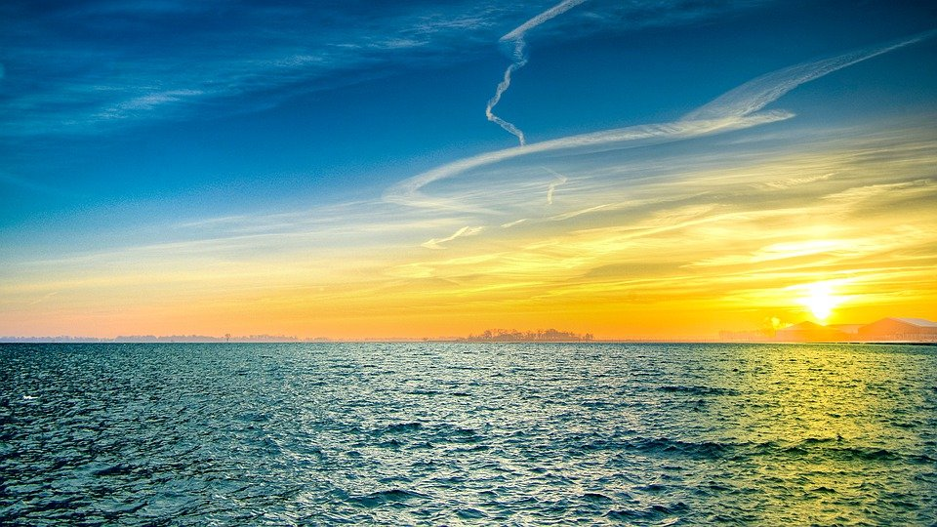
Amazing/terrible/wow facts about plastic
There is more plastic in the ocean than stars in the milky way
There is enough plastic in the seas to go around the world 4.5 times
This needs saving.

Slide 6
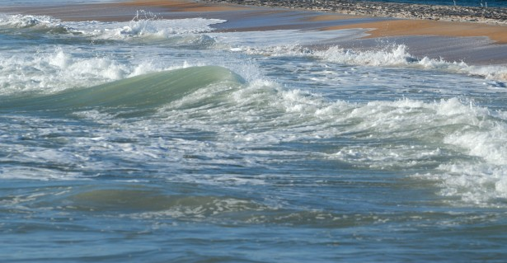
Even though we love our oceans we need to be careful

Slide 7
The pic featured on previous slide...
That was a riptide. A very strong underwater current that sucks you out to sea,
The only way to escape is to swim sideways like this

