Slide 1
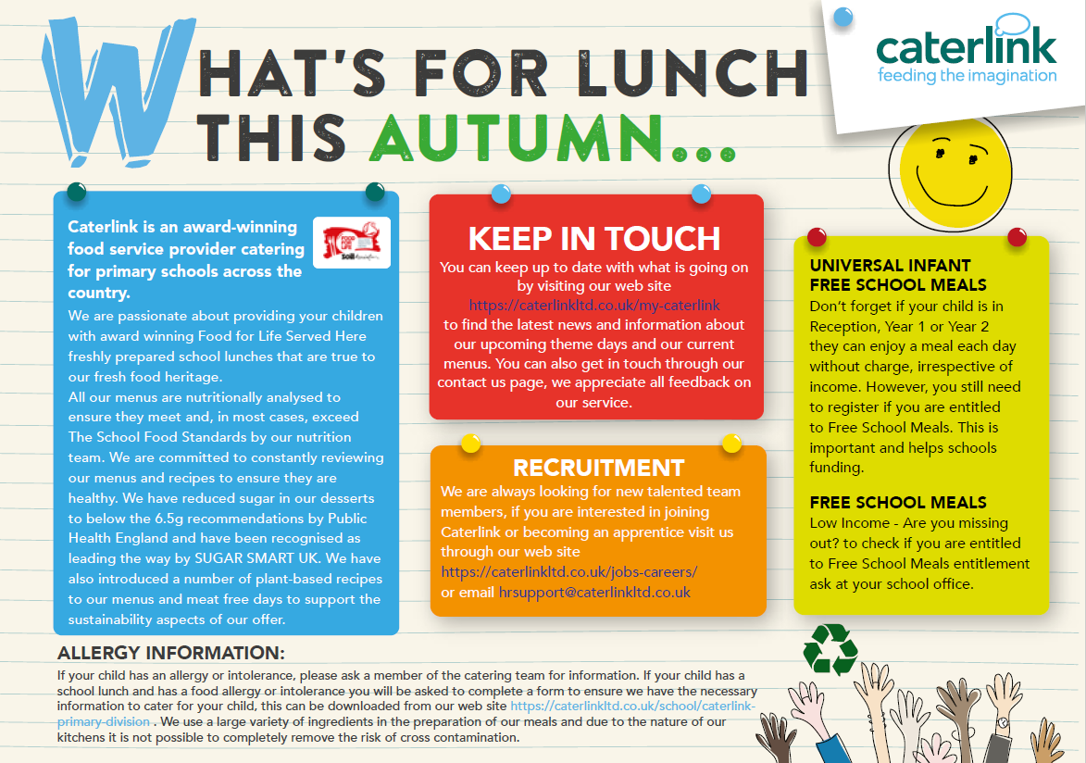

Slide 2




Autumn Menu 2020
Added Plant Power
Vegan
Wholemeal
Monday
Tuesday
Wednesday
Thursday
Friday
Week 1 31/08/2020 21/09/2020 12/10/2020 09/11/2020 30/11/2020 | Option 1 | Macaroni cheese | Meatballs with Rice | Roast Pork Roast Potatoes & Gravy | Beef Spaghetti Bolognaise | Breaded fish with Chips
 | Option 2 | Jacket Potato with Beans and Salad or Vegetables | Vegan Mexican roll with home baked wedges | Veg Wellington Roast with Roast Potatoes | Jacket Potato Tuna and Vegetables or Salad | Vegetarian Sausage and Chips
 | Veg | Cauliflower Peas | Sweetcorn Mixed salad | Broccoli Carrots | Sweetcorn Green beans | Baked Beans Peas
 | Dessert | Lemon drizzle cake Or Fruit | Fruit crumble with custard Or Fruit | Apple Cheese & crackers Or Fruit | Chocolate & orange cake with chocolate sauce or Fruit | Vanilla Shortbread or Fruit
Available Daily: The menu is reduced from the normal selection to ensure we follow the government guidelines and Covid safe
Week 2 07/09/2020 28/09/2020 19/10/2020 16/11/2020 07/12/2020 | Option 1 | Cheese & tomato pizza | Sausage Roll with home baked Wedges | Roast Chicken Roast Potatoes & Gravy | Cheese and Tomato Pin wheel with potato | Fish fingers or salmon fish fingers with Chips
 | Option 2 | Jacket Potato Tuna and Vegetables or Salad | Southern style veggie burger with home baked wedges | Moroccan Veggie Balls with Roast Potatoes | Jacket Potato with Vegetarian Bolognaise | Vegetarian Sausage Roll and Chips
 | Veg | Sweetcorn Broccoli | Peas Rainbow slaw | Carrots Green beans | Mixed salad Broccoli | Baked Beans Peas
 | Dessert | Chocolate brownie or Fruit | Iced Sponge or Fruit | Cookie or fruit | Apple Sponge & Custard or Fruit | Apple cheese & crackers or fruit
ALLERGY INFORMATION:
If your child has an allergy or intolerance please ask a member of the catering team for information. If your child has a school lunch and has a food allergy or intolerance you will be asked to complete a form to ensure we have the necessary information to cater for your child. We use a large variety of ingredients in the preparation of our meals and due to the nature of our kitchens it is not possible to completely remove the risk of cross contamination, traces or elements within products.
Week 3 14/09/2020 05/10/2020 02/11/2020 23/11/2020 14/12/2020 | Option 1 | Veggie Hotdog | Sausage and Mash with Gravy | Roast Gammon Roast Potatoes & Gravy | Chicken Curry with Rice | Fish in Batter with Chips
 | Option 2 | Jacket Potato with Beans and Salad or Veg | Vegetable Pasta Bake | Vegetable Hotpot | Jacket Potato with Beans and Salad or Vegetables | Southern Style Veggie Burger
 | Veg | Carrot Peas | Broccoli Carrots | Sweetcorn Savoy Cabbage | Green beans Cauliflower | Baked Beans Peas
 | Dessert | Banana chocolate oaty square or Fruit | Marble cake & custard or Fruit | Fruit jelly & peaches or Fruit | Orange drizzle cake or Fruit | Fruit & Yogurt or Fruit
Notes:
SILVER MENU

