Slide 1

Year 4 Equivalent Fractions
Know and use decimal equivalents to $\frac{1}{2}$
Know and use decimal equivalents to $\frac{1}{4}$
Know and use decimal equivalents to $\frac{3}{4}$

Slide 2
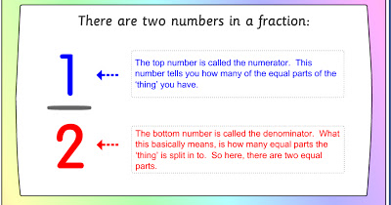
What makes a fraction?

Slide 3
Discussion:
What does equivalent mean?
Are we aware of any fractions that are equivalent? – can you show me?
What relationship can you see between the numerator and the denominator?
Can a fraction have more than one equivalent?
Can you show me using equipment an example of an equivalent fraction?

Slide 4
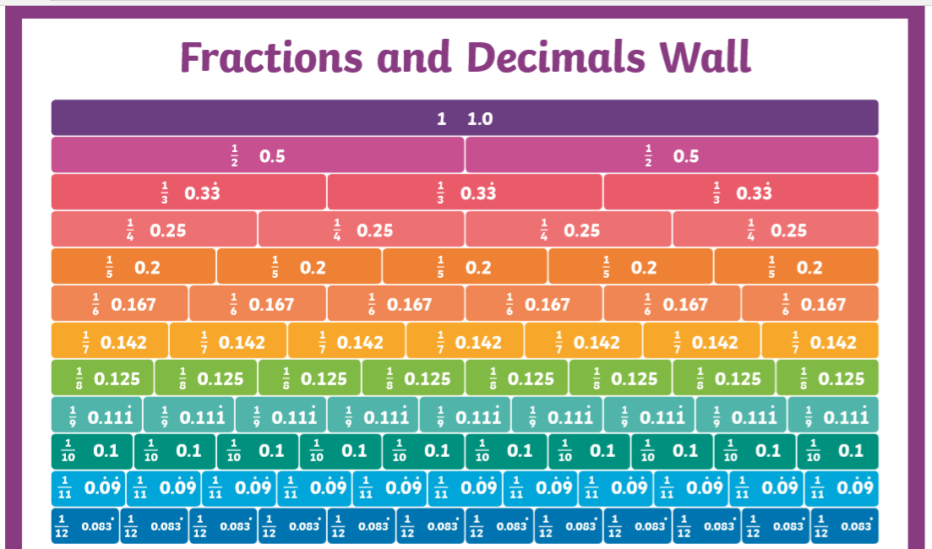

Slide 5
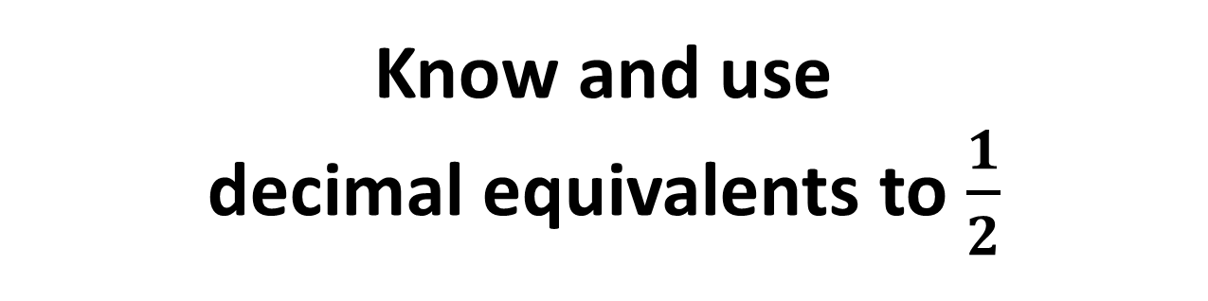
Know and use decimal equivalents to $\frac{1}{2}$

Slide 6
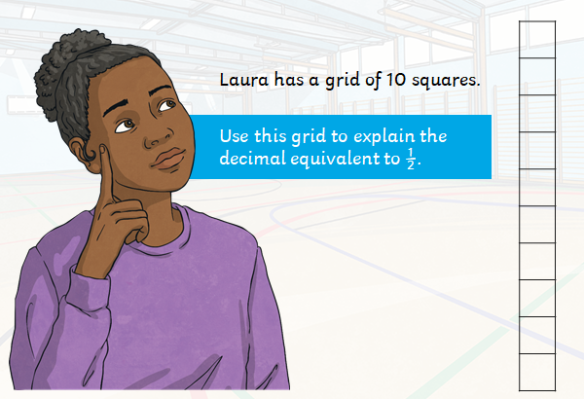
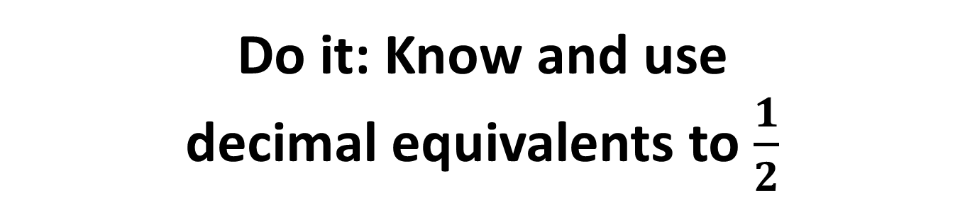
Do it: Know and use decimal equivalents to $\frac{1}{2}$
Notes:
Co

Slide 7
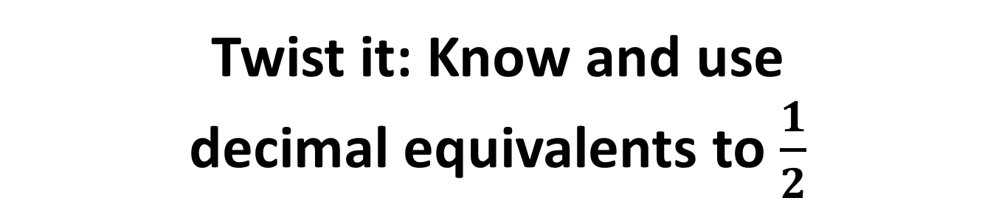

Twist it: Know and use decimal equivalents to $\frac{1}{2}$
All decimal equivalents to $\frac{1}{2}$ will have the digit 5 in them.
True or False?
Prove it.

Slide 8
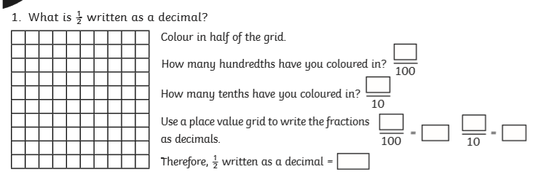
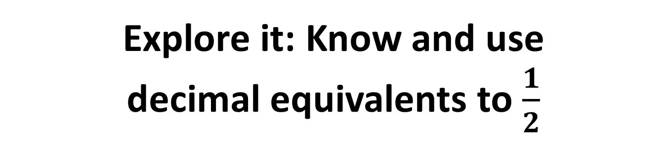
Explore it: Know and use decimal equivalents to $\frac{1}{2}$

Slide 9
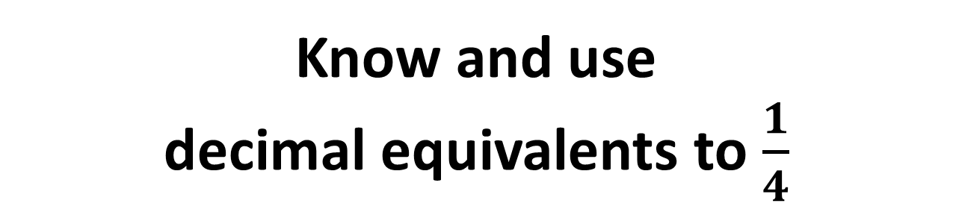
Know and use decimal equivalents to $\frac{1}{4}$

Slide 10
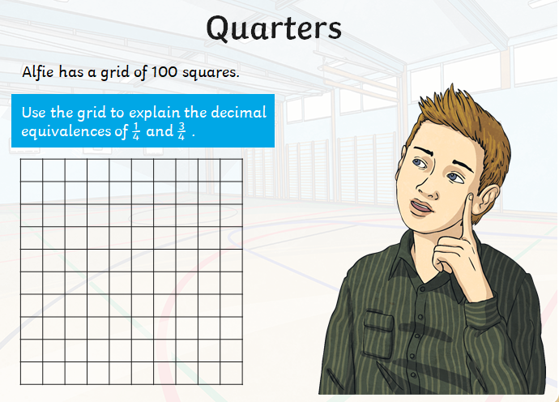

Do it: Know and use decimal equivalents to $\frac{1}{4}$

Slide 11
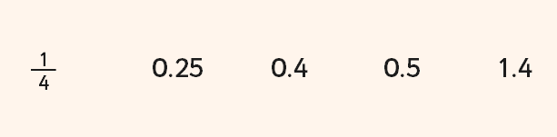

Twist it: Know and use decimal equivalents to $\frac{1}{4}$

Slide 12
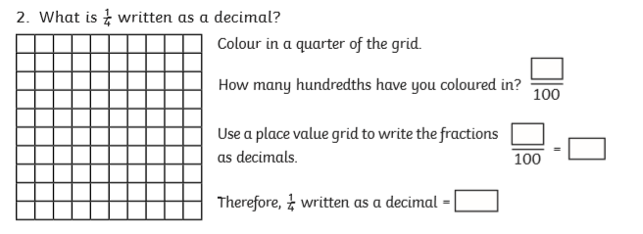

Explore it: Know and use decimal equivalents to $\frac{1}{4}$

Slide 13
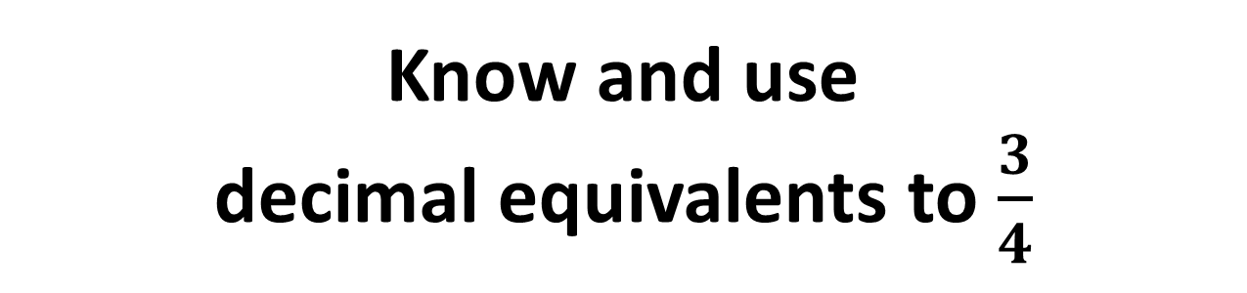
Know and use decimal equivalents to $\frac{3}{4}$

Slide 14

Do it: Know and use decimal equivalents to $\frac{3}{4}$

Slide 15
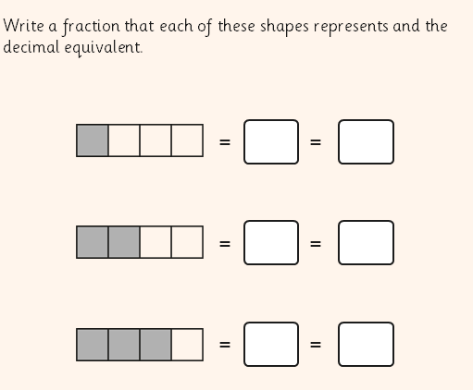

Twist it: Know and use decimal equivalents to $\frac{3}{4}$

Slide 16
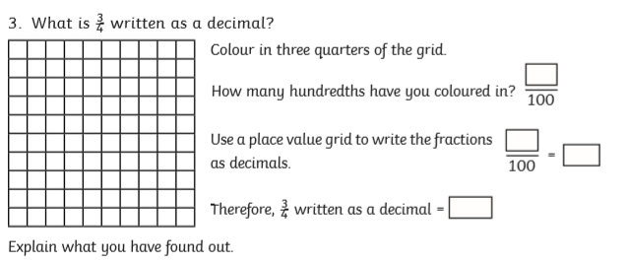
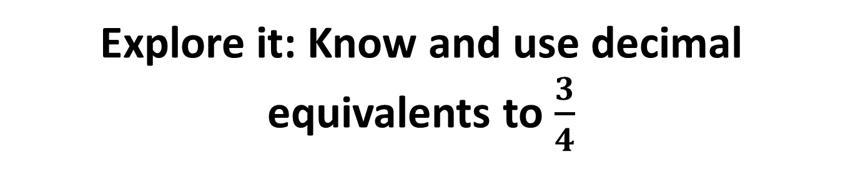
Explore it: Know and use decimal equivalents to $\frac{3}{4}$
Notes:
C

Slide 17
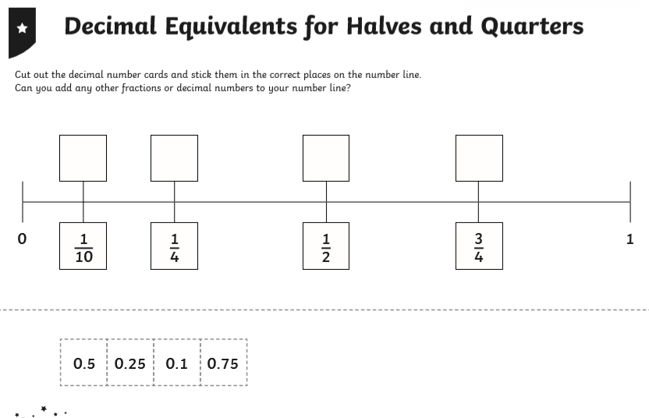

Slide 18
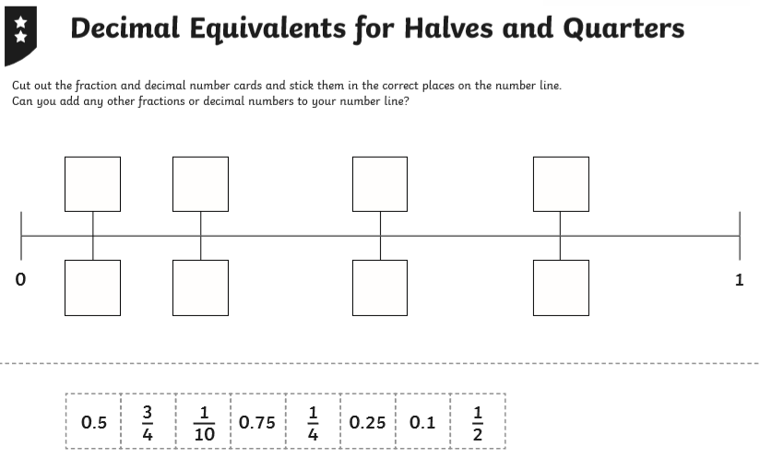

Slide 19
