Slide 1
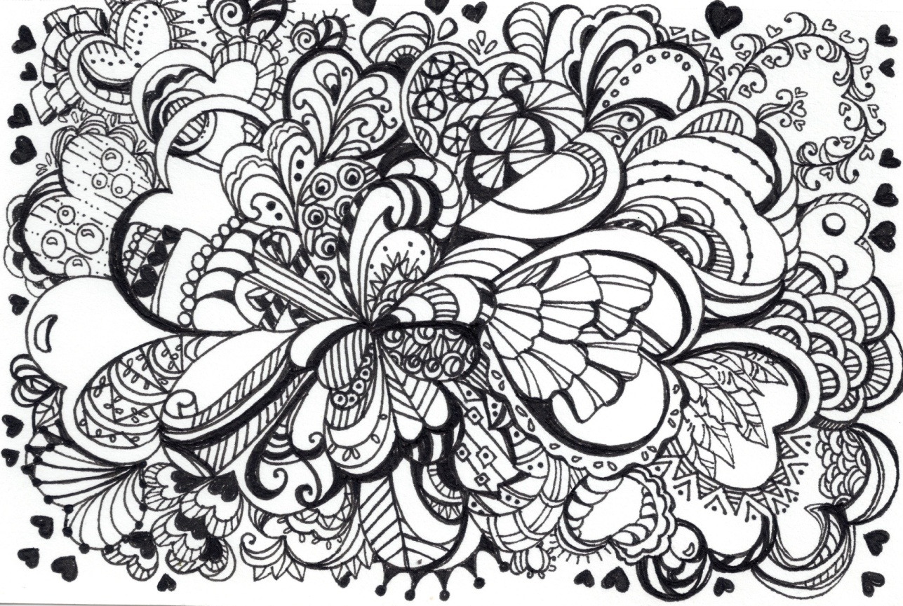
Zentangle
L.I. – I am learning about Zentangle Art, and to increase my skill in line, shape, space and form.

Slide 2
What is Zentangle?
The Zentangle Method is an easy-to-learn, relaxing, and fun way to create beautiful images by drawing structured patterns.
Almost anyone can use it to create beautiful images. It increases focus and creativity, provides artistic satisfaction along with an increased sense of personal well being. The Zentangle Method is enjoyed all over this world across a wide range of skills, interests and ages.

Slide 4
Characteristics of Zentangle
Zentangle
Intuitive
Creative
Fun and Relaxing
Empowering
Non-technical
Unexpected Results

Slide 5
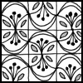
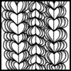
There are lots of ‘pre-designed’ Zentangles we can borrow...
Mariposa
Drogon
Heartswell

Slide 6
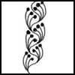
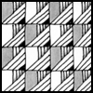
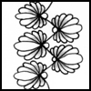
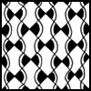
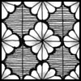
Adante
El Prado
Measles
Abreko
Hexastar
Rainking

Slide 7
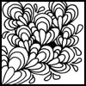
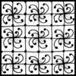
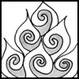
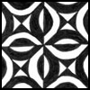
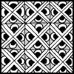
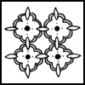
D’Rua
LTD
Tamisolo
Chloe
BEP
Sati

Slide 8
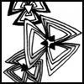
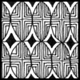
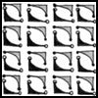
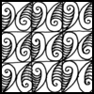
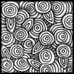
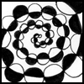
Triangular
Zooloo
L Zen 7’s
Croissant
Pixioze
Helix

Slide 9
Or we can create our own!

Slide 10
Things to remember:
Zentangle MUST be created in a ‘zen’ environment
Zentangle MUST not be created using rulers or guidance
Zentangle is drawn straight onto paper using pen, we do not practice in pencil and go over
If a ‘mistake’ is made, it is up to you as the creator to find a creative way of incorporating it into your design.
The best zentangles are ones which are slowly completed with lots of small, detailed, repeating patterns.

