Slide 1
Year 4
Summer Term
Week 5
Place Value:
Decimals

Slide 2
Subject knowledge links:
https://www.bbc.co.uk/bitesize/topics/zsjqtfr/articles/zsbd7p3
https://whiterosemaths.com/homelearning/year-4/

Slide 3
PLACE VALUE: DECIMALS
SUMMER TERM 2020
Suggested Manageable Steps Year 4
Week 5
Step 6 Divide a one-digit number by 100
Step 7 Divide a two-digit number by 10 Step 8 Divide a two-digit number by 100 Step 9 Count in tenths (starting from 2dp number) and position on a number line
Step 10 Compare numbers with 1 dp
Step 13ultiplication or division to solve scaling or correspondence problems

Slide 4
Step 6
Divide a one digit number by 100.
Useful recap
https://whiterosemaths.com/homelearning/year-4/
Week 2 Lesson 5 - Step 10 - Divide 1 or 2-digits by 100

Slide 5
Do it: Divide a 1 digit number by 100.
Instructions:
Use your place value grid. (or draw one outside with chalk if you can!)
Choose a digit between 1 and 9.
Now move your number two steps to the right. Calculate your new answer.
What do you notice about ÷ 10, then about ÷ 10 again as compared ÷ 100?
Are there any patterns?
Extra: Variation 1: Make number cards and move them.
Extra: Variation 2: Be a number and move!

Slide 6
Do it: Divide a 1 digit number by 100. Date:

Slide 7
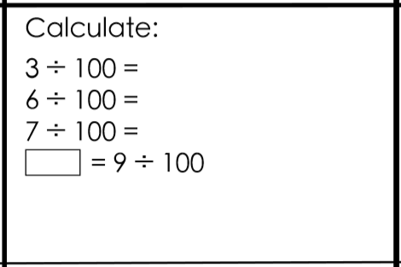
Do it: Divide a 1 digit number by 100. Date:

Slide 8
Twist it: Divide a 1 digit number by 100. Date:

Slide 9
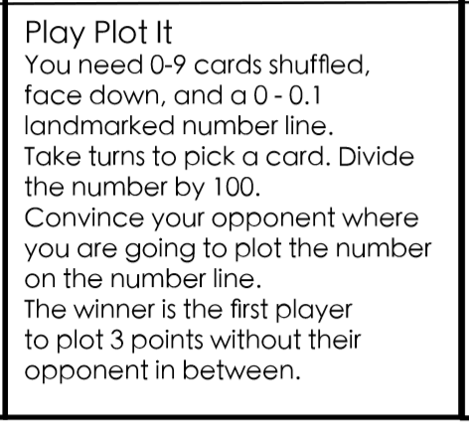
Explore it: Divide a 1 digit number by 100. Date:
Home school resources: Use or make the number line on the slide below.

Slide 10
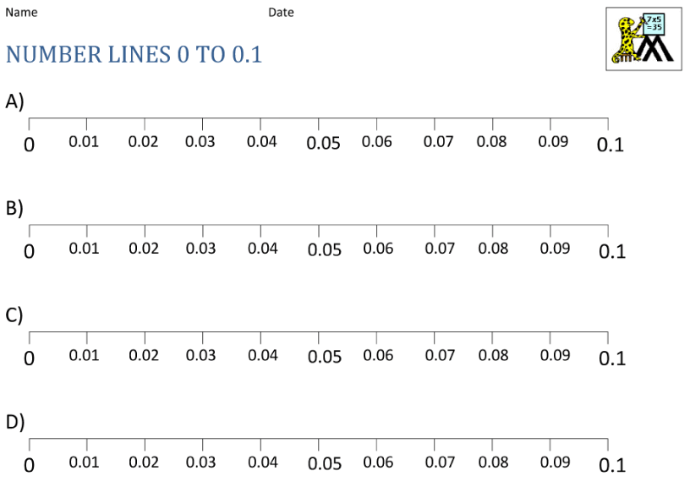

Slide 11
Explore it: Divide a 1 digit number by 100. Date:
Roll a die to generate a number.
Divide your number by 100.
Record your answer.
Roll again.

Slide 12
Step 7
Divide a two digit number by 10.
https://whiterosemaths.com/homelearning/year-4/
Week 2 Lesson 1 - Step 6 - Divide 2-digits by 10

Slide 13
Discuss it: To divide a two digit number by 10

Slide 14
Discuss it: To divide a two digit number by 10

Slide 15
Do it: To divide a two digit number by 10 Date:____________

Slide 16
Do it: To divide a two digit number by 10 Date:____________

Slide 17
Do it: To divide a two digit number by 10 Date:____________

Slide 18
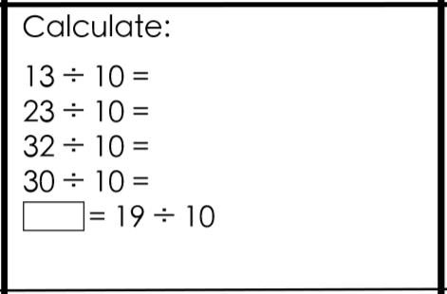
Do it: Divide a two digit number by 10. Date:

Slide 19
Do it: To divide a two digit number by 10 Date:____________

Slide 20
Twist it: Divide a two digit number by 10. Date:

Slide 21
Twist it: To divide a two digit number by 10 Date:____________

Slide 22
Explore it: Divide a two digit number by 10. Date:

Slide 23
Explore it: To divide a two digit number by 10 Date:____________

Slide 24
Explore it: To divide a two digit number by 10 Date:____________

Slide 25
Step 8
Divide a two digit number by 100.
Useful recap

Slide 26
Do it: To divide a two digit number by 100 Date:______

Slide 27
Do it: To divide a two digit number by 100 Date:______

Slide 28
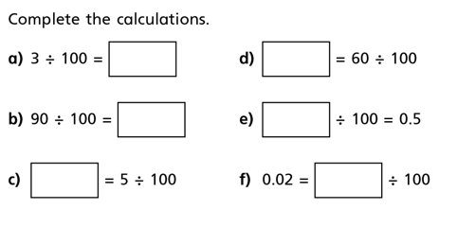
Twist it: To divide a two digit number by 100 Date:___
Do it: To divide a two digit number by 100 Date:______

Slide 29
Twist it: To divide a two digit number by 100 Date:____

Slide 30
Explore it: To divide a two digit number by 100 Date:_____

Slide 32
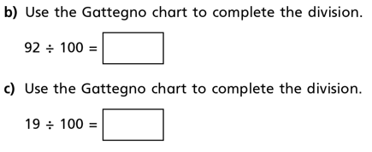
Explore it: To divide a two digit number by 100 Date:__
Do it: To divide a two digit number by 100 Date:______

Slide 34
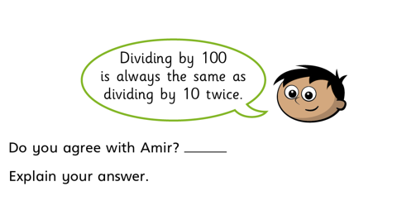
Explore it: Divide a two digit number by 100. Date:

Slide 35
Step 9
Count in tenths and position on a number line.

Slide 36
Do it: Date:

Slide 37
Do it: Count up in tenths and position on a number line. Date:

Slide 38
Do it: Count up in tenths and position on a number line.
Date:

Slide 39
Do it: Count up in tenths and position on a number line.
Date:

Slide 40
Twist it: Count up in tenths and position on a number line.
Date:

Slide 41
Do it: Count up in tenths and position on a number line.
Date:

Slide 42
Explore it: Count up in tenths and position on a number line.
Date:

Slide 43
Step 10
Compare numbers with 1 decimal place

Slide 44
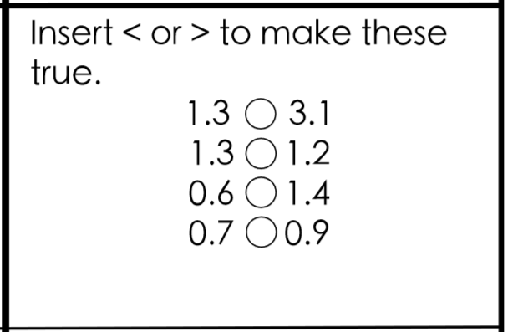
Do it: Compare numbers with 1 decimal place Date:

Slide 45
Twist it: Compare numbers with 1 decimal place Date:

Slide 46
Explore it: Compare numbers with 1 decimal place Date:

