Slide 1
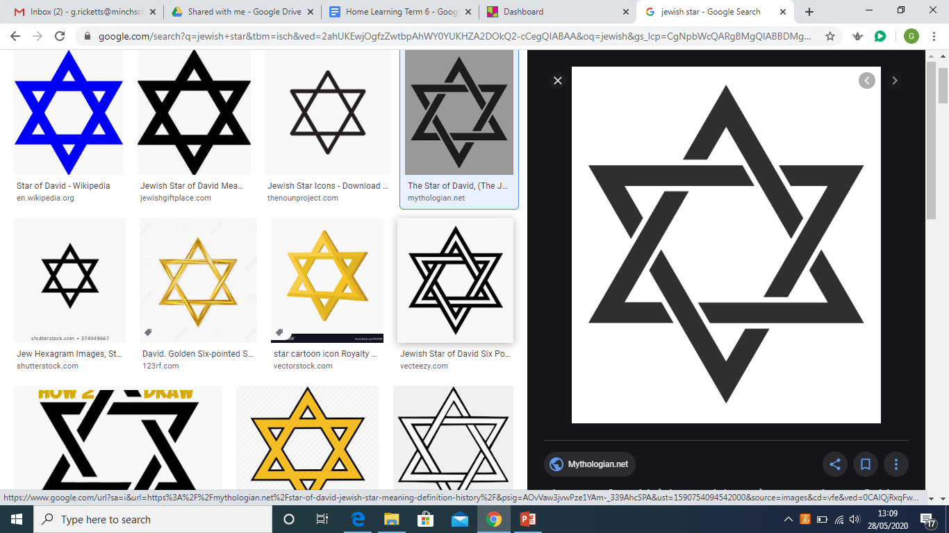
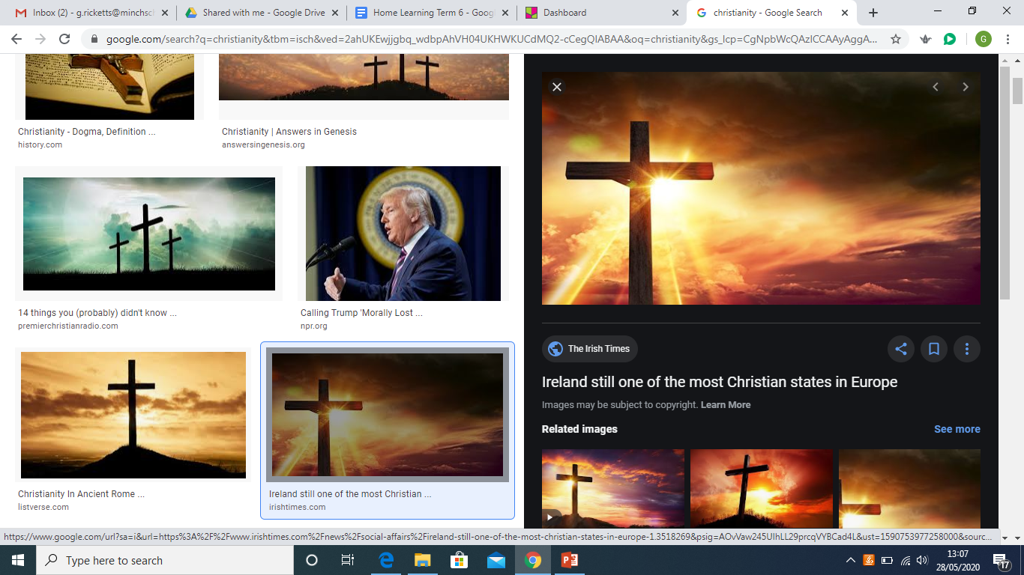
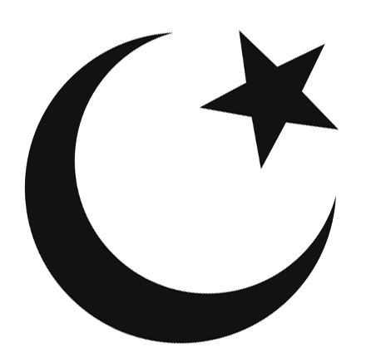
Unit U2.11 Why do some people believe in God and some people not?

Slide 2
What do you know already?
What do you already know about what God is like as far as Christians, Jews and Muslims are concerned.
Christians | Jews | Muslims

Slide 3
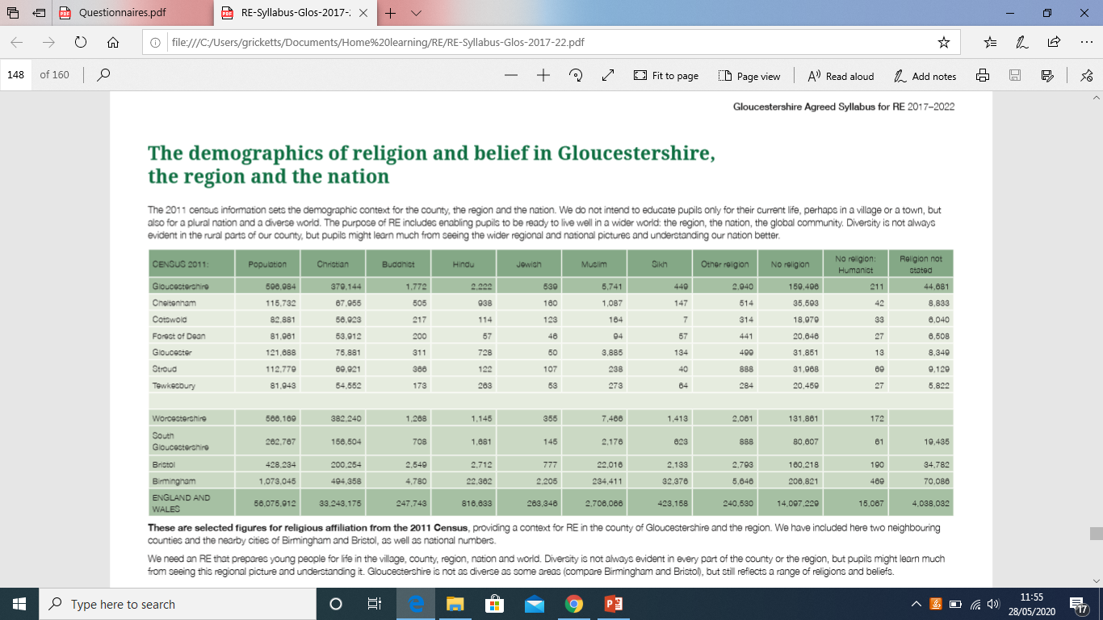
Research!

Slide 4
Research!
Find out about how many people in the world and in your local area believe in God – using global statistics and the 2011 UK census (see document on previous page!).
Why do you think so many people believe in God?
Reasons why people might believe in God

Slide 5
Research!
Find out about how many do not believe. What do the words ‘theist’, ‘agnostic’ and ‘atheist’ mean? Find out their definitions and record them here!
Theist
Agnostic
Atheist

Slide 6
Case studies!
On the next few slides are some opinions from anonymous sources. They have kindly agreed to share their private views about religion.
Can you identify whether they are Theist, Agnostic or Atheist?
What are your personal feelings about what they have shared?
Do you agree or disagree with any of their ideas and why?
What factors can influence someone's ideas about the existence of God?

Slide 7
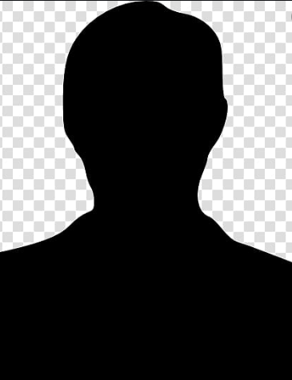
Case study 1
“I was raised in a Christian home. My mother and father were both firm believers in God and we have always strived to live our lives as good Christians. I believe my religion gives me strength and purpose – it shows me the way forward and even when some decisions are difficult, I can look to my faith to help me decide what the best thing to do is. I am part of a community that shares a common belief and I know that when I need help or guidance that they will be there for me. It’s like having an extended family. I have no problem with people having their own beliefs and I don’t try to persuade them to become a Christian like me. I hope that by seeing me and the way I live my life, that people might become inspired to behave in a similar way but I would never judge someone based on what they believe or don’t believe! I have had difficult times in my life – I’ve had loved ones die, I’ve lost jobs and I’ve had people treat me badly but through it all, I am proud that I have maintained the strength to keep believing. When our faith is tested, we find out how strong we truly are!”

Slide 8
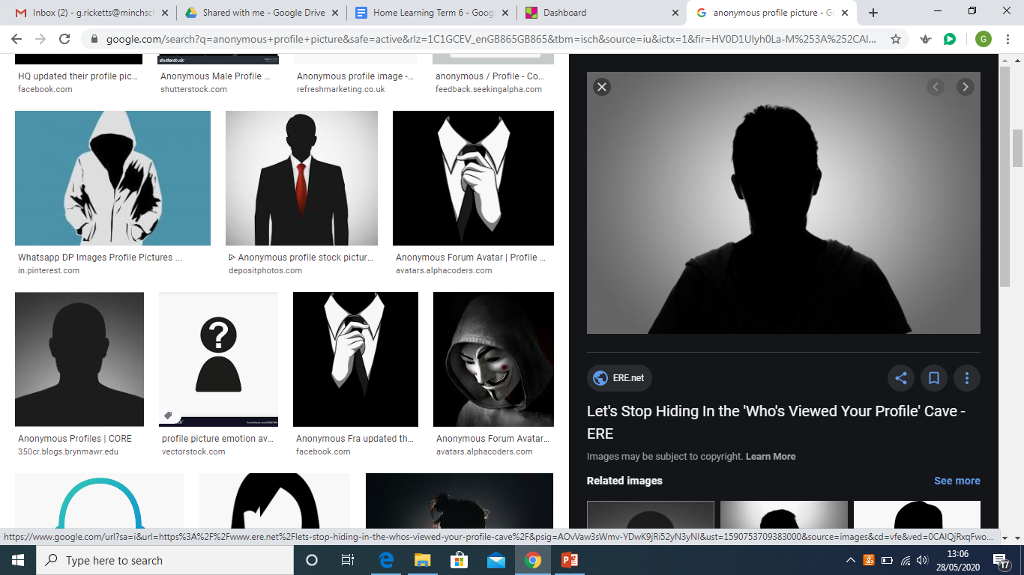
Case study 2
“I’ve never really been sure about whether God truly exists. I have a difficult time believing in something that I can’t see with my own two eyes. Because there is a lack of physical proof that there is a God, I am reluctant to take it purely based on faith that I am loved by an entity I’ve never met and that they will answer my prayers when things are tough. I have seen terrible things happen to good people that lead me to ask “Where is God?” I have always lived my life in a way that respects and values other people. I know that these important principles are shared in holy books but I think you can be a good person without necessarily labelling yourself “a Christian”. I have believers and non believers in my life and I appreciate them for who they are. I measure them by their good deeds and not by their faith. I can see how there could be a divine power though - the world being in the perfect place for life to exist and flourish is all too beautiful to surely be coincidence! Everything in life is so impressively designed that there could well be something divine behind it!”

Slide 9
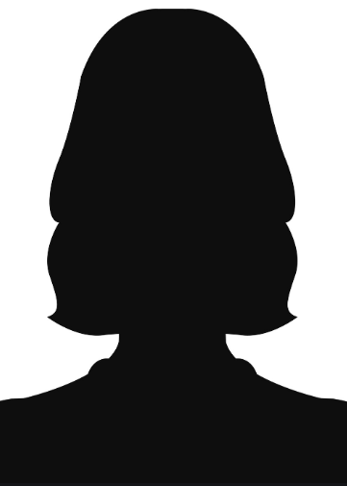
Case study 3
“I think that religions keep people separate from each other. People have spend too many years disagreeing about religion and this has led to some insane wars as time has gone by. I believe that everyone has the right to choose what they believe but I will never label myself “a Christian” because I only trust what I know to be true and there isn’t a shred of proof that a God exists. This doesn’t make me a bad person! Quite the opposite in fact! I believe that if people are to flourish we need to support each other and have a set of laws that govern how we treat one another to keep the world fair and just. These laws should be agreed by people and not cooked up in a story, written by one author. Some messages (in the bible for example) have been misinterpreted by people and have led to some being treated really unfairly throughout history. If religion didn’t exist, people wouldn’t use it as an excuse to justify their actions. They would have to take more responsibility. There would be no “acts of God” that explain away natural disasters and terrible things like that.”

Slide 10
The Task
Write a discussion text using the title of this unit as your question to explore (Why do some people believe in God and some people not?)
You might want to interview some members of your family and ask them what they believe!
Good luck!

