Slide 1
Year 3
Summer Term 1
Week 5
Money
(part 2)

Slide 3
Subject knowledge links:
Money
https://www.bbc.co.uk/bitesize/topics/z8yv4wx/resources/1

Slide 4
Step 6 : Subtract pounds and pence from £5

Slide 5
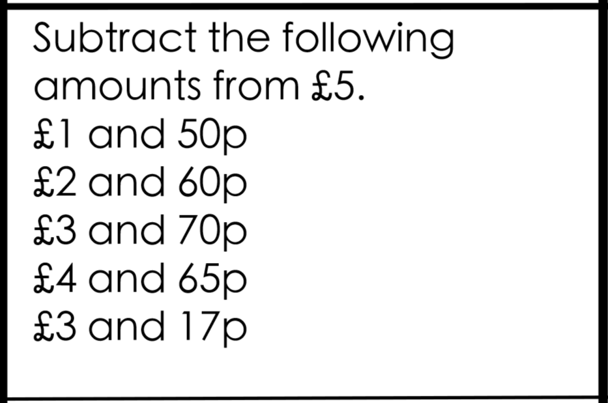
Do it: Subtract pounds and pence from a £5 Date:______

Slide 6
Twist it: Subtract pounds and pence from a £5 Date:______

Slide 7
Explore it: Subtract pounds and pence from a £5 Date:______

Slide 8
Step 7: Subtract pounds and pence from £10

Slide 9
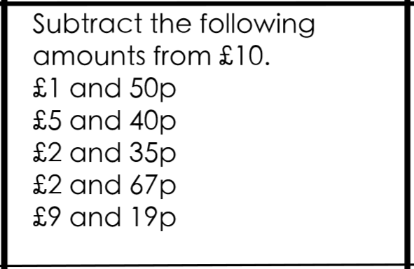
Do it: Subtract pounds and pence from £10 Date:______

Slide 10
Twist it: Subtract pounds and pence from £10 Date:______

Slide 11
Explore it: Subtract pounds and pence from £10 Date:______

Slide 12
Step 7: Calculate change beyond £1

Slide 13
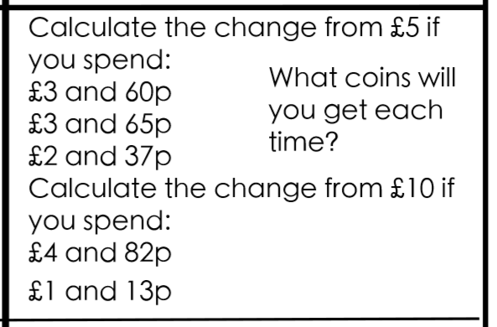
Do it: Calculate change beyond £1 Date:______

Slide 14
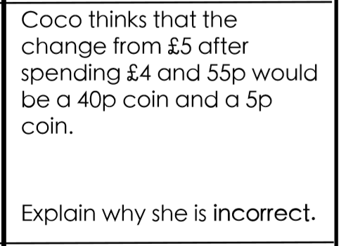
Twist it: Calculate change beyond £1 Date:______

Slide 15
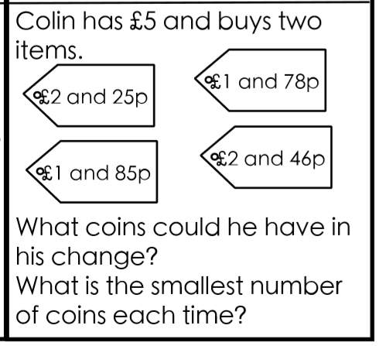
Explore it: Calculate change beyond £1 Date:______

