Slide 1
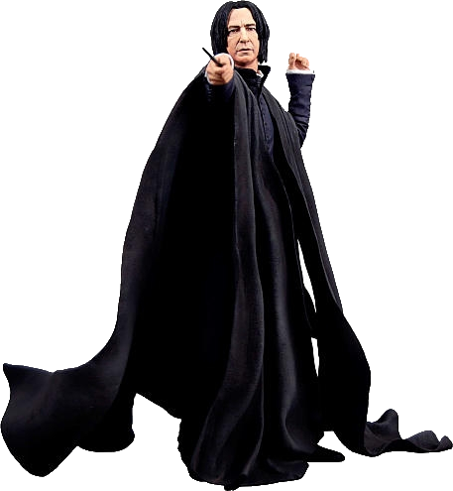
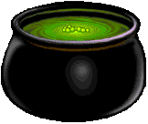
The Negative Cauldron
with Severus Snape
Professor of Potions

Slide 2
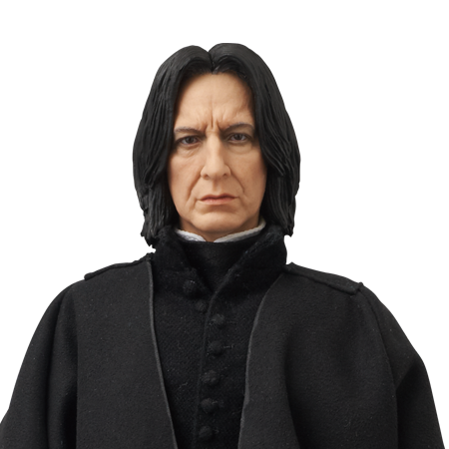
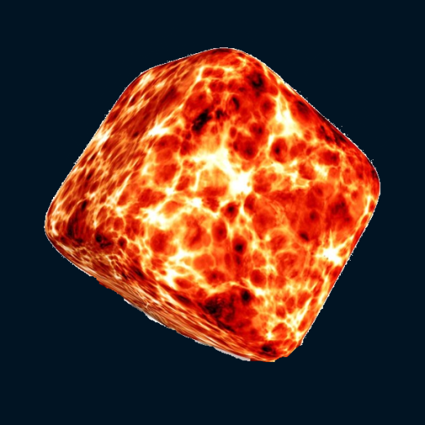
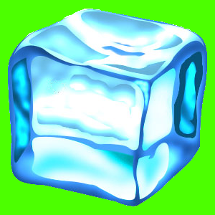
When carrying out our very important work in protecting against the dark arts, the temperature of the cauldron is essential!
Even Potter would know that when adding a single ice cube to a cauldron, it will lower the temperature of the cauldron by one degree...
For this reason, when preparing the cauldron for a spell, we will use traditional fire cubes and ice cubes.
And of course, when adding a fire cube...
...the temperature will increase by one degree

Slide 3
Mathematically speaking – if you must – an ice cube is worth negative one
And of course a fire cube is worth positive one
ˉ1
1
⁺1

Slide 4
Imagine, if you will, that our cauldron begins at the temperature of ten degrees.
20
10
0
10

Slide 5
What will happen if I add 4 fire cubes?
20
10
0
10
10 + 4 = 14

Slide 6
What will happen if I now subtract 6 fire cubes?
20
10
0
14
14 – 6 =
10 + 4 = 14
8

Slide 7
When you subtract a larger positive number from a smaller one, you get a negative number
Okay... Something harder.
I’ve changed the thermometer.
What will happen if I now subtract 10 fire cubes?
10
0
ˉ10
8 ― 10 =
ˉ2

Slide 8
Try a few of your own...
Go on!
Write this as a number sentence first: What happens if I start at 5 degrees and then subtract 6 fire cubes?
5 – 7 =
4 – 9 =
1 – 2 =
0 – 3 = What about if the temperature starts negative?
ˉ5 – 3 =

Slide 9
Too easy I think.
Let’s try something harder.
What will happen if I take a cauldron at 2 degrees and I add 4 ice cubes?
Think carefully!
10
0
ˉ10
When you add a negative, then the total goes down.
It’s a bit like subtracting
2 + ˉ4 =
ˉ2

Slide 10
Let’s try another just to check. What happens if I start at 8 degrees and I add 5 ice cubes?
10
0
ˉ10
When you add a negative, then the total goes down.
It’s a bit like subtracting
Let’s write the calculation first
8 + ˉ5 =
3

Slide 11
But what if it’s already negative? What happens if I start at ˉ2 degrees and add 3 ice cubes?
10
0
ˉ10
When you add a negative, then the total goes down.
It’s a bit like subtracting
Let’s write the calculation first
ˉ2 + ˉ3 =
ˉ5

Slide 12
Try a few of your own...
Go on!
Write this as a number sentence first: What happens if I start at 3 degrees and then add 5 ice cubes?
4 + ˉ 9 =
1 + ˉ 2 =
0 + ˉ 3 =
Write this as a number sentence first: What happens if I start at ˉ12 degrees and then I add 3 ice cubes?
ˉ5 + ˉ7 =
ˉ5 + 7 =

Slide 13
Okay... Let’s see if you’re really up to it!
What happens if I start taking ice cubes out?
What will happen if I take a cauldron at 2 degrees and I subtract 4 ice cubes?
Think carefully!
10
0
ˉ10
When you subtract a negative, the total goes up.
It’s a bit like adding
2 ― ˉ4 =
6

Slide 14
But what if it starts off negative? What happens if I start at ˉ2 degrees and subtract 6 ice cubes?
10
0
ˉ10
When you subtract a negative, the total goes up.
It’s a bit like adding.
Let’s write the calculation first
ˉ2 ― ˉ6 =
4

Slide 15
Let’s try one more together. The cauldron is at ˉ5 degrees. I subtract 3 ice cubes?
10
0
ˉ10
When you subtract a negative, the total goes up.
It’s a bit like adding.
Let’s write the calculation first
ˉ5 ― ˉ3 =
ˉ2

Slide 16
Try a few of your own...
Go on!
Write this as a number sentence first: My cauldron is at 3 degrees and I subtract 5 ice cubes. What is the new temperature?
14 + ˉ 9 =
4 ― ˉ 7 =
ˉ 8 ― ˉ 3 =
ˉ12 ― ˉ 5 ?
ˉ5 ― ˉ5 =
ˉ5 ― ˉ7 =

