Slide 1
Comparing and ordering Fractions, Decimals and Percentages.

Slide 2
We’ve had plenty of practice of ordering and comparing amounts . Practise ordering these from smallest to largest.
123.08
123.118
123.18
123.288
123.8
123.808

Slide 3
We’ve had plenty of practice of ordering and comparing amounts . Practise ordering these from smallest to largest.
13
19
10
4
6
16
24
12
6
8
39
38
40
32
36
48
48
48
48
48
4
6
19
13
10
6
8
24
16
12

Slide 4
We’ve had plenty of practice of ordering and comparing amounts . Practise ordering these from smallest to largest.
12.2 %
12.5 %
1.25 %
15.5 %
15.2 %
0.125 %
0.125 %
1.25 %
12.2 %
12.5 %
15.2 %
15.5 %

Slide 5
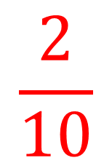
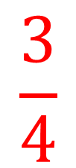
But what if we are presented with an assortment of values to compare and order?
0.99
0.21
4%
0.44
12%
0.4
We are going to need to work out the equivalent values to make sure we have ordered them correctly from smallest to largest!

Slide 6
Do it!
The easiest way of doing this, is to create an equivalent FDP table!

Slide 7
Twist it!

Slide 8
Explore it!
NOTE: This is tricky, so you are allowed to use a calculator but only to work out Latin and Music!
Never say your teachers don’t have a heart!

