Slide 1
Finding missing values involving percentages.

Slide 2
A quick recap!
To find a percentage of an amount we have to divide the amount by 100 to find 1%.
So, 1% of 600 = 6
To find more complex percentages (like 17%), we can find 1% as above and then multiply by the given percentage.
So, 17% of 600 = 600 ÷ 100 X 17 = 102

Slide 3
A quick recap!
We can use our knowledge of known number facts to find percentages quickly too!
To find 50% - find half of the amount!
To find 25% - find quarter of the amount (or half a half!)
To find 10% - divide the amount by 10!
To find 5% - divide the amount by 10 and then by 2!
Use can use combinations of these facts to find others too!
To find 75% - find 50% and 25% and simply add them together!
To find 35% - find 25% and 10% and simply add them together!

Slide 4
STEM sentence
“To find percentages of amounts, we need to find out what 1% is and multiply by the given percentage.”

Slide 5
Sometimes we might be asked to find the total amount after being given a percentage value like this!
DON’T PANIC! We can use our knowledge of finding percentages of amounts to simply work backwards!

Slide 6
Here is a bar model to show us how to calculate the missing value!
342
4 X
8
160
1200
1368
1368
We know that 25% = 342
So 4 X 25% = Total!
342
342
342

Slide 7
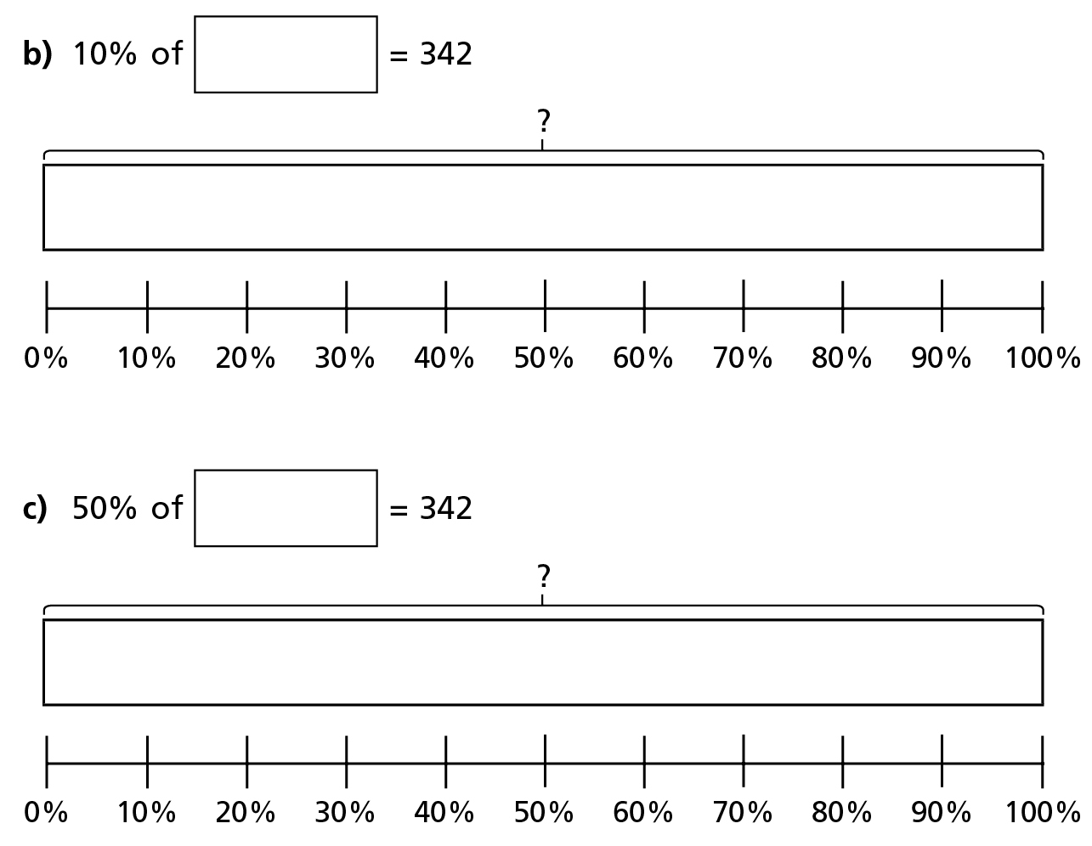
Do it!

Slide 8
Do it!

Slide 9
Do it again!

Slide 10
Twist it!

Slide 11
Explore it!

