Slide 1
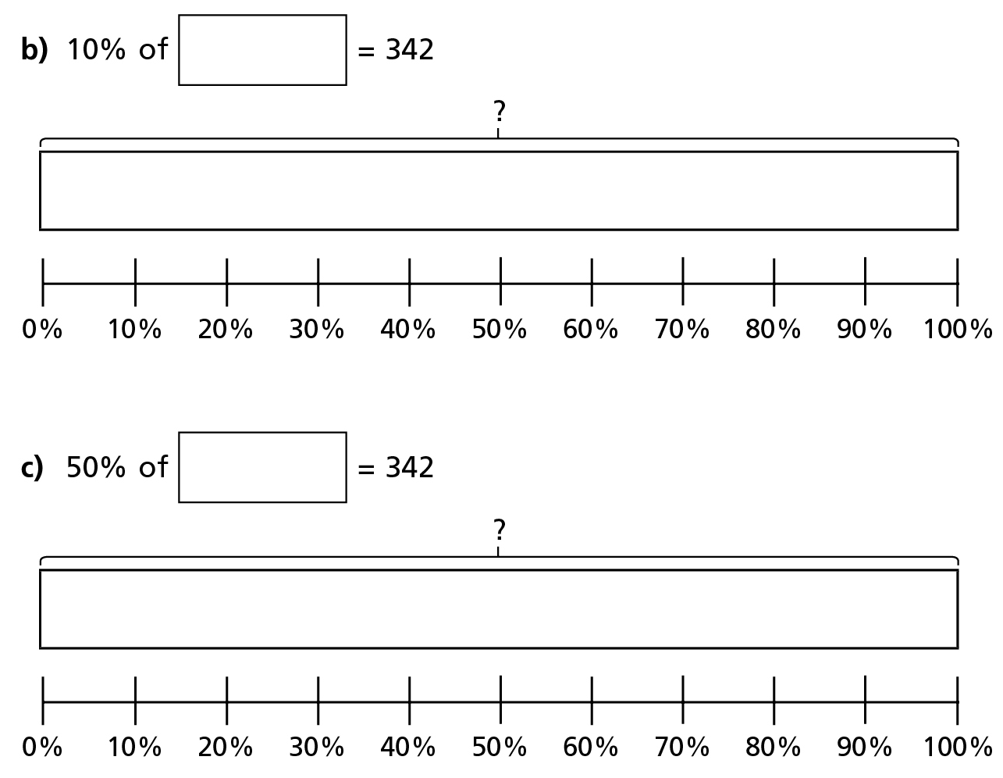
Do it!
3420
684

Slide 2
Do it!
456
470
282

Slide 3
Do it again!
150
25
300
75
400
40
200
25

Slide 4
Twist it!
She has mistaken the 200 for the total, rather than just the percentage value!
2000
200
200
200
200
200
200
200
200
200
200
2000

Slide 5
Explore it!
50
10
100
20
200
40

