Slide 2
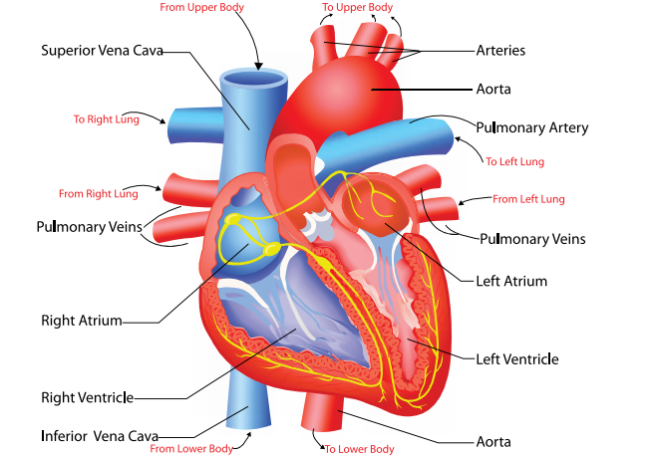

Slide 7
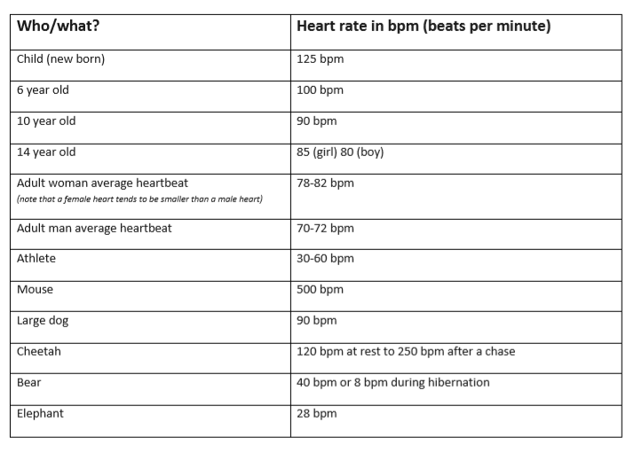

Slide 8
Make an estimate for each of these questions:
What is the heartrate – in beats per minute – of a 4 year old child at rest?
What is the resting heartrate of an adult who is very fit?
What is the heartrate of an unfit adult (85 bpm plus)
What is the heartrate of a 10 or 11 year old after moderate exercise?
Whose heart might be beating at 125 bpm?

Slide 9
Make an estimate for each of these questions:
What is the heartrate – in beats per minute – of a 4 year old child at rest? (around 100 bpm)
What is the resting heartrate of an adult who is very fit? (anything from 40-60 bpm)
What is the heartrate of an unfit adult (85 bpm plus)
What is the heartrate of a 10 or 11 year old after moderate exercise? (120-140 bpm – though it will vary)
Whose heart might be beating at 125 bpm? (a new born at rest; a child doing moderate exercise; an adult doing vigorous exercise)

