Slide 1
The Circulatory System

Slide 6
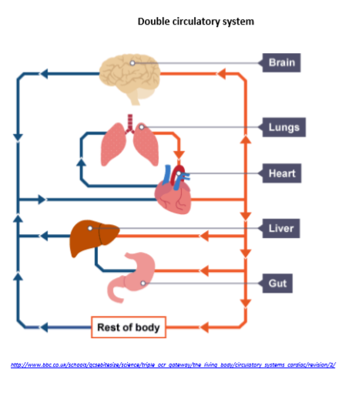

Slide 7
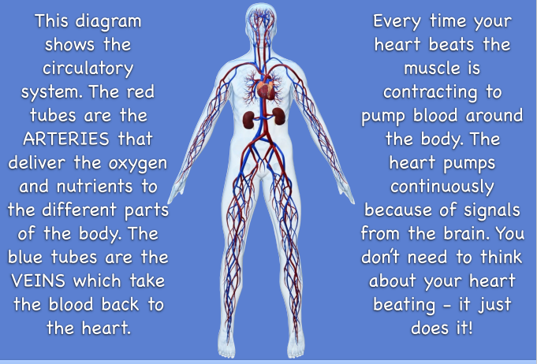

Slide 8
Have a go at making a model of the circulatory system; You could do it in all sorts of ways:
Draw a diagram
With Lego
With a train set
Act it out with people
On Scratch
On Kodu
Make a Gif through your class Padlet.
Check out Mr W’s video showing his model on Padlet.
Can you do better? Yes!

