Slide 1
These variables can effect how fast or slow your circulatory system works:
• Age
• Activity level (sleeping, resting, exercising)
• Fitness level
• Air temperature
• Body position (standing up or lying down)
• Emotions and stress levels
• Body size
• Medications
• Food and drink
• Illness

Slide 2
Circulation Investigation:
Investigate how any of those variables affects your circulation (how fast or slow your heart beats, or how fast or slow your breathing is).
e.g. Does lying down make your heart beat faster?
If you want, there are some investigations to do with exercise in this presentation – they are also saved in a Word document. You could use those or make up your own. There is also a blank squared paper document if you would like to present your investigation in a different way.
You could write up your investigation like a report, or you could make a poster; you could even film it and make it into a sort of science TV show about what affects our circulation.

Slide 3
Investigation Ingredients:
You will need: a stopwatch or some kind of timer, an inquisitive mind and a pencil / ruler / colouring pencils to present your findings in a beautiful way.
Remember to:
Say which variable you are choosing to test, and which ones you will keep the same.
Make a prediction.
Record your results and present them clearly and beautifully in some sort of graph.
Make a conclusion – What happened? Was your prediction correct? Did anything go wrong? How could you make it better?
Then, based on what you have learned from that investigation you can do another one, and another…

Slide 4
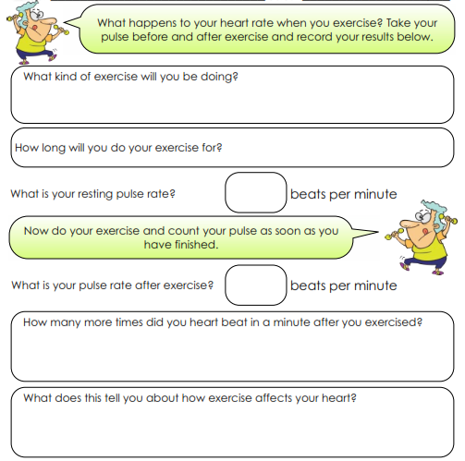
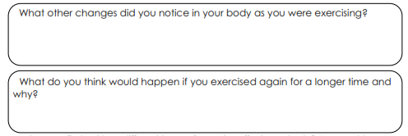

Slide 5
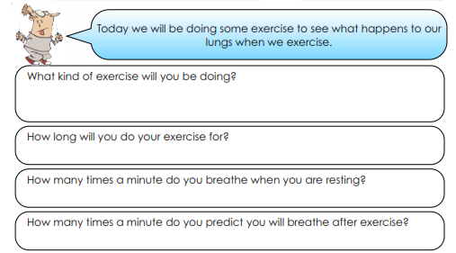
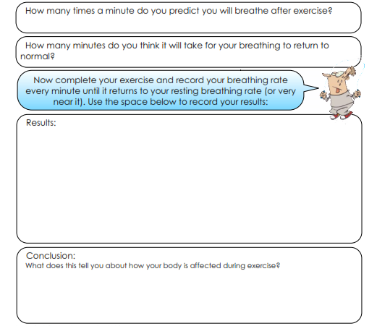

Slide 6
