Slide 1
THE
DIGESTIVE SYSTEM
To start with, on a blank piece of paper, draw a mind map of anything you remember about the DIGESTIVE SYSTEM from when you learned about it when you were in year 3 or 4.

Slide 2
Now on the other side of that paper, draw a mind map with anything you know about the CIRCULATORY SYSTEM.
If you don’t know much – yet – then that’s why we’re here!
THE
CIRCULATORY SYSTEM
Some words to think about:
Circulation
Organ
Nutrients
Blood vessels
Muscle
Contraction
Blood
Oxygenated blood
Deoxygenated blood
Chamber

Slide 3
Now we can begin! You can add to those mind maps with anything new you learn (remember to use a different colour).
Here is some useful vocabulary. Do you know what these words mean?
Circulation
Organ
Nutrients
Blood vessels
Contraction
Oxygenated blood
Deoxygenated blood
Chamber
The continuous flow of blood around the body.
A part of the body that has does a vital job to keep a person alive and well.
Substances that is needed for life , health and growth e.g. protein, vitamins etc.
Tubes in the body which blood can be pumped through
A muscle squeezing, or becoming shorter.
Blood that is carrying oxygen to different parts of the body.
Blood that is not carrying oxygen (because the oxygen has been delivered).
An enclosed space (like a room, though the heart is made of different chambers

Slide 4
What is blood?
Write one sentence that is the best definition you can come up with.

Slide 5
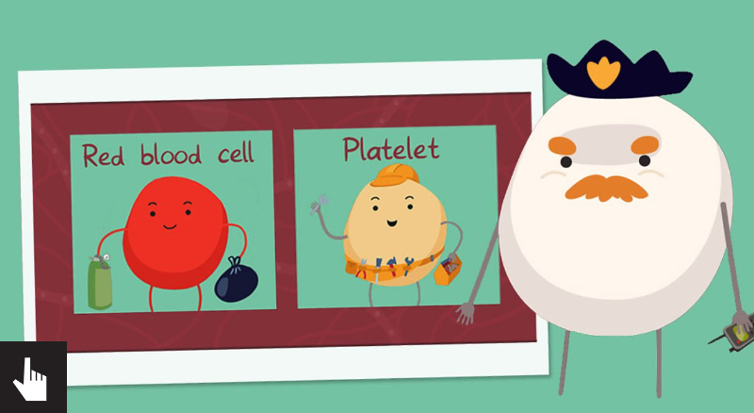
http://www.bbc.co.uk/guides/zqv4cwx#z2g8k7h

Slide 6
Here is a recipe for a ‘blood smoothie’ (not quite as gross as it sounds). If you can find the ingredients, or similar replacements for things you can’t get, have a go at making it.
Even if you can’t make it, have a look at the recipe and see if you can match the ingredients to the components of blood on the next slide.
Blood Smoothies
Ingredients
• 300g raspberries or strawberries
• A few small white marshmallows
• 1 teaspoon of sprinkles
• 400ml fruit juice
Method
Put the berries into the jug first, followed by the marshmallows and sprinkles, then top up with fruit juice (before blending it is a little like magnified blood seen through a magnifying glass).
Blend all ingredients and enjoy! The blended version is how we see blood with the naked eye.

Slide 7
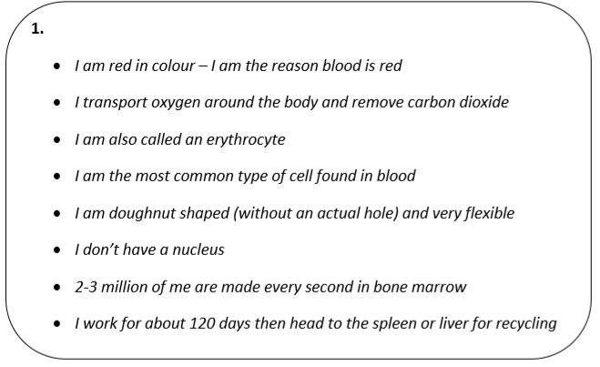
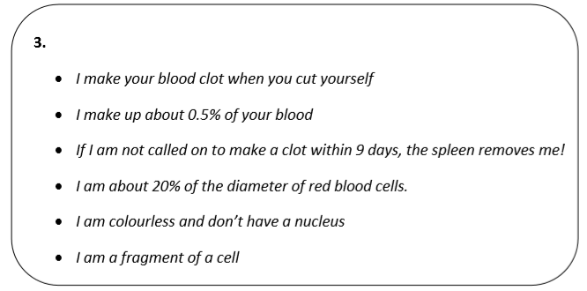
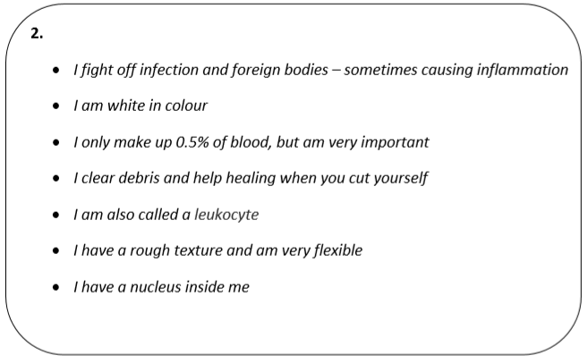
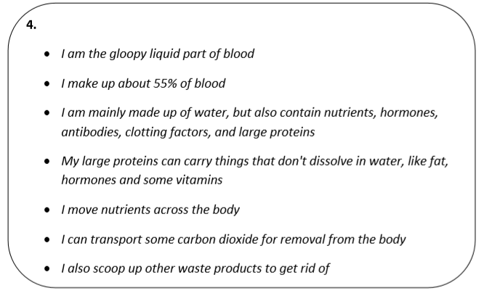
Each smoothie ingredient represents a component of blood.
Can you guess which description matches which ingredient / component?

Slide 8
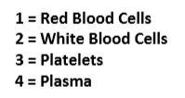
Each smoothie ingredient represents a component of blood.
Can you guess which description matches which ingredient / component?

Slide 9
Here are some pictures of blood – they are magnified, taken using a microscope.
You could try and sketch them if you like.
What do they remind you of?

Slide 10
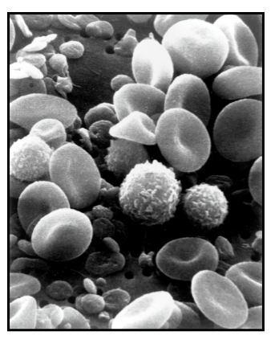

Slide 11
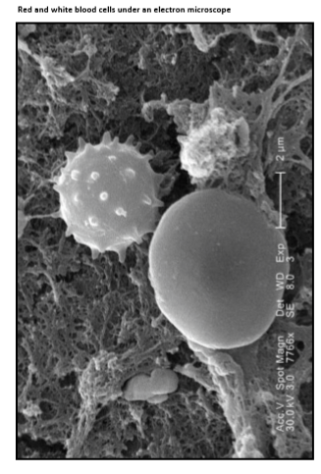

Slide 12
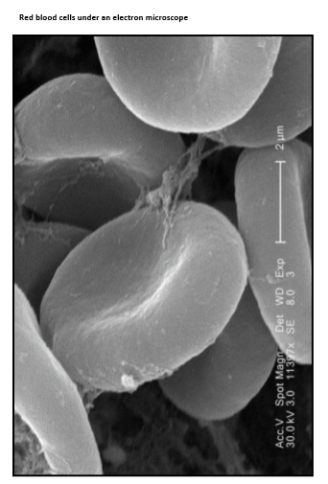

Slide 13
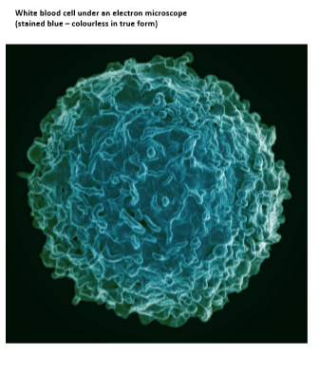

Slide 14
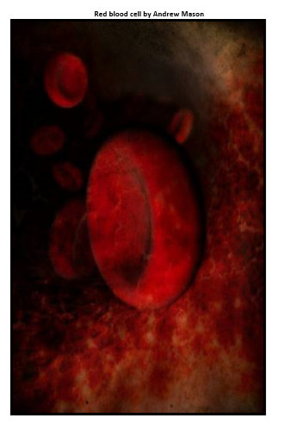

Slide 15
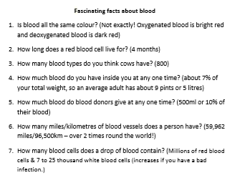
Now give someone in your family a quiz with these fascinating facts.

