Slide 1
Year 4
Summer Term
Week 4
Place Value:
Decimals

Slide 2
Subject knowledge links:
https://www.bbc.co.uk/bitesize/topics/zsjqtfr
https://whiterosemaths.com/homelearning/year-4/

Slide 3
PLACE VALUE: DECIMALS
SUMMER TERM 2020
Suggested Manageable Steps Year 4
Week 4
Step 1 Recognise that hundredths arise from ÷ into 100 equal parts and ÷ tenths by 10.
Step 2 Read and represent a number with 2 decimal places
Step 3 Count up in hundredths Step 4 Count down in hundredths
Step 5 Divide a one-digit number by 10
Step 13ultiplication or division to solve scaling or correspondence problems

Slide 4
Elicitation
Which words do you know that link to decimals?
A tenth of a hundred is 1 True/False
A hundredth of 300 is 30 True/False
3 divided by 10 is 0.3 True/False
6 divided by 100 is 0.60 True/False
23 divided by 10 is 0.23 True/False
35 divided by 100 is 0.35 True/False
Fill in the boxes
Write in the missing numbers

Slide 5
Step 1
Recognise that hundredths arise
from ÷ into 100 equal parts and
÷ tenths by 10
https://whiterosemaths.com/homelearning/year-4/
Lesson 1 Recognise tenths and hundredths. Video plus w/s
Lesson 2 Tenths as decimals. Video plus w/s

Slide 6
Do it: Recognise that hundredths arise from ÷ into 100 equal parts and ÷ tenths by 10 Date:______

Slide 7
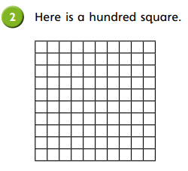
Teach it: Find hundredths of a whole and express as fractions and decimals Date:______
 | Express as hundredths. | Express as a decimal.
4 full rows
6 full columns
13 squares
2 full rows and 5 squares
3 full columns and 8 squares
 | Hundredths | Express as a decimal.
4 tenths is equivalent to
70 tenths is equivalent to
5 tenths is equivalent to

Slide 8
Do it: Recognise that hundredths arise from ÷ into 100 equal parts and ÷ tenths by 10 Date:______

Slide 9
Discuss it: Recognise that hundredths arise from ÷ into 100 equal parts and ÷ tenths by 10 Date:______
Discuss the model below.
What would go in this missing boxes?
What could the row above the top row show?
1 ― 10
 |  |  | 1 ― 100 |  |  | 1 ― 100
0.1 |  | 0.1 |  |  |  |  | 0.1
Notes:
Intro https://whiterosemaths.com/homelearning/year-4/ Lesson 1 Recognise tenths and hundredths. Lesson 2 Tenths as decimals. Excellent teaching vid and accompanying w/s.

Slide 10
Teach it/Twist it: Recognise that hundredths arise from ÷ into 100 equal parts and ÷ tenths by 10 Date:______
Q: 23 hundredths as a decimal would be 0.023 True/False
Discuss your answer.

Slide 11
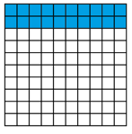
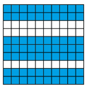
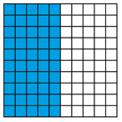
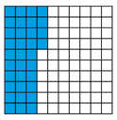
Twist it: Recognise that hundredths arise from ÷ into 100 equal parts and ÷ tenths by 10 Date:______
In each representation below, the hundred squares represents a whole.
a)
This hundred square shows 20 tenths which
is also 0.2
True/ False
Discuss
c)
This hundred square shows 70 tenths which
is also 0.7
True/ False
Discuss
b)
This hundred square shows 5 tenths which
is also 0.05 as a decimal.
True/ False
Discuss
d)
This hundred square shows 3 tenths which
is also 0.03
True/ False
Discuss

Slide 12
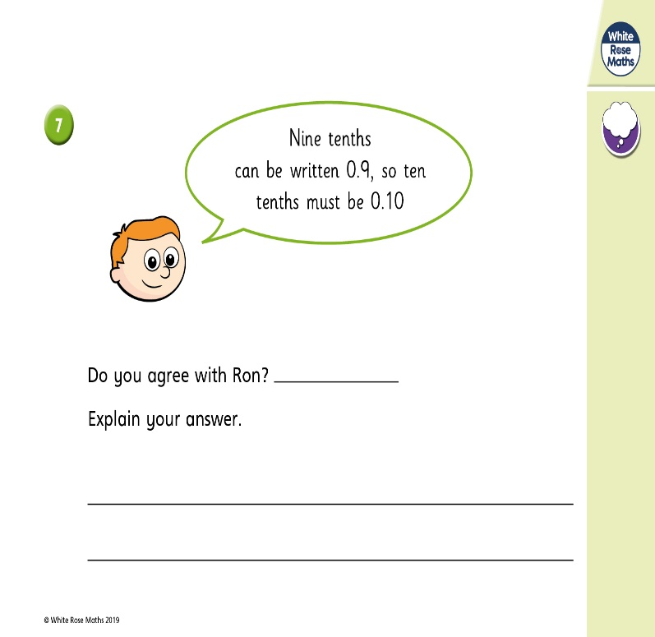
Twist it: Recognise that hundredths arise from ÷ into 100 equal parts and ÷ tenths by 10 Date:______

Slide 13
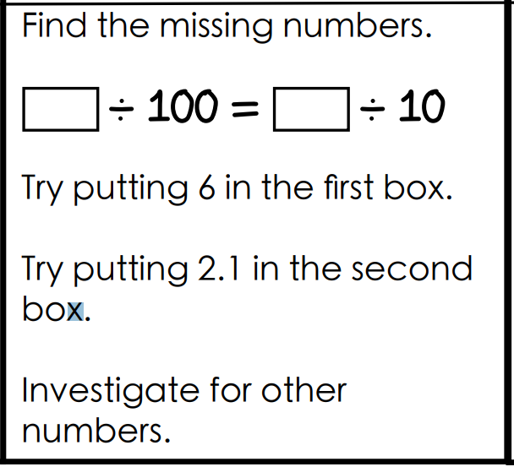
Explore it: Recognise that hundredths arise from ÷ into 100 equal parts and ÷ tenths by 10 Date:______

Slide 14
Explore it: Recognise that hundredths arise from ÷ into 100 equal parts and ÷ tenths by 10 Date:______

Slide 15
Step 2
Read and represent a number with 2 decimal places
Notes:
See Lesson 5 on

Slide 16
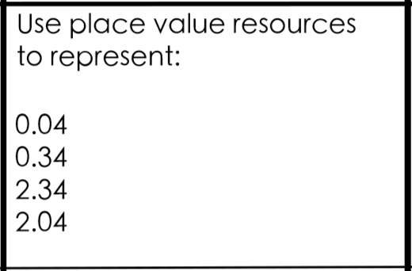
Do it: Read and represent a number with 2 decimal places Date:______
Lockdown resourcing!: Draw a place value grid like the one on the slide below..
Make some place value
counters like these.
Now use your home made place value resources to try this activity.
Keep your grid and counters. You’ll need them again.

Slide 17
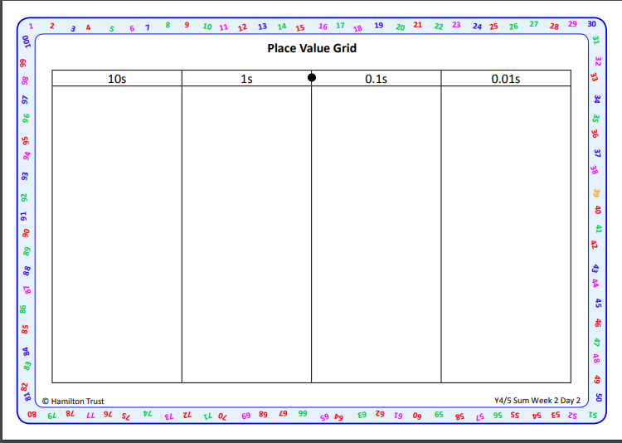

Slide 18
Twist it: Read and represent a number with 2 decimal places Date:______

Slide 19
Explore it: Read and represent a number with 2 decimal places Date:______

Slide 20
Step 3
Count up in hundredths

Slide 21
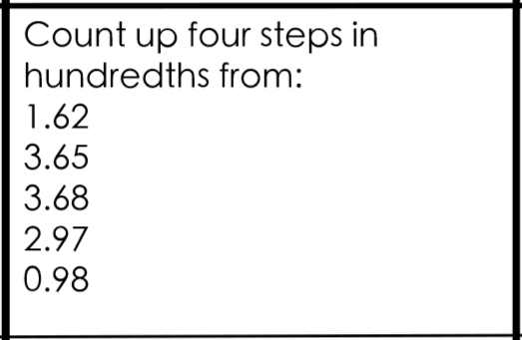
Do it: Count up in hundredths Date:______

Slide 22
Complete the number lines below.
Do it: Count up in hundredths Date:______
1
10
2
10
6
10
0 |  |  |  |  |  |  |  |  |  | 1
20
100
30
100
70
100
0 |  |  |  |  |  |  |  |  |  | 1
© Classroom Secrets Limited 2019

Slide 23
Do it: Count up in hundredths Date:______
Complete the number lines below.
1
10
2
10
3
10
4
10
5
10
6
10
7
10
8
10
9
10
0 |  |  |  |  |  |  |  |  |  | 1
10
100
20
100
30
100
40
100
50
100
60
100
70
100
80
100
90
100
0 |  |  |  |  |  |  |  |  |  | 1
© Classroom Secrets Limited 2019

Slide 24
Do it: Count up in hundredths Date:______
How many hundredths are represented on the hundred square below?
92
100
82
100
A. | B. | C.
18
100
© Classroom Secrets Limited 2019

Slide 25
Do it: Count up in hundredths Date:______
How many hundredths are represented on the hundred square below?
92
100
82
100
18
100
A. | B. | C.
© Classroom Secrets Limited 2019

Slide 26
Twist it: Count up in hundredths Date:______
True or false?
The following sequences are correct.
A. | 68 | , | 69 | , | 7 | , | 71
 | 100 |  | 100 |  | 10 |  | 100
B. | 93 | , | 92 | , | 91 | , | 8
 | 100 |  | 100 |  | 100 |  | 10
Represent the correct sequence on the number line below.
© Classroom Secrets Limited 2019

Slide 27
Twist it: Count up in hundredths Date:______
True or false?
The following sequences are correct.
A. | 68 | , | 69 | , | 7 | , | 71
 | 100 |  | 100 |  | 10 |  | 100
True
B. | 93 | , | 92 | , | 91 | , | 8
 | 100 |  | 100 |  | 100 |  | 10
False - should be or .
8
10
9
10
90
100
© Classroom Secrets Limited 2019

Slide 28
Twist it: Count up in hundredths Date:______

Slide 29
Explore it: Count up in hundredths Date:______
Archie has completed this section of a number line below.
Is he correct? Explain how you know.
46
100
47
100
48
100
49
100
5
10
52
100
53
100
© Classroom Secrets Limited 2019

Slide 30
Explore it: Count up in hundredths Date:______
Archie has completed this section of a number line below.
Is he correct? Explain how you know.
Archie is incorrect because...
46
100
47
100
48
100
49
100
5
10
52
100
53
100
© Classroom Secrets Limited 2019

Slide 31
Explore it: Count up in hundredths Date:______
Archie has completed this section of a number line below.
Is he correct? Explain how you know.
Archie is incorrect because he has missed out .
46
100
47
100
48
100
49
100
5
10
52
100
53
100
51
100
© Classroom Secrets Limited 2019

Slide 32
Do it: Count up in hundredths Date:______
Match the child to the correct number.
Zita has 3 tenths and 2 hundredths.
Callum has 4 tenths and 3 hundredths.
Ruby has 4 tenths and 13 hundredths.
A.
B.
C.
43
100
32
100
53
100
© Classroom Secrets Limited 2019

Slide 33
Do it: Count up in hundredths Date:______
Match the child to the correct number.
Zita has 3 tenths and 2 hundredths.
Callum has 4 tenths and 3 hundredths.
Ruby has 4 tenths and 13 hundredths.
A.
B.
C.
43
100
32
100
53
100
Callum
Zita
Ruby
© Classroom Secrets Limited 2019

Slide 34
Twist it: Count up in hundredths Date:______
You have 2 tenths and 9 hundredths already. How many more tenths and hundredths do you need to make one whole?
Record your answer as a fraction on the number line below.
© Classroom Secrets Limited 2019

Slide 35
Do it: Count up in hundredths Date:______
You have 2 tenths and 9 hundredths already. How many more tenths and hundredths do you need to make one whole?
Record your answer as a fraction.
and or .
7
10
1
100
71
100
© Classroom Secrets Limited 2019

Slide 36
Step 4
Count down in hundredths.
Notes:
See Lesson 5 on

Slide 37
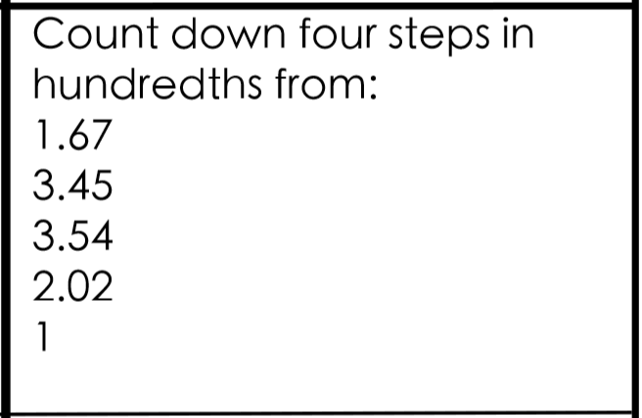
Do it: Count down in hundredths Date:______

Slide 38
Twist it: Count down in hundredths Date:______

Slide 39
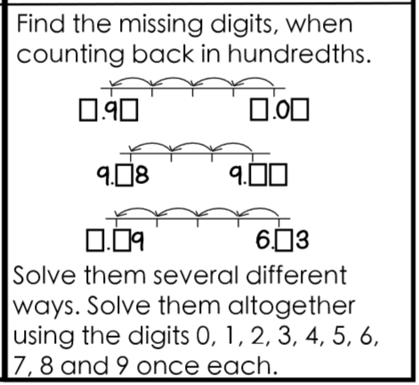
Explore it: Count down in hundredths Date:______

Slide 40
Step 5
Divide a one digit number by 10.
https://whiterosemaths.com/homelearning/year-4/
Lesson 5 Dividing 1 digit by 10 Video plus w/s
Notes:
See Lesson 5 on

Slide 41
Discuss it: To divide a one digit number by 10

Slide 42
Discuss it: To divide a one digit number by 10

Slide 43
Do it: To divide a one digit number by 10 Date:____________

Slide 44
Do it: To divide a one digit number by 10 Date:____________

Slide 45
Do it: To divide a one digit number by 10 Date:____________

Slide 46
Do it: To divide a one digit number by 10 Date:____________

Slide 47
Twist it: To divide a one digit number by 10 Date:____________

Slide 48
Explore it: To divide a one digit number by 10 Date:____________

Slide 49
Explore it: To divide a one digit number by 10 Date:____________

