Slide 1
Year 1 Maths week beginning 1st May 2020 Multiplication and Division

Slide 2
Day 1 - Double numbers up to at least 10
Day 2 - Halve numbers up to (at least) 20
Day 3 - Count (from zero) in equal steps of 2s
Day 4 - Count (from zero) in equal steps of 5s
Day 5 - Count (from zero) in equal steps of 10s
Day 6 - Solve one-step problems involving multiplication using equal groups
Day 7 - Solve one-step problems involving multiplication using repeated addition
Day 8 - Solve one-step problems involving multiplication using arrays
Day 9 - Solve one-step problems involving division (grouping)
Day 10 - Solve one-step problems involving division (sharing)

Slide 3
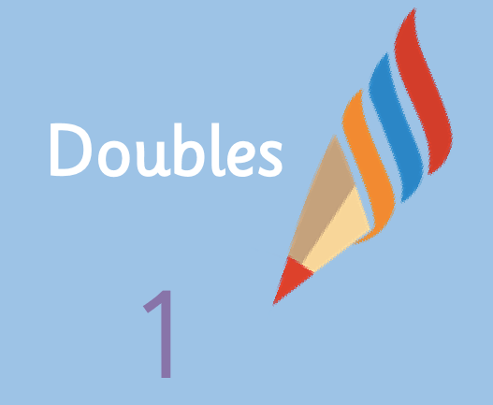
Maths Day 1 Doubling numbers to 10

Slide 5
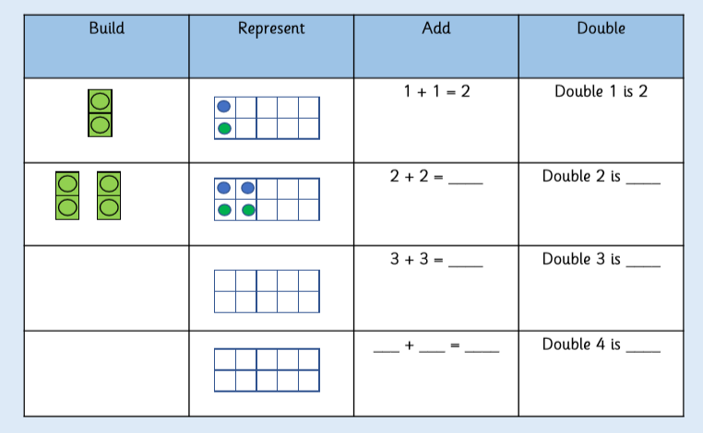
Do it!

Slide 6
Twist it!

Slide 7
Explore it!

Slide 8
Want to do more?
https://wrm-13b48.kxcdn.com/wp-content/uploads/2020/homelearning/year-1/Lesson-1-Y1-Summer-Block-1-WO5-Make-doubles-2020.pdf

Slide 9
Maths Day 2 Halving numbers to 20

Slide 10
Double it!
1 + 1 = 2
answer

Slide 11
Double it!
3 + 3 = 6
answer

Slide 12
Double it!
5 + 5 = 10
answer

Slide 13
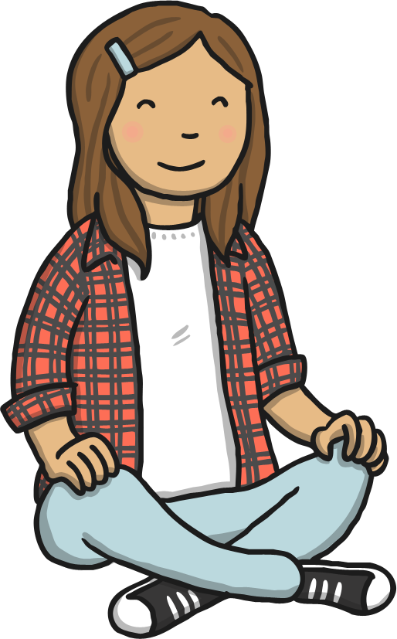
I’m thinking of a number. I’ve doubled it and my answer is 6. What number was I thinking of?
3
answer

Slide 14
I’m thinking of a number. I’ve doubled it and my answer is 8. What number was I thinking of?
4
answer

Slide 16
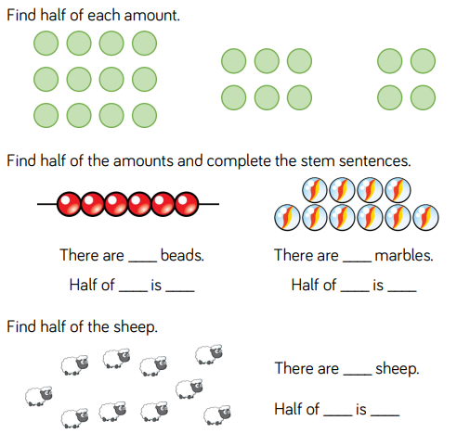

Slide 17
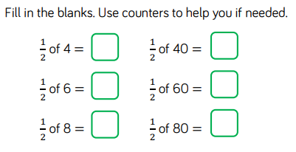
Do it!

Slide 18
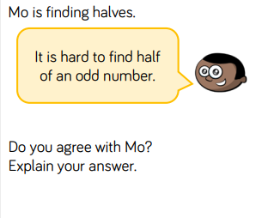
Twist it!

Slide 19
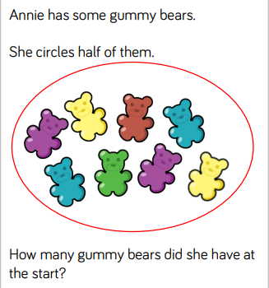
Explore it!

Slide 20
Maths Day 3 Counting in 2s

Slide 21
Halve it!
I had 6 sweets. I gave half to my sister. How many sweets did I have left?
3
answer

Slide 22
Halve it!
I had 6 sweets. I gave half to my sister. How many sweets did I have left?
3
answer

Slide 23
I’m thinking of a number. I’ve halved it and my answer is 2. What was my number?
4
answer

Slide 24
I’m thinking of a number. I’ve halved it and my answer is 4. What was my number?
8
answer

Slide 25
Counting in 2s

Slide 27
Do it!

Slide 28
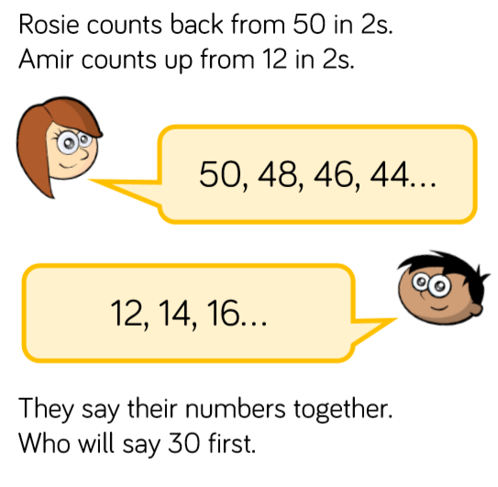
Twist it!

Slide 29
Explore it!

Slide 30
Maths Day 4 Counting in 5s

Slide 31
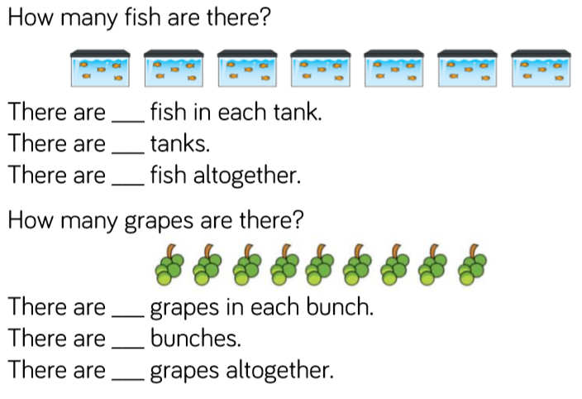
Do it!

Slide 33
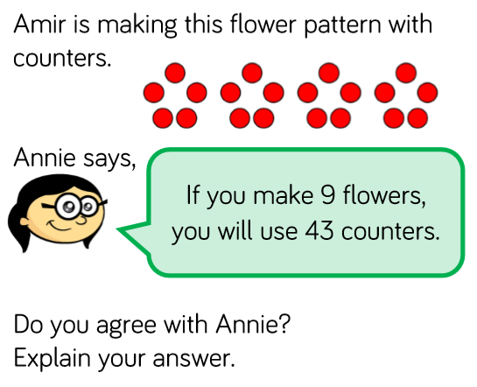
Twist it!

Slide 34
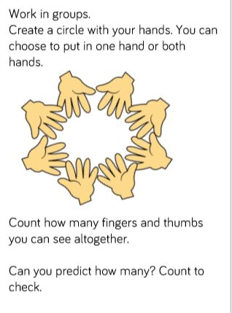
Explore it!

Slide 35
Maths Day 5 Counting in 10s

Slide 37
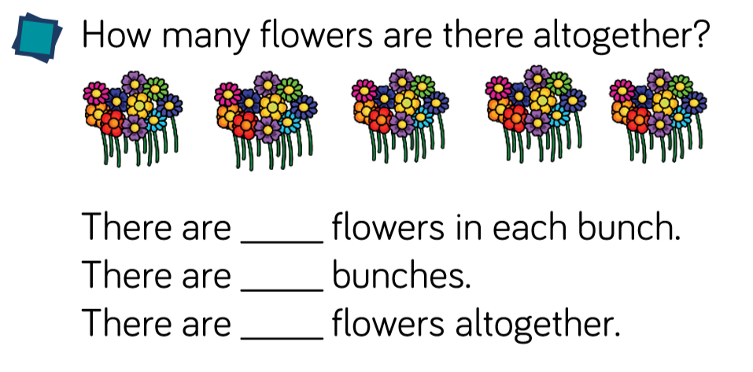

Slide 39
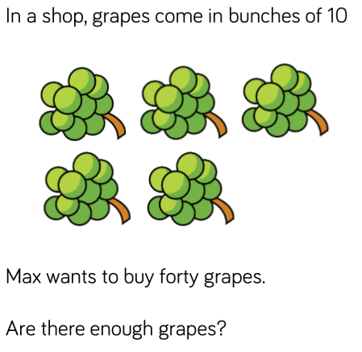
Explore it!

Slide 40
Maths Day 6 Multiplication with equal groups

Slide 41
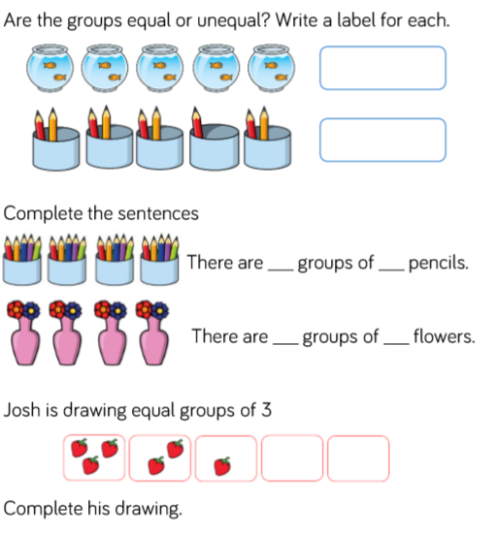

Slide 42
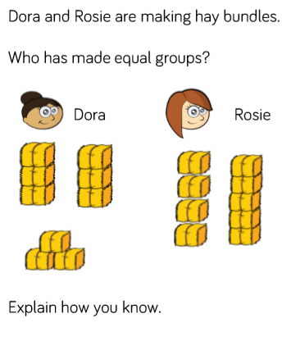
Twist it!

Slide 43
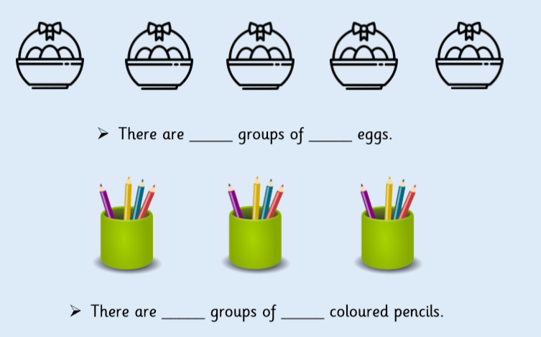
Explore it!

Slide 44
Maths Day 7 Multiplication using repeated addition

Slide 45
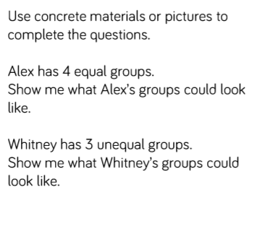

Slide 46
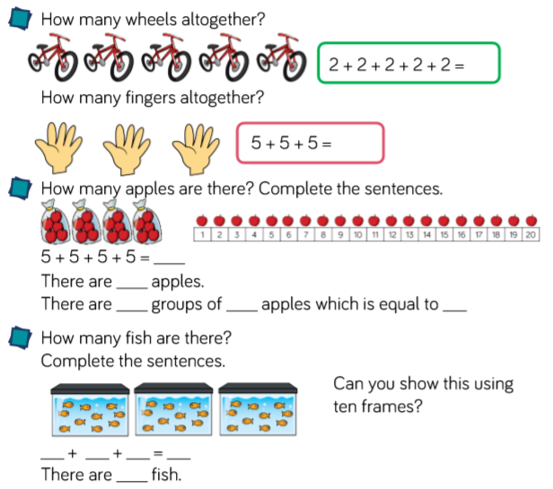
Do it!

Slide 47
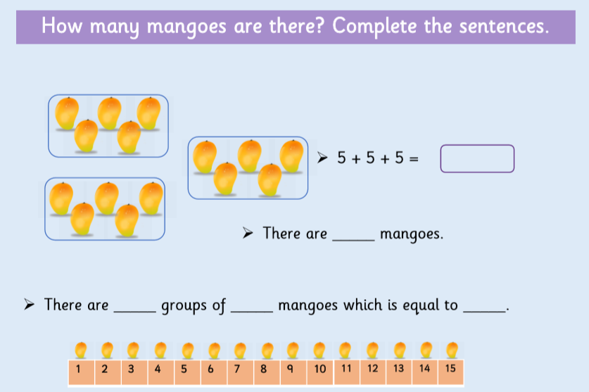

Slide 48
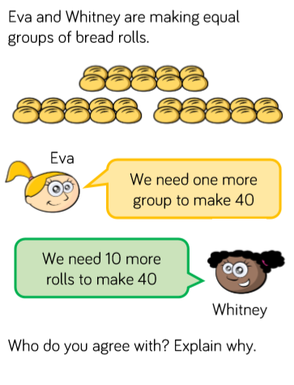
Twist it!

Slide 49
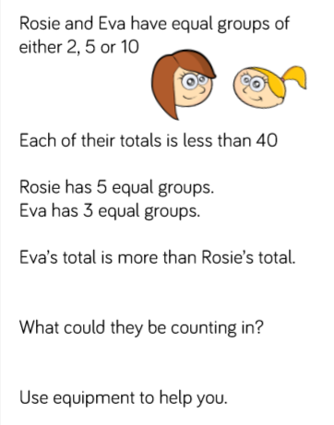
Explore it!

Slide 50
Maths Day 8 Multiplication using arrays

Slide 51
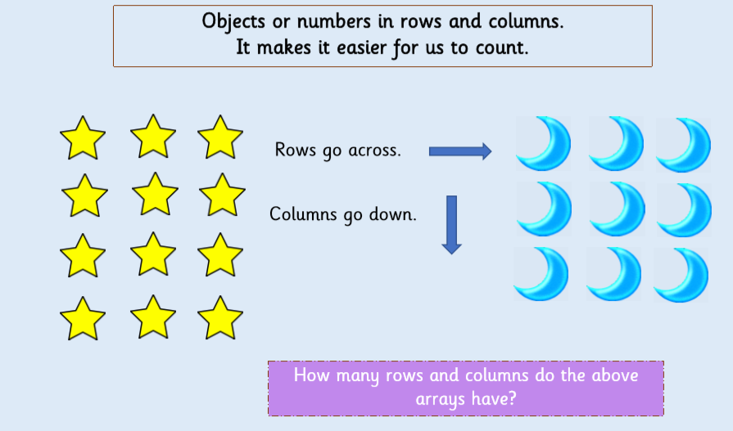

Slide 53
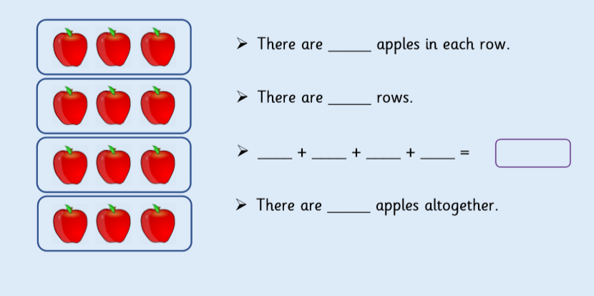

Slide 55
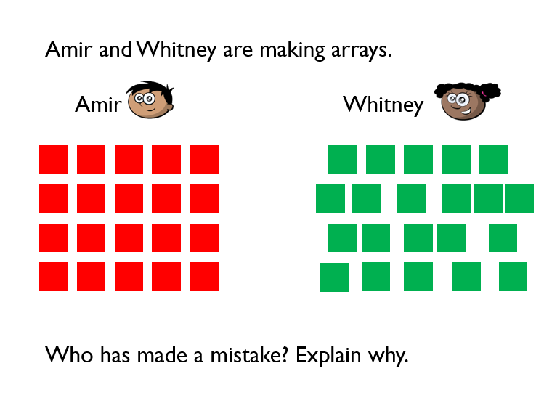
Twist it!

Slide 56
Explore it!

Slide 57
Maths Day 9 Division by grouping

Slide 61
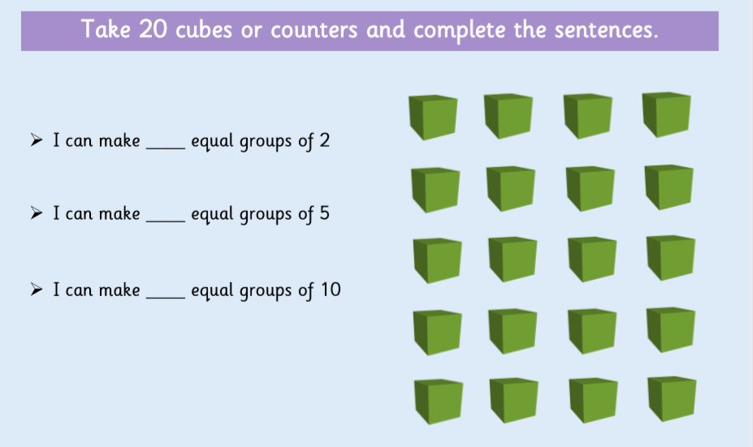

Slide 62
Twist it!

Slide 63
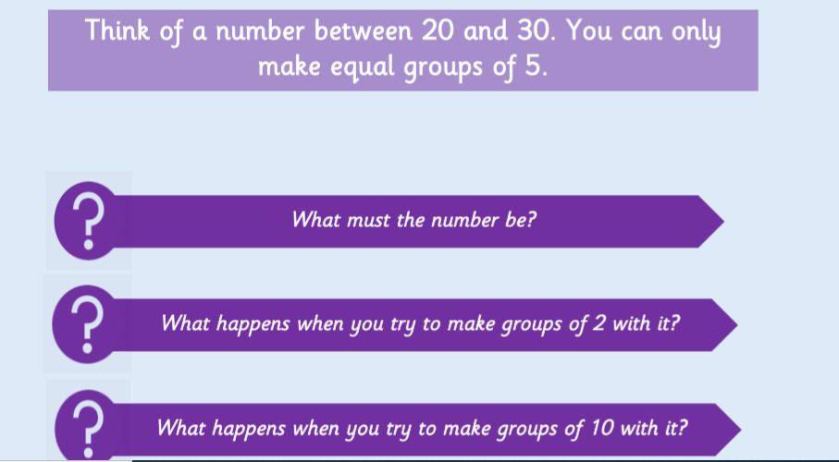
Explore it!

Slide 64
Maths Day 10 Division by sharing

Slide 65
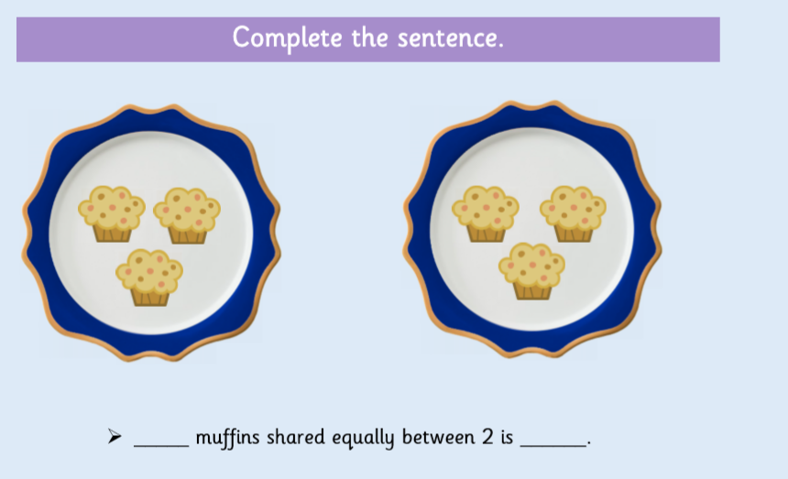

Slide 67
Twist it!

Slide 68
Explore it!

