Slide 1
Multiplication Recap Summer Class Maths 2020

Slide 2
Long Multiplication
With your talk partner, on whiteboards- talk through the steps to get to this answer.
Write a step by step Success Criteria in your Maths books
24
x34
96
7
2
1
0
1
8
1
6
1

Slide 3
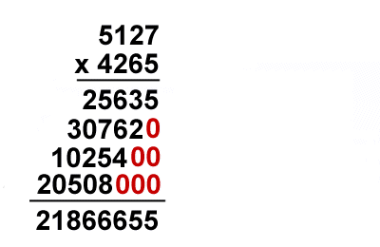
WOW! Look at this enormous LONG MULTIPLICATION
With your talk partner and your Success Criteria – slowly work together on a whiteboard. Is this the correct answer? Mark it!
Now – make one up for your partner. Put in a marvellous mistake to really test your partner.

Slide 4
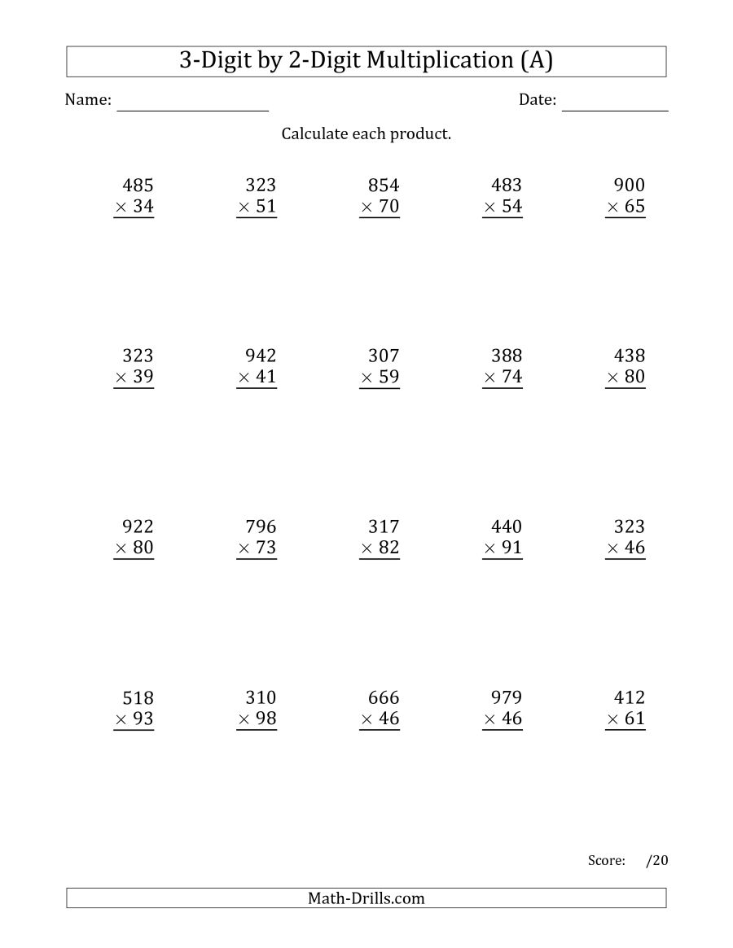
Do it!
Choose 5 and complete in your Maths book.
Get your talk partner to mark them before you move on.

Slide 5
Garry says, “I read 9 pages of my book every night. It takes me 5 weeks to read the book. Therefore my book must have 45 pages because 9 x 5 is 45”

Slide 6
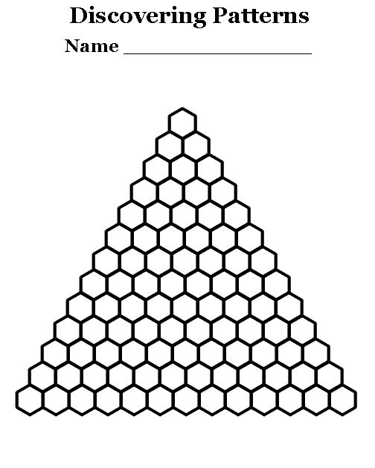
Explore it!
On your blank version you are going to create your own multiplication triangle.
Write the numbers 1 – 14 on the bottom row. In the shape above, put the product of the 2 numbers below it. How far up the triangle can you get? What number is at the very top?

