Slide 1
Living Things and their Habitats
Science Y3/4

Slide 2
Useful links to use throughout the unit
https://www.bbc.co.uk/bitesize/topics/zn22pv4
https://www.dkfindout.com/uk/animals-and-nature/invertebrates/
https://www.bbc.co.uk/teach/class-clips-video/science-ks2--ks3-classification-of-organisms/zh7g92p

Slide 3
Lesson 1 – Grouping Living things

Slide 4
What do all of these have in common?

Slide 5
What do all of these have in common?
THEY’RE ALL LIVING THINGS

Slide 6
How can we group living things?
How many ways can we group living things?
What questions can you come up with that would sort the living things into different groups?
Write down as many as you can that would help to sort the groups.

Slide 7
Examples of ways of grouping
Plants
Animals

Slide 8
Examples of ways of grouping
Plants
Non-Mammals
Mammals

Slide 9
Another way of grouping
 | Lives in water | Lives on land
Has legs
Does not have legs
What animal could you put in this box?
Notes:
Questions to consider – could any plants/flowers go into this Carroll diagram? Explain your thinking.

Slide 10
Criteria
We have asked questions to sort living things into groups. These are called criteria.
e.g.
Plant or animal
Lives in the sea or does not live in the sea
Has legs or does not have legs
How many of these criteria can you come up with?

Slide 11
Ideas for you to do
Can you make your own version of slide 6 or 7?
Can you make your own version of slide 8?
Are there any other ways of grouping living things besides the ones you’ve been shown?
On slide 11 are living things for you to sort however you decide.

Slide 12
How would you sort these living things?
Lemur, shrimp, wolf rabbit, mouse, gorilla, brown bear, gazelle, whale, lion, pangolins, sea lion, koala, elephant, walrus, stingray, gecko, rhino, panda, slug, chameleon, beetle, frog, clownfish, ostrich, crab, emu, crocodile, snail, earthworm, snake, lobster, tortoise, eel, starfish, jellyfish, praying mantis, flamingo swan, mosquito, pigeon, toucan, hummingbird chicken, bee, goose, eagle

Slide 13
Lesson 2 – Classifying vertebrates

Slide 14
Classification
In lesson 1, we learnt that we can group living things using lots of different criteria.
Today we are going to look at how we can classify animals into groups called vertebrates and invertebrates.
Can you remember what these two words mean? (clue – we looked at them in the skeleton/bones unit)

Slide 15
Vertebrates & Invertebrates
VERTEBRATES
Animals with a backbone. e.g.
INVERTEBRATES
Animals without a backbone e.g.

Slide 17
How do we further group vertebrates?
There are 5 main groups in which we can split vertebrates:
Mammal
Fish
Reptile
Bird
Amphibian

Slide 18
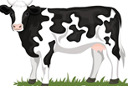
What are…?
Mammals
Mammals have warm blood, and have hair or fur on their bodies.
Mammal babies are born alive.
The mothers feed their babies milk.
Fish
Fish live in water.
They have fins instead of legs and gills instead of lungs.
They lay their eggs in water.
They have cold blood and scaly skin.

Slide 19
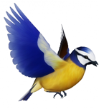
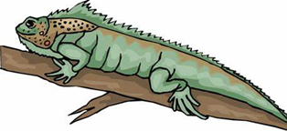
What are…?
Reptiles
Some reptiles live on land, and some in water.
They have lungs that breathe air.
They have scales and are cold-blooded.
They lay their eggs on land.
Birds
Birds have a beak, wings, feathers and 2 legs.
They lay eggs on land.
They have warm blood.

Slide 20
What are…?
Amphibians
Amphibians live on land and in water.
They are cold-blooded.
They have gills when they are young.
They have smooth skin.
They lay their eggs in water.

Slide 21
Classification key
Classification keys are a way of identifying living things through a series of questions based on their similarities and differences.
You may start with quite a broad question e.g.
Does it have wings?
Each question has a yes or no answer
Then all of the following questions will narrow down the options.
See the next slide for an example.

Slide 22
Classification key example
Does it lay eggs?
Yes
No
Can it fly?
Mammal
No
Yes
Amphibian
Bird

Slide 23
Ideas for you to do
How many different animals can you find for each vertebrate group?
Can you make a classification key for someone in your family to do?

Slide 24
Use a few of these animals when making your classification keys
Lemur, wolf, rabbit, mouse, gorilla, brown bear, gazelle, whale, lion, pangolins, sea lion, koala, elephant, walrus, stingray, gecko, rhino, panda, chameleon, frog, clownfish, ostrich, emu, crocodile, snake, lobster, tortoise, eel, flamingo, swan, pigeon, toucan, hummingbird chicken, goose, eagle

Slide 25
Lesson 3 – Classifying invertebrates

Slide 26
What is an invertebrate?
Can you remember what an invertebrate is?
Animals that do not have a backbone, or a skeleton made of bones. Many have a hard shell outside their bodies to protect them. Others have soft, flexible bodies.
Can you think of any examples?

Slide 27
Classifying Invertebrates
Just like vertebrates, we can group invertebrates into more specific groups:
Insects
Annelids
Protozoa
Crustaceans
Molluscs
Arachnids
Echinoderms
Flatworms
Myriapods
Coelenterates

Slide 28
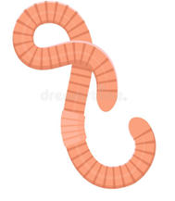
What are…?
Insects
They have an exoskeleton covering their body.
The body consists of 3 parts: the head, thorax and abdomen.
They must shed their exoskeleton in order to grow.
They have a pair of antennae on their head.
Annelids
They have bodies divided into segments.
They don't have any limbs.
Some have long bristles; others have shorter bristles and seem smooth.

Slide 29
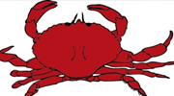
What are…?
Protozoa
They eat tiny algae and bacteria.
They can only be seen under a microscope.
They are simple, single-celled animals.
They are a source of food for fish and other animals.
They reproduce by splitting in half.
Crustaceans
They have a hard, external shell which protects their body.
They live mostly in the ocean or other waters.
They have a head and abdomen.
Many have claws that help with crawling and eating.

Slide 30
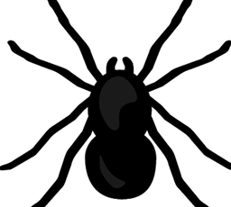
What are…?
Molluscs
They live on land or in water.
Most have a soft, skin-like organ covered with a hard outside shell.
Land molluscs move slowly on a flat sole called a foot.
Ocean molluscs attach themselves to rocks or other surfaces, and can't move.
Arachnids
Most arachnids have 4 pairs of legs.
The first pair of legs may be used for holding their prey and feeding.
They have a hard exoskeleton and jointed legs for walking.
Arachnids do not have antennae.

Slide 31
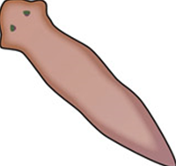
What are…?
Echinoderms
They are marine animals that live in the ocean.
They have arms or spines that radiate from the centre of their body.
The central body contains their organs, and their mouth for feeding.
The mouth is underneath, to eat other sea life.
Flatworms
They are relatively simple animals.
They have soft bodies.
They may infect humans, pets and farmyard animals.

Slide 32
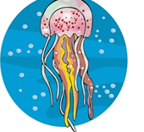
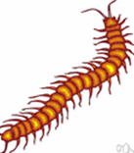
What are…?
Myriapods
The body is made up of numerous similar segments.
Nearly all the segments bear true jointed legs.
Elongated bodies.
Coelenterates
Means that they have a hollow gut.
They typically have a tube- or cup-shaped body.
Tentacles that bear stinging cells.

Slide 33
Can you sort these animals into the correct invertebrate group?
Jellyfish, crab, lobster, starfish, spider, bee, centipede, millipede, snail, slug, earthworm, shrimp, sea urchin, sand dollar, sea cucumber, barnacle, woodlice, scorpion, cricket, grasshopper, octopus, stag beetle, ladybird, cockroach

Slide 34
Ideas for you to do
How many different animals can you find for each vertebrate group?
Can you make a classification key for someone in your family to do?
Can you make a model of one of the animals?

Slide 35
Lesson 4 – Invertebrate hunt

Slide 36
Let’s go outside!
If you can, over the next few days, see what invertebrates you can find in your garden.
Remember:
When looking for invertebrates, we need to be really careful to not disturb their habitats.
Handle anything you find with care.
Make sure you return anything you find back to where it came from.

Slide 37
What you need
Small spoon – use to scoop up the creature gently
Clear cup/container – place the creature in this to study
Magnifying glass – if you have one, get close up details of what you find
Ruler – measure the length of the creature
Pencil – draw and write your results
Paper/booklet – keep a record of all of your findings

Slide 38
Where to look
Under rocks and stones
Inside or under rotting wood
In short grass
In long grass/tall flowers
In soil
Under fallen leaves

Slide 39
What to do
Draw a picture of your specimen and label the body parts.
What type of invertebrate is it?
Where did you find it?
Use the next slide as a guide of how to lay out your results.
Can you make a booklet of what you find?
Can you draw a map of your garden and note down where you found everything?

Slide 40
Example of recording results
Invertebrate found: Beetle
Habitat where it was found:
Under leaves in my garden
Characteristics:
It has 6 legs.
Its body is in 3 parts.
It has a hard wing case.
It has long thin antennae.

