Slide 1

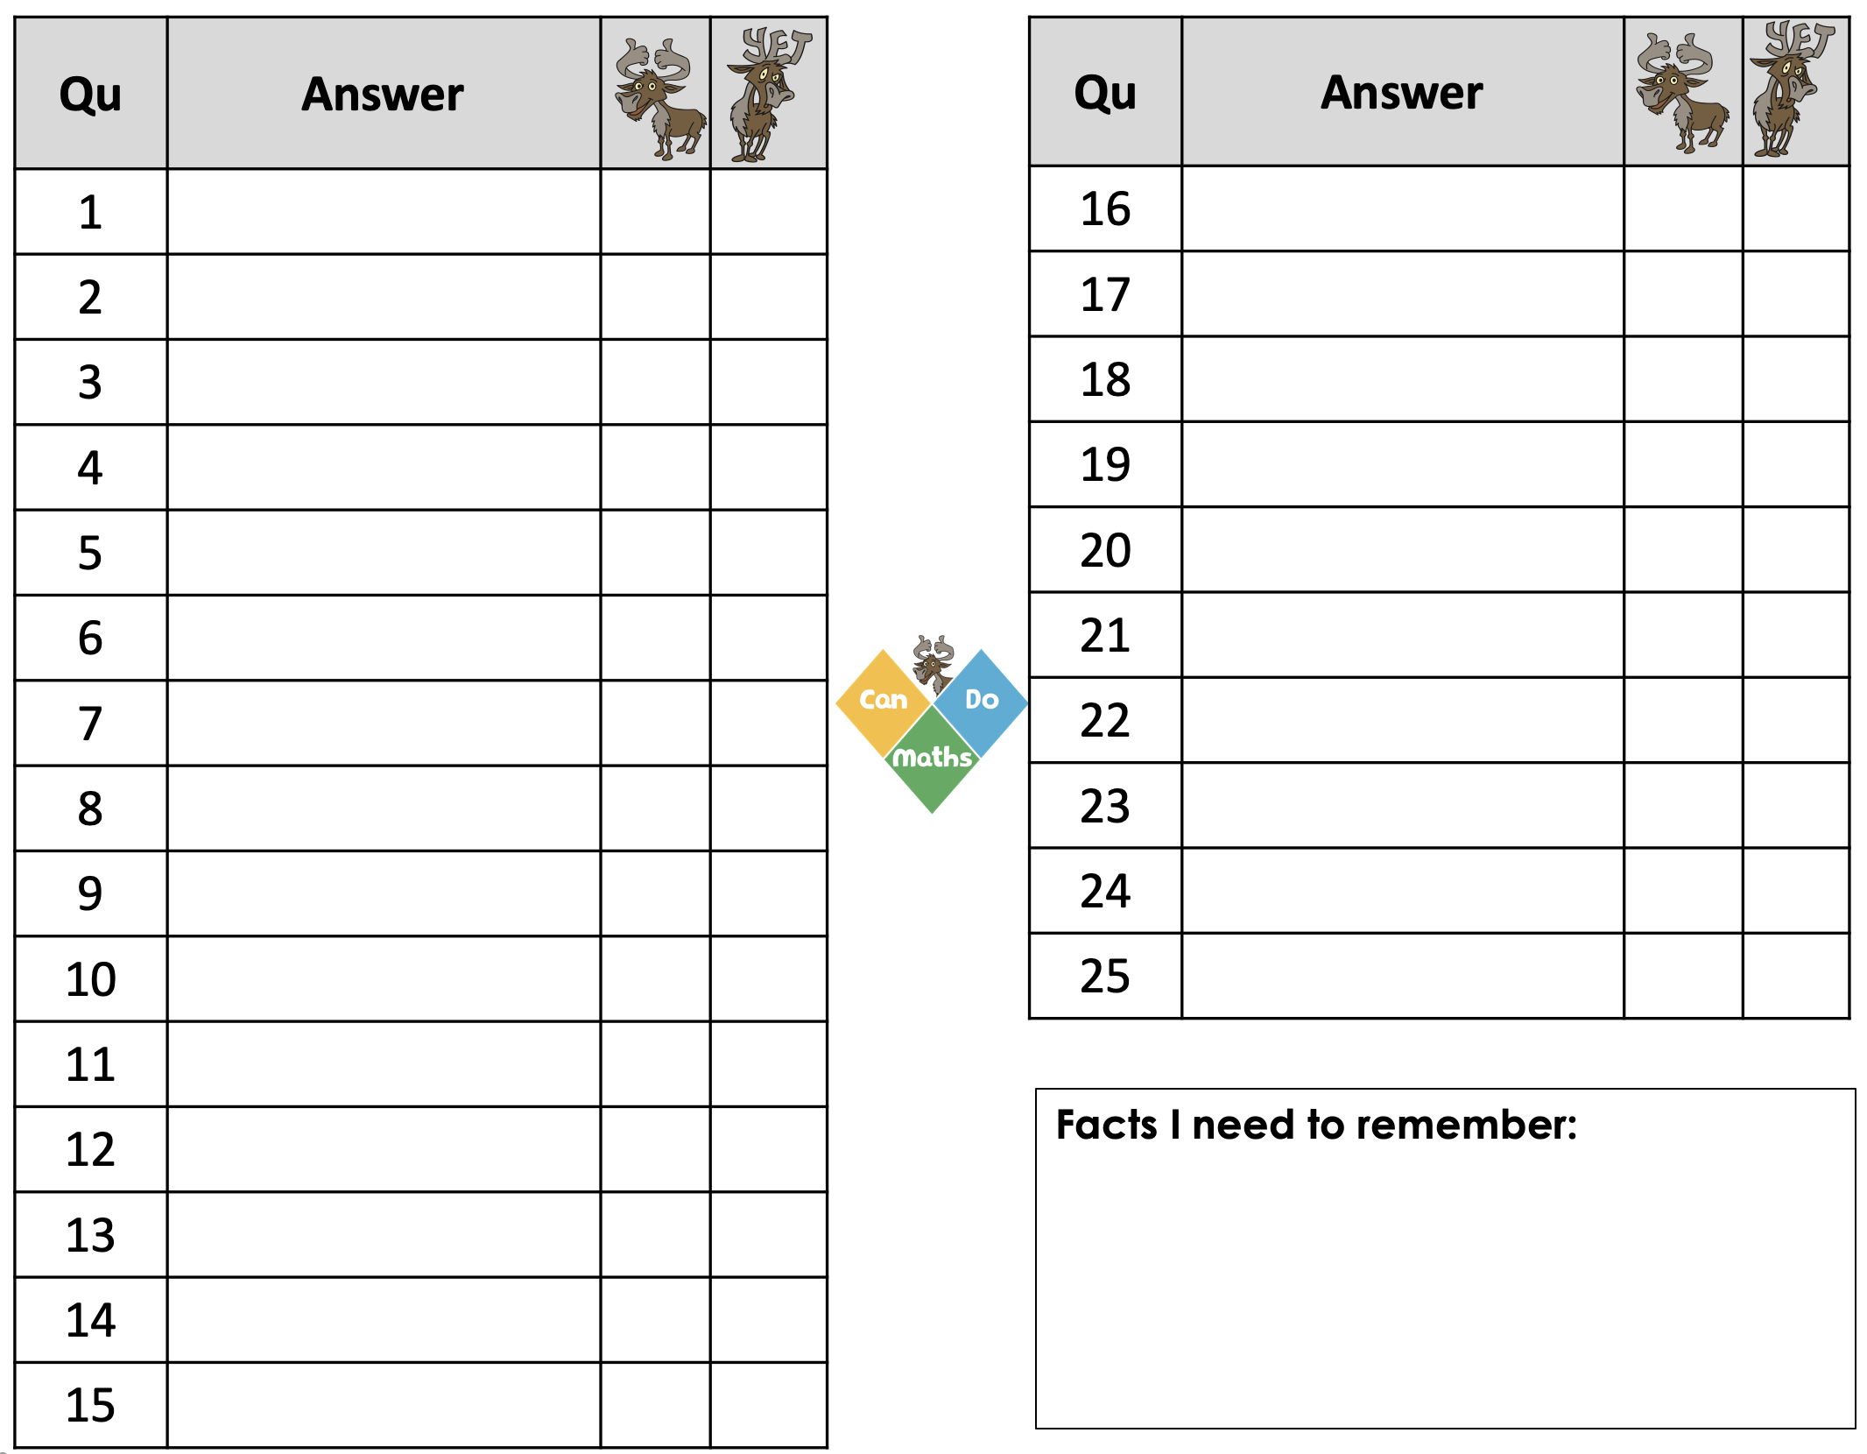
+ Each question will appear for 4 seconds
+ Please attempt all questions
Let’s celebrate how many
multiplication facts you know

Slide 2
Qu | Answer
1
2
3
4
5
6
7
8
9
10
11
12
13
14
15
Qu | Answer
16
17
18
19
20
21
22
23
24
25
Facts I need to remember:

Slide 3

2 5 =
$$×$$

Slide 4
10 10 =
$$×$$

Slide 5
5 3 =
$$×$$

Slide 6
7 5 =
$$×$$

Slide 7

6 11 =
$$×$$

Slide 8

5 5 =
$×$

Slide 9
5 12 =
$$×$$

Slide 10
3 3 =
$$×$$

Slide 11
4 4 =
$$×$$

Slide 12
3 6 =
$$×$$

Slide 13
8 4 =
$$×$$

Slide 14
3 12 =
$$×$$

Slide 15
3 9 =
$$×$$

Slide 16
4 12 =
$$×$$

Slide 17
3 8 =
$$×$$

Slide 18
6 6 =
$$×$$

Slide 19
8 7 =
$$×$$

Slide 20
9 6 =
$$×$$

Slide 21
8 12 =
$$×$$

Slide 22
6 7 =
$$×$$

Slide 23
11 11 =
$$×$$

Slide 24
7 9 =
$$×$$

Slide 25
9 9 =
$$×$$

Slide 26
12 12 =
$$×$$

Slide 27
11 12 =
$$×$$

Slide 28
Which ones do you know ?
Well done!
Which ones do you not know ..... yet?

Slide 29
Qu | Answer
1 | 10
2 | 100
3 | 15
4 | 35
5 | 66
6 | 25
7 | 60
8 | 9
9 | 16
10 | 18
11 | 32
12 | 36
13 | 27
14 | 48
15 | 24
Qu | Answer
16 | 36
17 | 56
18 | 54
19 | 96
20 | 42
21 | 121
22 | 63
23 | 81
24 | 144
25 | 132
Facts I need to remember:

Slide 30
https://candomaths.org/#linksAndResources

Slide 31
Today’s
Factor-Factor-Product is
9
54
6

Slide 32
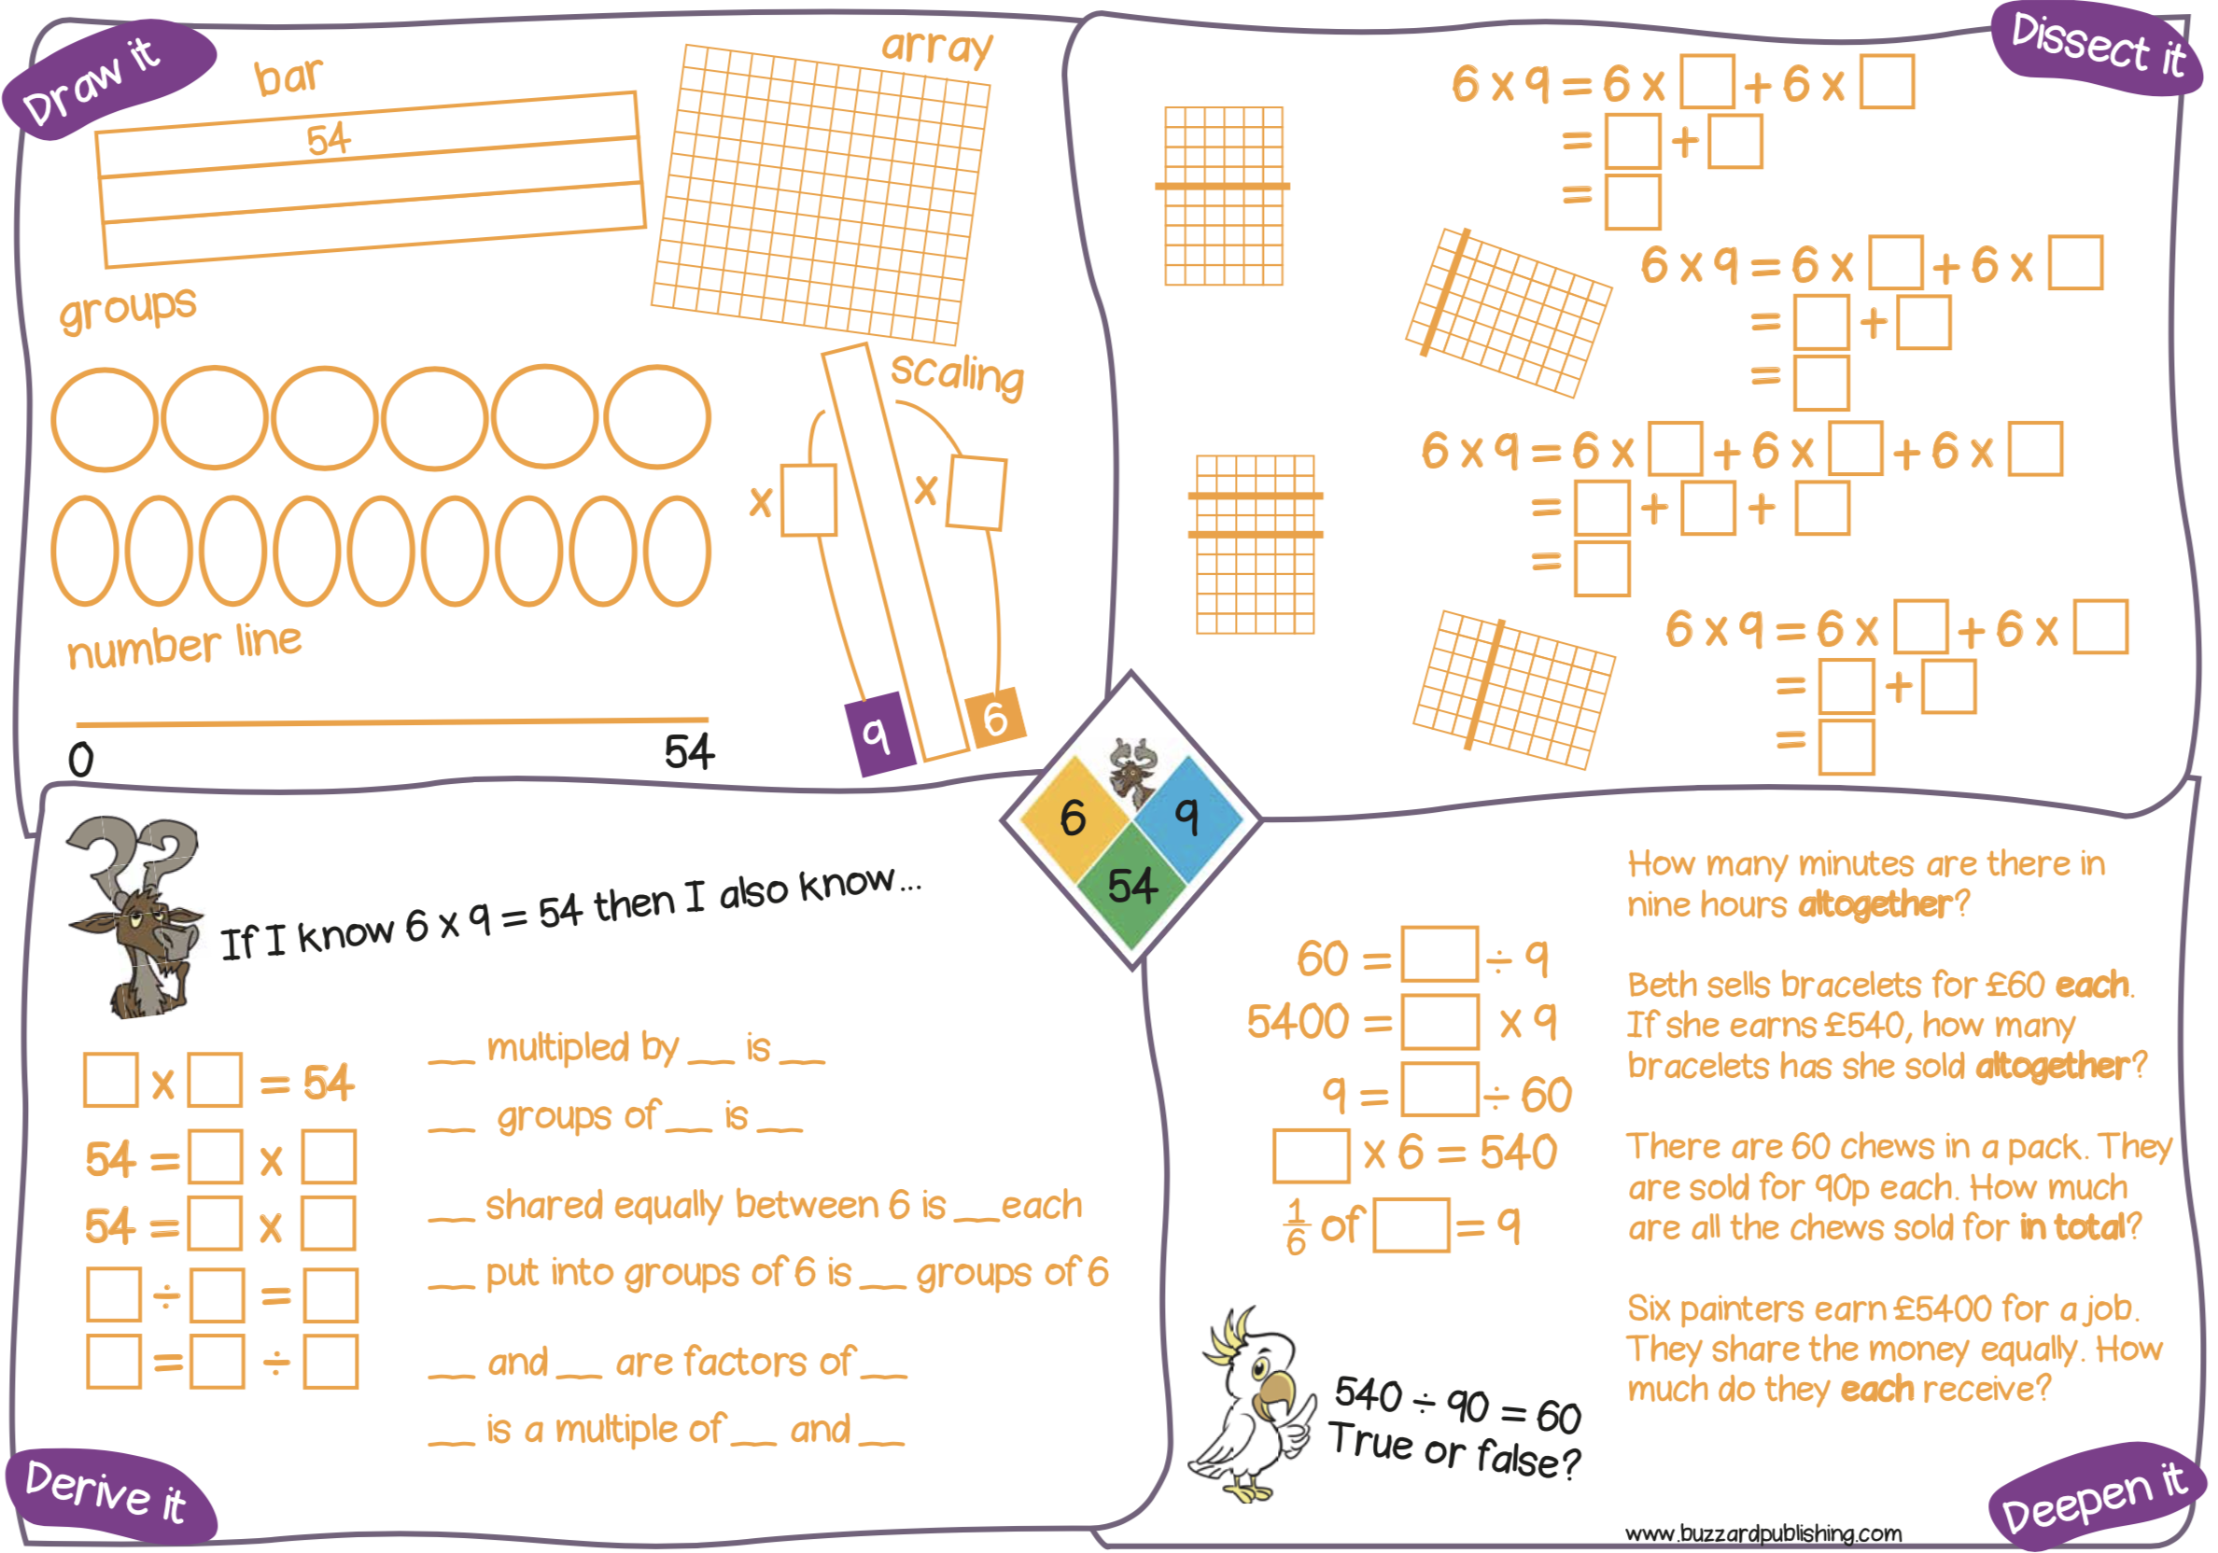
https://buzzardpublishing.com/product-category/can-do-maths/cando-tables/

Slide 33

If I know …. | then I also know …. ...... × ...... = ...... ...... × ...... = ...... ...... ÷ ...... = ...... ...... ÷ ...... = ...... ...... = ...... × ...... ...... = ...... × ...... ...... = ...... ÷ ...... ...... = ...... ÷ ...... | and I also know …. …... is a factor of …... …... is a factor of …... ...... is a multiple of ...... ...... is a multiple of ...... ...... is a common multiple of ...... and ...... | and I also know ….
9
4
6
9
54
6

Slide 34

If I know …. | then I also know …. | and I also know …. | and I also know ….
9
4
6
9
54
6
$× ÷$ Facts
Factor Multiple
Fractions

Slide 35
If I know …. | then I also know …. 6 × 9 = 54 9 × 6 = 54 54 ÷ 6 = 9 54 ÷ 9 = 6 54 = 6 × 9 54 = 9 × 6 6 = 54 ÷ 9 9 = 54 ÷ 6 | and I also know …. 6 is a factor of 54 9 is a factor of 54 54 is a multiple of 6 54 is a multiple of 9 54 is a common multiple of 6 and 9 | and I also know ….
9
54
6

Slide 36
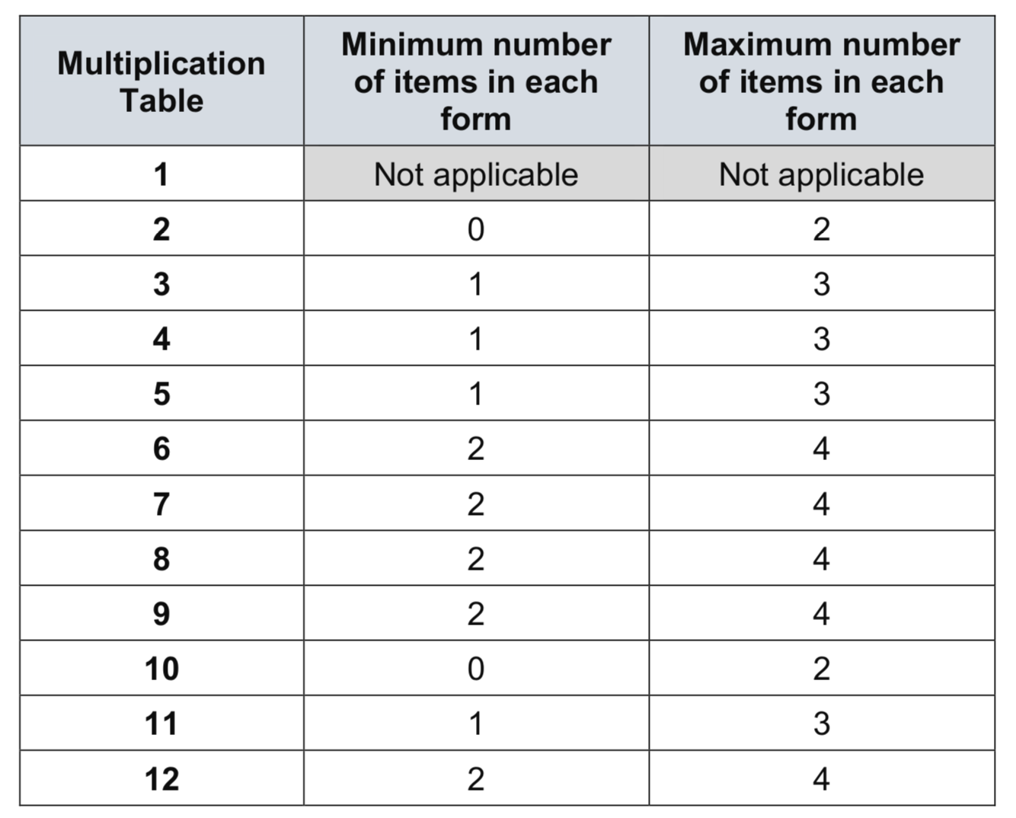

Slide 37
2 Questions from | 5 Questions | 8 Questions from | 10 Questions from
2 x 2 | 5 x 3 = | 3 x 3 = | 6 x 6 =
2 x 5 | 5 x 4 = | 3 x 4 = | 6 x 7 =
2 x 10 | 5 x 5 = | 3 x 6 = | 6 x 8 =
10 x 10 | 5 x 6 = | 3 x 7 = | 6 x 9 =
 | 5 x 7 = | 3 x 8 = | 6 x 12 =
 | 5 x 8 = | 3 x 9 = | 7 x 7 =
 | 5 x 9 = | 3 x 12 = | 7 x 8 =
 | 5 x 11 = | 4 x 4 = | 7 x 9 =
 | 5 x 12 | 4 x 6 = | 7 x 12 =
 | 3 x 11 | 4 x 7 = | 8 x 8 =
 | 4 x 11 | 4 x 8 = | 8 x 9 =
 | 6 x 11 | 4 x 9 = | 8 x 12 =
 | 7 x 11 | 4 x 12 = | 9 x 9 =
 | 8 x 11 |  | 9 x 12 =
 | 9 x 11 |  | 11 x 11 =
 | 10 x 11 |  | 11 x 12 =
 |  |  | 12 x 12 =

