Slide 1
Money

Slide 2
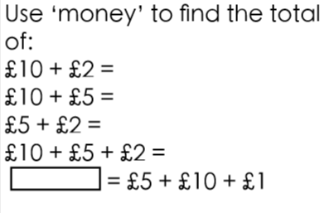
LI: Combine £1, £2, £5, £10 and use the symbols for pounds (£) Do it

Slide 3
Twist it
Coco thinks that if she has £1 and £2 and £5 she has two notes and a coin.
Do you agree with her? Give your reasons.

Slide 4
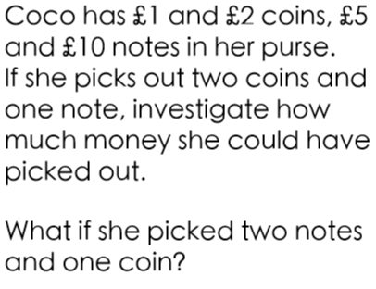
Explore it

Slide 5
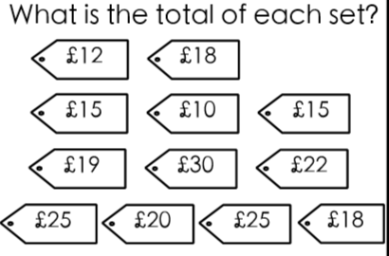
LI: Find the sum of different amounts of pounds Do it

Slide 6
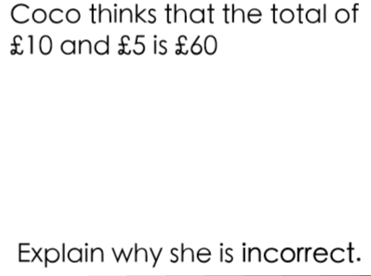
Twist it

Slide 7
Explore it

Slide 8
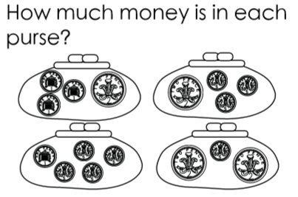
LI: Combine 1p, 2p, 5p coins to make different totals Do it

Slide 9
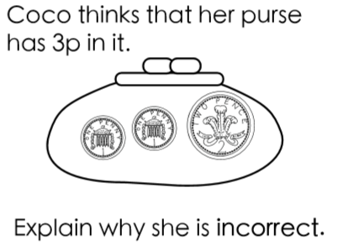
Twist it

Slide 10
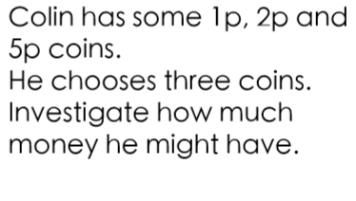
Explore it

Slide 11
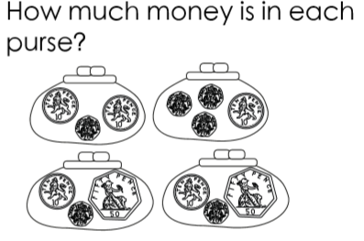
LI: Combine 10p, 20p and 50p coins to make different totals Do it

Slide 12
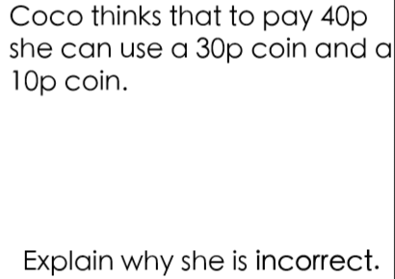
Twist it

Slide 13
Explore it
Always, sometimes, never true
You can make 0p using one or two coins.

Slide 14
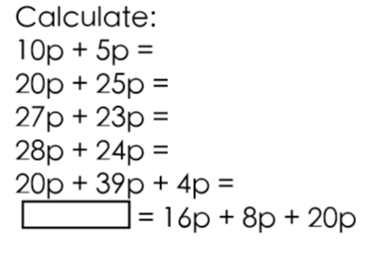
LI: Find the sum of different amounts of pence Do it

Slide 15
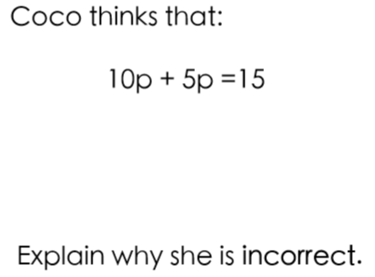
Twist it

Slide 16
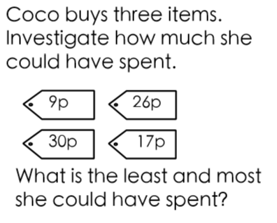
Explore it

Slide 17
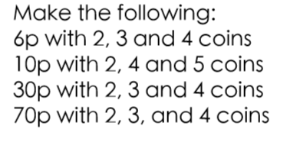
LI: Find different combinations of coins that equal the same amounts of money Do it

Slide 18
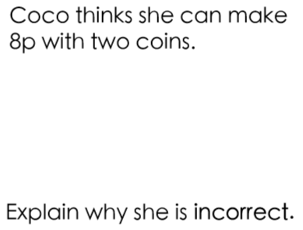
Twist it

Slide 19
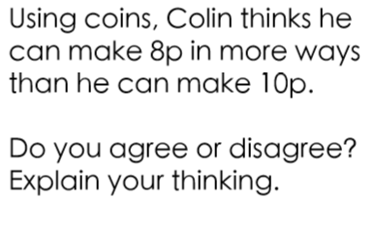
Explore it

Slide 20
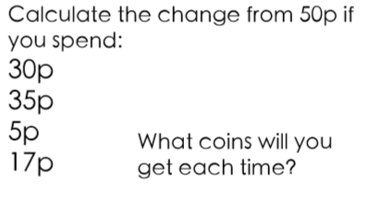
LI: Calculate change from 50p Do it

Slide 21
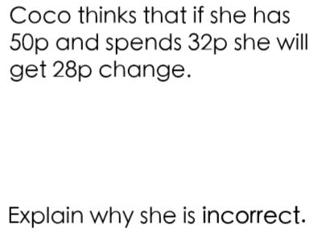
Twist it

Slide 22
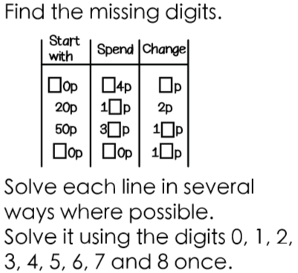
Explore it

Slide 23
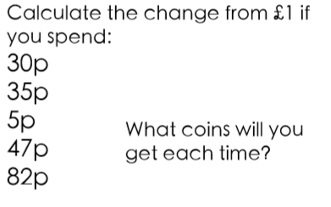
LI: Calculate change from £1 Do it

Slide 24
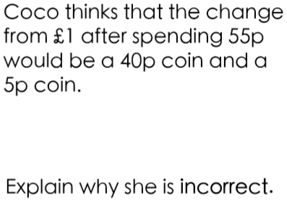
Twist it

Slide 25
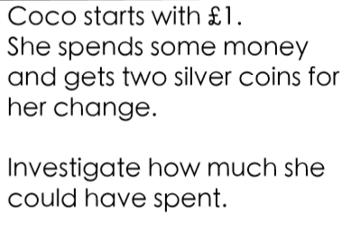
Explore it

