Slide 1
Interpreting Pie Charts
If any of the links don’t work:
Right click on the image and go to open hyperlink
Copy the address and paste it into the address bar on the internet
Google it! We’ve included the image so you will be able to find it more easily.

Slide 2
Presenting and Measuring Data Important vocabulary to learn for the week! Click to check you know the definition.
Data
Information that has been collected by counting or measuring.
Scale
Points on the axis with equal intervals.
Axis
A graph has two perpendicular lines (lines at right angles). The horizontal axis is called the x-axis. The vertical axis is called the y-axis.
Graph
A diagram showing data.
Frequency
The number of times an event occurs.
Line graph
A graph where straight lines join points together to show the data.
Average
Loosely means an ordinary or typical value. There are 3 types of average that we learn about: mean, median and mode. When just the word average is used, it refers to the mean.
Mean
The sum of a set of numbers, or quantities, divided by the number of terms in the set. Example: The arithmetic mean of 5, 6, 14, 15 and 45 is (5 + 6 + 14 + 15 + 45) ÷ 5 i.e. 17.
Pie Chart
Also known as pie graph. A form of presentation of data. Within a circle, sectors like ‘slices of a pie’ represent the quantities involved.

Slide 3
Interpreting Pie Charts
Click on the picture to go to the video.
This was the clearest video we could find to explain pie charts. Please remember that we call them PIE CHARTS but the teacher in the video calls them circle graphs!
Reading circle graphs (pie charts) tutorial -https://www.youtube.com/watch?v=KzXZfv9anpU

Slide 4
DO IT!
In the lesson 4 folder there is a PDF document called Pie Charts. Choose one of the pages of questions (pages 1-4) from this document and complete it (if you also want to fill in your own one on page 5, you can do that after).
The answers are at the bottom of the document (pages 6 & 7) for you to check your work.

Slide 5
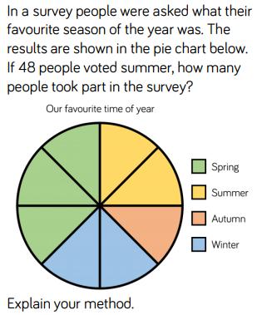
TWIST IT!
Click for answer...

Slide 6
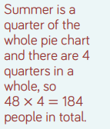
TWIST IT!

Slide 7
TWIST IT!
192 people

Slide 8
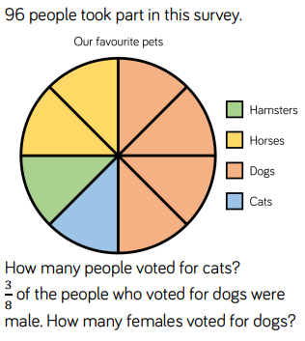
TWIST IT!
Click for answer...

Slide 9
TWIST IT!

Slide 10
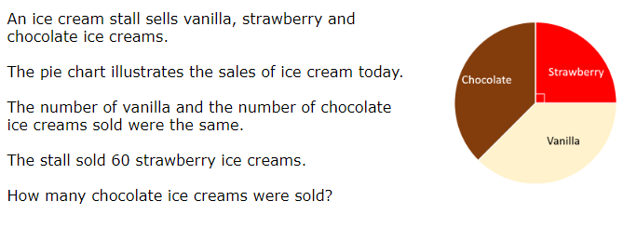
EXPLORE IT!
Ice Cream Pie!

Slide 11
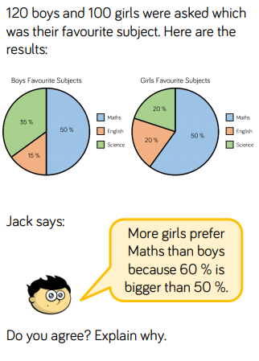
EXPLORE IT!

Slide 12
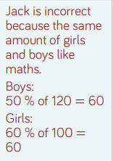
EXPLORE IT!

