Slide 1
Mean, Median & Mode
If any of the links don’t work:
Right click on the image and go to open hyperlink
Copy the address and paste it into the address bar on the internet
Google it! We’ve included the image so you will be able to find it more easily.

Slide 2
Presenting and Measuring Data Important vocabulary to learn for the week! Click to check you know the definition.
Data
Information that has been collected by counting or measuring.
Scale
Points on the axis with equal intervals.
Axis
A graph has two perpendicular lines (lines at right angles). The horizontal axis is called the x-axis. The vertical axis is called the y-axis.
Graph
A diagram showing data.
Frequency
The number of times an event occurs.
Line graph
A graph where straight lines join points together to show the data.
Average
Loosely means an ordinary or typical value. There are 3 types of average that we learn about: mean, median and mode. When just the word average is used, it refers to the mean.
Mean
The sum of a set of numbers, or quantities, divided by the number of terms in the set. Example: The arithmetic mean of 5, 6, 14, 15 and 45 is (5 + 6 + 14 + 15 + 45) ÷ 5 i.e. 17.

Slide 4
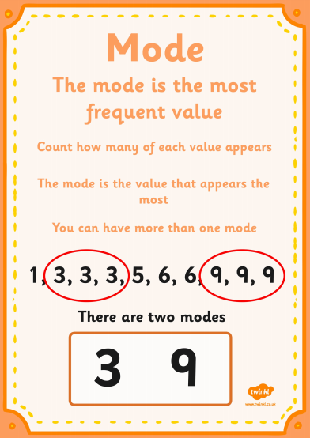

Slide 5
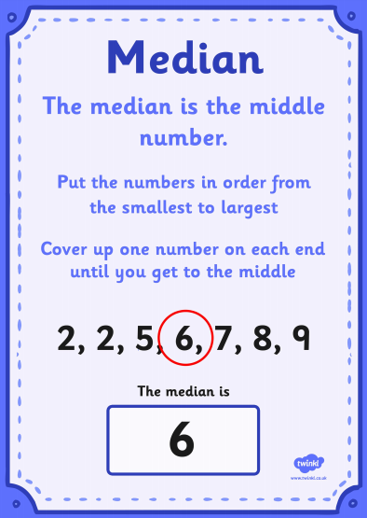

Slide 7
Now for a song…
follow the links below!
This one first for the song...
Then this one – you can sing along, and the diagrams are really clear.
Melody Treehouse, averages
https://www.youtube.com/watch?v=z4nlVZkm4eQ
Sparky Teaching, averages
https://www.youtube.com/watch?v=gB_033ID7i8

Slide 8
Find the Mean
DO IT!
Find the mean of each set of data:
6, 3, 9, 7, 5
1.3m, 0.7m, 2.6m, 2.3m, 0.4m, 1.7m
26, 27, 35, 18, 23, 27
£1.34, 89p, £1.57, £2.46, £2.09, 59p What do you need to think about carefully when finding the mean with this set of data?
Make some sets of data for a partner to find the mean.
6
1.5m
26
£1.49
All £ or p so 89p = £0.89
Answers

Slide 9
How Much?
TWIST IT!
Five classes of children collect some money to share equally with five local charities. Four of the classes record how much money they have collected, but the fifth class forgot to record theirs.
Here are the four classes collections: £34, £29, £18, £27.
The total is shared equally so each charity receives £25.
How much did the fifth class raise?
Write a similar problem for a partner.
£17
Answers

Slide 10
Play – print out and play the game in the Lesson 3 folder, or make up your own averages game to play.

