Slide 1
Drawing Pie Charts
If any of the links don’t work:
Right click on the image and go to open hyperlink
Copy the address and paste it into the address bar on the internet
Google it! We’ve included the image so you will be able to find it more easily.

Slide 2
Presenting and Measuring Data Important vocabulary to learn for the week! Click to check you know the definition.
Data
Information that has been collected by counting or measuring.
Scale
Points on the axis with equal intervals.
Axis
A graph has two perpendicular lines (lines at right angles). The horizontal axis is called the x-axis. The vertical axis is called the y-axis.
Graph
A diagram showing data.
Frequency
The number of times an event occurs.
Line graph
A graph where straight lines join points together to show the data.
Average
Loosely means an ordinary or typical value. There are 3 types of average that we learn about: mean, median and mode. When just the word average is used, it refers to the mean.
Mean
The sum of a set of numbers, or quantities, divided by the number of terms in the set. Example: The arithmetic mean of 5, 6, 14, 15 and 45 is (5 + 6 + 14 + 15 + 45) ÷ 5 i.e. 17.
Pie Chart
Also known as pie graph. A form of presentation of data. Within a circle, sectors like ‘slices of a pie’ represent the quantities involved.

Slide 3
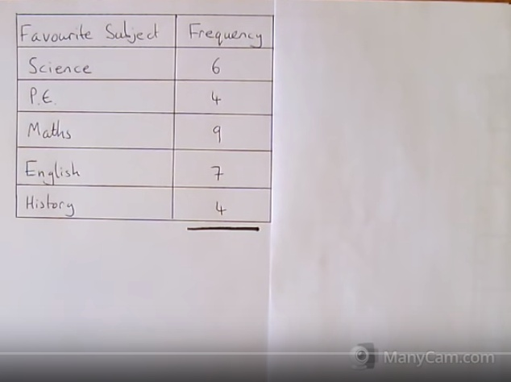
How to draw pie charts – click on the picture! Don’t worry if you haven’t got a compass or protractor - there’s an online method too!
Drawing pie charts, Maths Explained - https://www.youtube.com/watch?v=p_nPxTRuLxo

Slide 4
My Results
Use your knowledge to explain what is happening here.
Pie Charts
“What is your favourite Quality Street?”
Sweet | Results
Strawberry Cream | 5
Orange Cream | 3
Purple Hazelnut | 6
Green Triangle | 2
Other | 2
TOTAL
Degrees
100°
60°
120°
40°
40°
Degrees
X 20
$\frac{360}{18}$ =
20°
360°
X 20
18

Slide 5
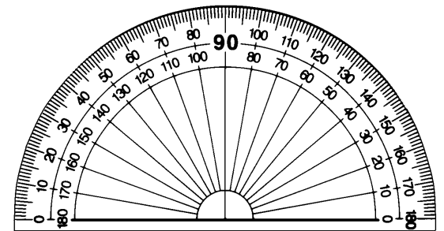
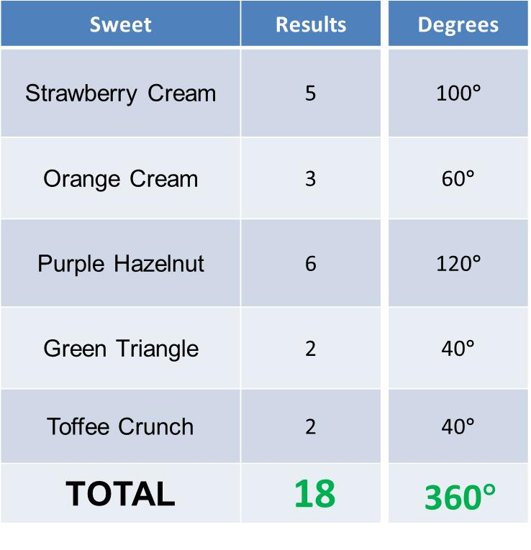
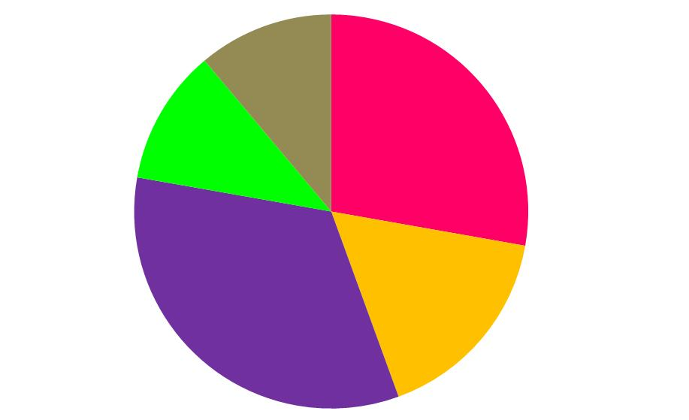
Pie Charts

Slide 6
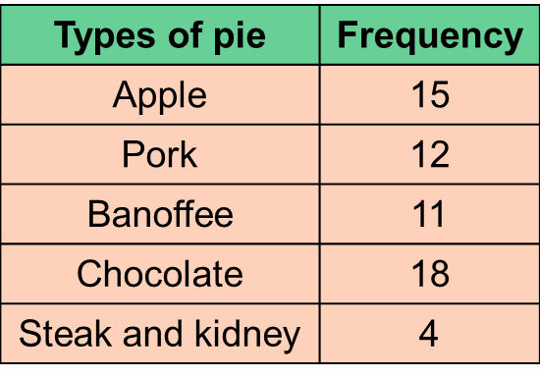
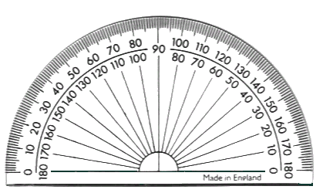
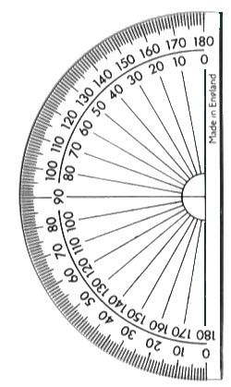
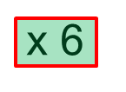
Watch the following 3 slides to see how pie charts can be constructed. Try and work out what the numbers will be as you go along.
When you have finished looking at the slides, you can make a pie chart of your own. Hints about how are on the last slide!
In a survey, people were asked to indicate which one of the pies they liked the best. The information is given in the table.
Display the information in a pie chart.
+
90°
+
72°
PORK
+
66°
APPLE
108°
.
+
24°
BANOFFEE
TOTAL =
60
360°
CHOCOLATE
360° in a full turn
Notes:
6

Slide 7
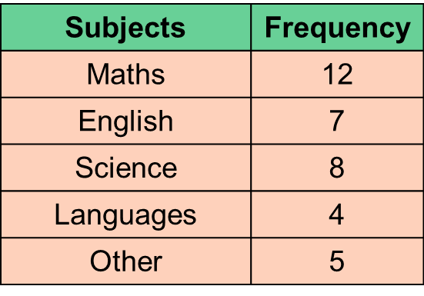
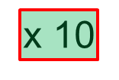
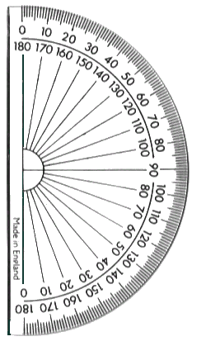
1) In a survey, people were asked to indicate which one of the subjects they liked the best. The information is given in the table.
Display the information in a pie chart.
+
120°
+
70°
80°
MATHS
+
ENGLISH
40°
.
+
50°
OTHER
TOTAL =
36
360°
SCIENCE
LANGUAGES
360° in a full turn
Notes:
7

Slide 8
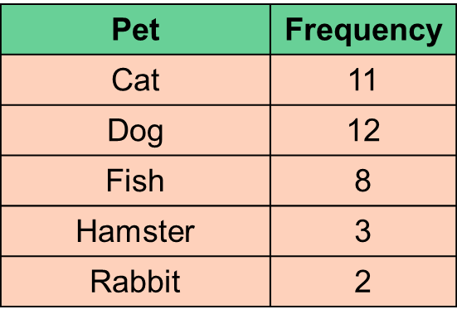
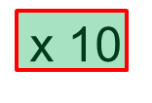
2) In a survey, people were asked to indicate their favourite pet. The information is given in the table.
Display the information in a pie chart.
+
110°
+
120°
CAT
+
80°
30°
.
+
DOG
20°
RABBIT
TOTAL =
36
360°
HAMSTER
FISH
360° in a full turn
Notes:
8

Slide 9
Use one of the slides of data to create your own pie chart.*
You could:
use a compass to draw a circle and then a protractor to work out the degrees
Use one of the circles in the folder and use a protractor to work out the degrees
Follow the link on the next page to draw a pie chart on line
* (Or you could collect some of your own data if you want an extra challenge. If you do this, it will be easier if the number of people that you ask is a factor of 360°.)

Slide 10
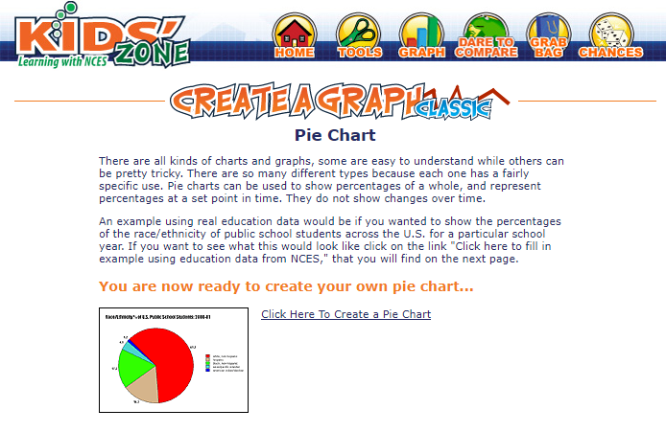
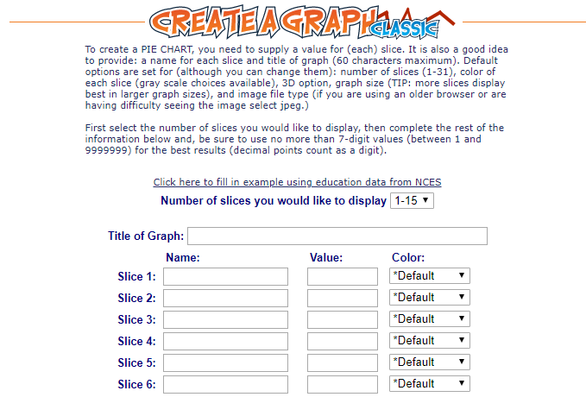
Kids Zone Create a Graph - https://nces.ed.gov/nceskids/graphing/Classic/pie.asp
Click here!
List the choices. For example: cats, dogs, rabbits etc
For example: pies, subjects or pets
How many people chose it

