Slide 1
Presenting and Measuring Data Important vocabulary to learn for the week! Click to check you know the definition.
Data
Information that has been collected by counting or measuring.
Scale
Points on the axis with equal intervals.
Axis
A graph has two perpendicular lines (lines at right angles). The horizontal axis is called the x-axis. The vertical axis is called the y-axis.
Graph
A diagram showing data.
Frequency
The number of times an event occurs.
Line graph
A graph where straight lines join points together to show the data.
Average
Loosely means an ordinary or typical value. There are 3 types of average that we learn about: mean, median and mode. When just the word average is used, it refers to the mean.
Mean
The sum of a set of numbers, or quantities, divided by the number of terms in the set. Example: The arithmetic mean of 5, 6, 14, 15 and 45 is (5 + 6 + 14 + 15 + 45) ÷ 5 i.e. 17.

Slide 2
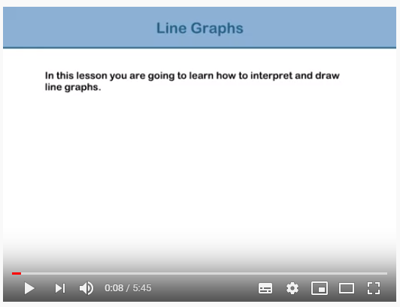
Drawing line graphs
Click on the screen shot to view a recap on yesterday’s lesson and some useful tips on drawing line graphs.
Line Graphs, The Learning Pod - https://www.youtube.com/watch?v=Opd1GDJjx4s

Slide 3
DO IT! TWIST IT! EXPLORE IT!
Complete and mark the sheet in the Lesson 2 folder to practise drawing line graphs.

