Slide 1
Line Graphs
If any of the links don’t work:
Right click on the image and go to open hyperlink
Copy the address and paste it into the address bar on the internet
Google it! We’ve included the image so you will be able to find it more easily.

Slide 2
Presenting and Measuring Data Important vocabulary to learn for the week! Click to check you know the definition.
Data
Information that has been collected by counting or measuring.
Scale
Points on the axis with equal intervals.
Axis
A graph has two perpendicular lines (lines at right angles). The horizontal axis is called the x-axis. The vertical axis is called the y-axis.
Graph
A diagram showing data.
Frequency
The number of times an event occurs.
Line graph
A graph where straight lines join points together to show the data.
Average
Loosely means an ordinary or typical value. There are 3 types of average that we learn about: mean, median and mode. When just the word average is used, it refers to the mean.
Mean
The sum of a set of numbers, or quantities, divided by the number of terms in the set. Example: The arithmetic mean of 5, 6, 14, 15 and 45 is (5 + 6 + 14 + 15 + 45) ÷ 5 i.e. 17.

Slide 3
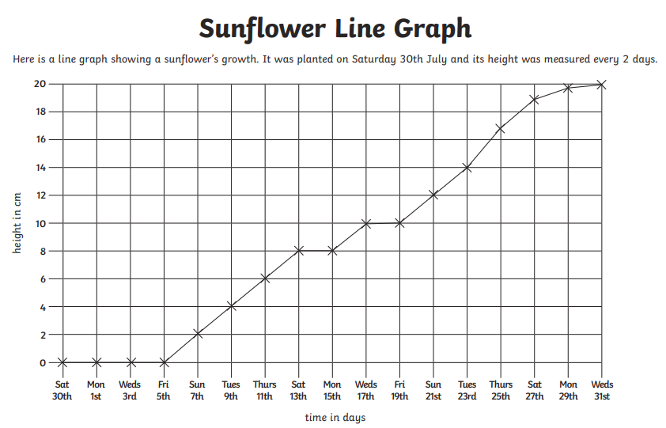
Interpreting Line Graphs Quick recap - say what you know about this line graph

Slide 4
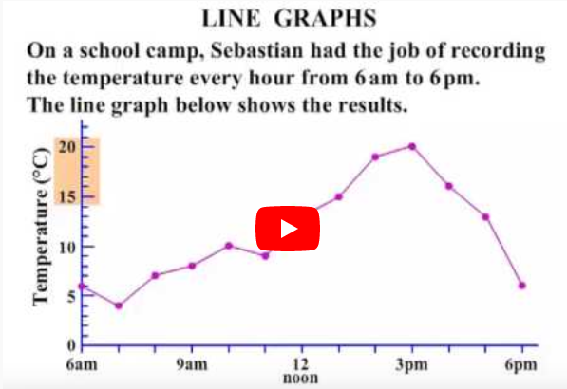
DO IT!
Click on the line graph below to learn more about interpreting line graphs.
Line Graphs CTC Math - https://www.youtube.com/watch?v=N5eaVBwmTq4

Slide 5
Now complete and mark one of the Interpreting line graphs sheets in the Lesson 1 folder.

Slide 6
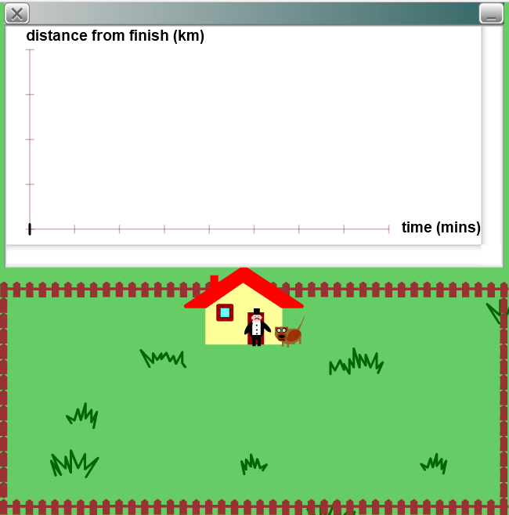
EXPLORE IT!
Take Your Dog for a Walk
Each day Mr Pearson takes his dog for a walk. You can see him on the hyperlinked picture on the right.
After you have followed the link, Try moving Mr Pearson and his dog using your computer mouse. The graph shows how far Mr Pearson is walking from his house after a certain amount of time.
What happens to the graph once Mr Pearson gets back to his house after his walk?
Can you make a curved line on the graph?
Describe how Mr Pearson must walk to create this curve.
How must Mr Pearson walk to make the curve steeper?
And can you make the curve shallower? How does Mr Pearson walk this time?
Nrich Maths, Take your dog for a walk
https://nrich.maths.org/4803

Slide 7
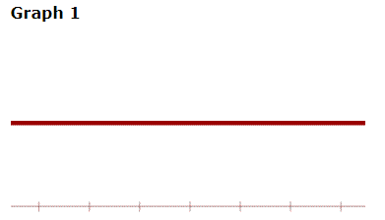
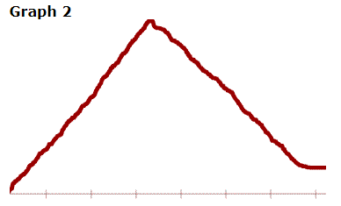
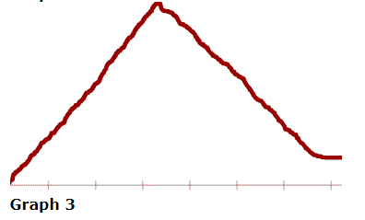
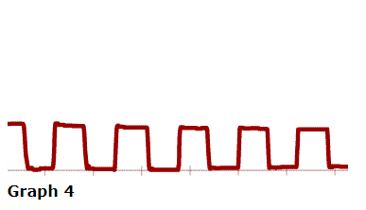
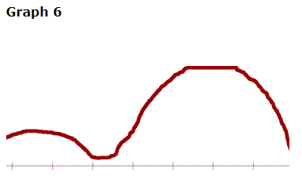
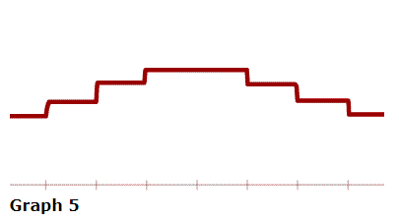
Take Your Dog for a Walk
Can you make Mr Pearson walk in ways that will create these graphs?
EXPLORE IT MORE!

