Slide 1
Year 3
Summer Term
Week 4
Maths Unit 4
Money

Slide 3
Subject knowledge links:
Money
https://www.bbc.co.uk/bitesize/topics/z8yv4wx/resources/1

Slide 4
Step 1: Use combinations of coins to make amounts beyond £1

Slide 5
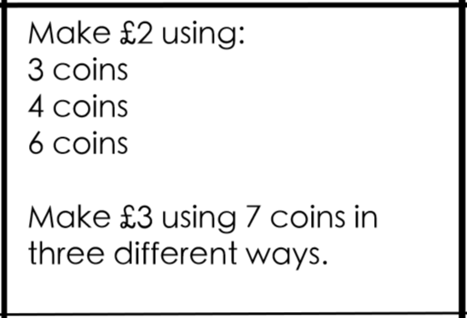
Do it: Use combinations of coins to make amounts beyond £1 Date:______

Slide 6
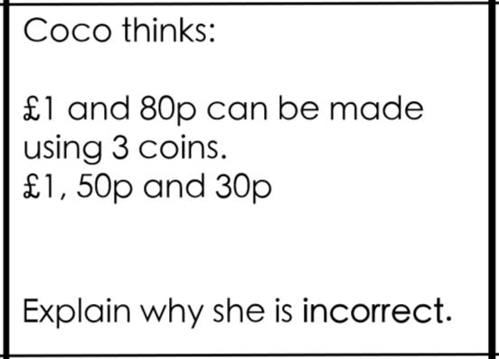
Twist it: Use combinations of coins to make amounts beyond £1 Date:______

Slide 7
Explore it: Use combinations of coins to make amounts beyond £1 Date:______

Slide 8
Step 2: Add amounts in pence

Slide 9
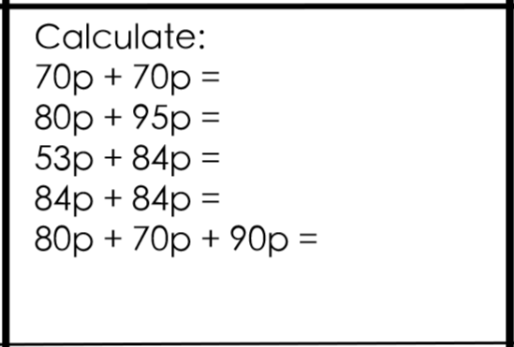
Do it: Add amounts in pence Date:______

Slide 10
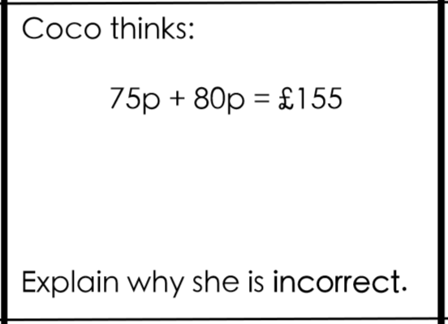
Twist it: Add amounts in pence Date:______

Slide 11
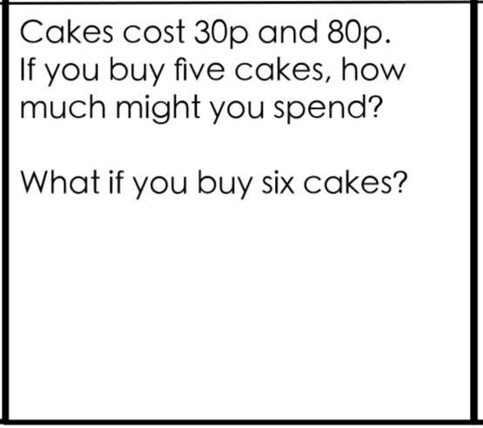
Explore it: Add amounts in pence Date:______

Slide 12
Step 3: Add amounts in pounds and pence

Slide 13
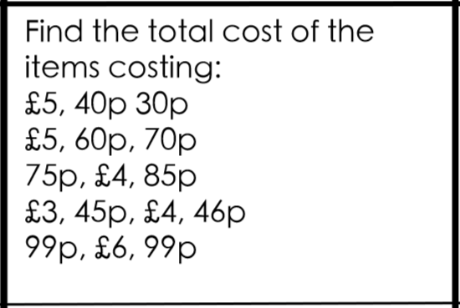
Do it: Add amounts in pounds and pence Date:______

Slide 14
Twist it: Add amounts in pounds and pence Date:______

Slide 15
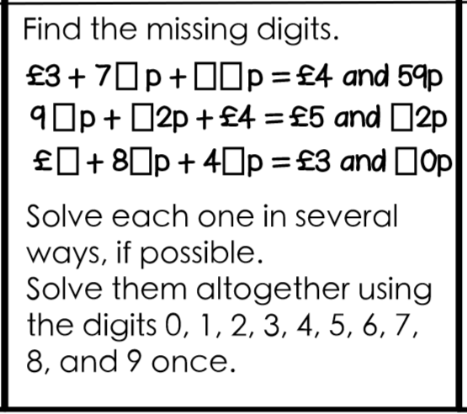
Explore it: Add amounts in pounds and pence Date:______

Slide 16
Step 4: Subtract pence from £2

Slide 17
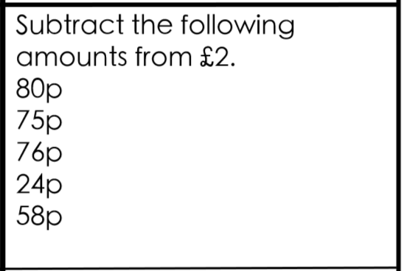
Do it: Subtract pence from £2 Date:______

Slide 18
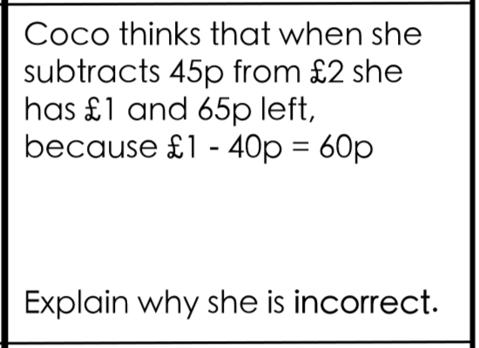
Twist it: Subtract pence from £2 Date:______

Slide 19
Explore it: Subtract pence from £2 Date:______

Slide 20
Step 5: Subtract pence from £5

Slide 21
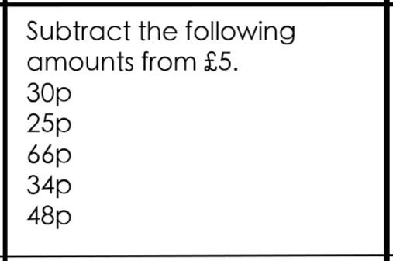
Do it: Subtract pence from £5 Date:______

Slide 22
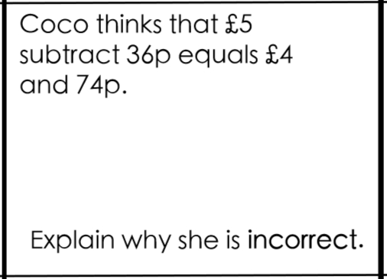
Twist it: Subtract pence from £5 Date:______

Slide 23
Explore it: Subtract pence from £5 Date:______

