Slide 1
Year 3
Summer Term
Maths Unit 1
Properties of shapes
Lines, 2D and 3D Shapes

Slide 2
Elicitation
What words do you know that link to 2D and 3D shapes?
Describe types of lines!
Describe a 2D shape.
What are the properties of a 3D shape?
What’s the difference between and line and a shape?

Slide 3
Teach it: Different types of lines
This is a horizontal line. It runs from left to right in a straight line. It is flat with no tilting up or down in gradient.
HINT: Think of the horizon. The horizon is where the Earth seems to meet the sky (imagine the sea against the sky). Horizon is in the word horizontal!
This is a vertical line. It goes straight up and down in a straight line.
This is a diagonal line. It looks like it is tilted and joins opposite corners of straight sided shapes such as squares and rectangles. It is always a straight line.

Slide 4
Step 1
identify and draw horizontal lines

Slide 5
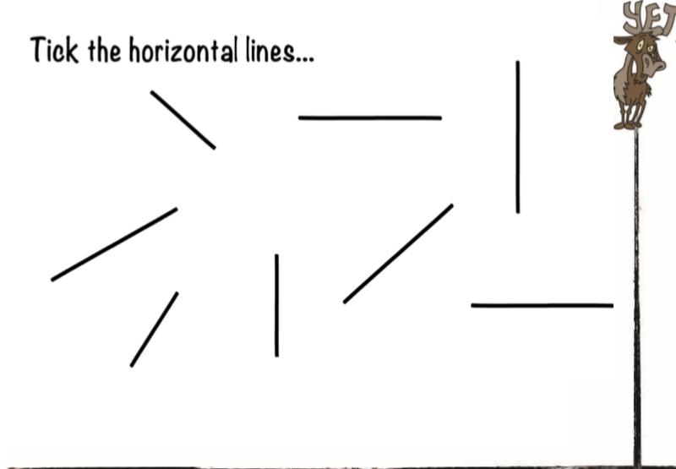
Do it: Identify and draw horizontal lines Date:______

Slide 6
Do it: Identify and draw horizontal lines Date:______

Slide 7
Twist it: Identify and draw horizontal lines Date:______

Slide 8
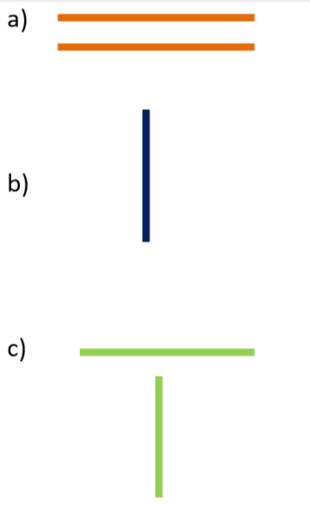
Explore it: Identify and draw horizontal lines Date:______
Explain which is different.

Slide 9
Step 2
identify and draw vertical lines

Slide 10
Do it: Identify and draw horizontal lines Date:______

Slide 11
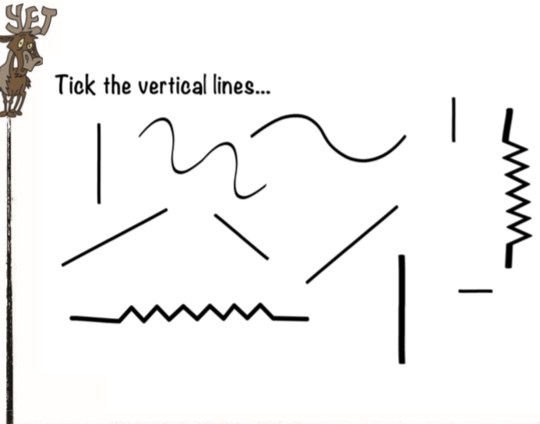
Do it: Identify and draw horizontal lines Date:______

Slide 12
Twist it: Identify and draw vertical lines Date:______

Slide 13
Explore it: Identify and draw vertical lines Date:______

Slide 14
Teach it: Parallel and perpendicular lines
These are parallel lines. Parallel lines are straight lines that never meet and are always the same distance apart.
These are perpendicular lines. They are straight lines that meet at a right angle.

Slide 15
Step 3
identify and draw parallel lines

Slide 16
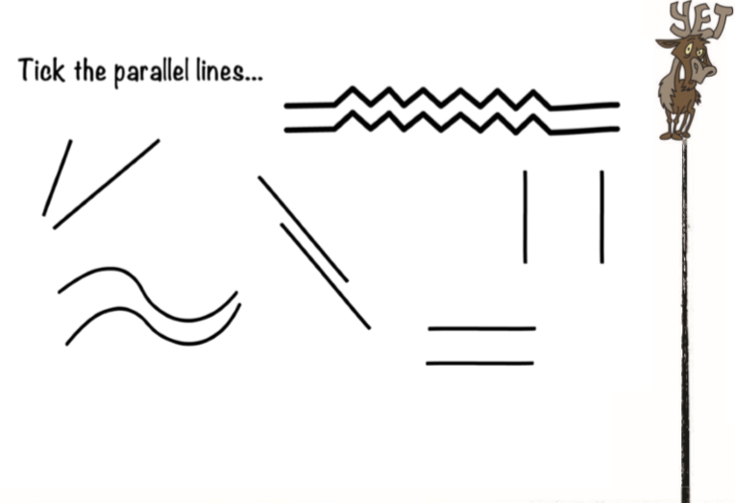
Do it: Identify and draw parallel lines Date:______

Slide 17
Do it: Identify and draw parallel lines Date:______

Slide 18
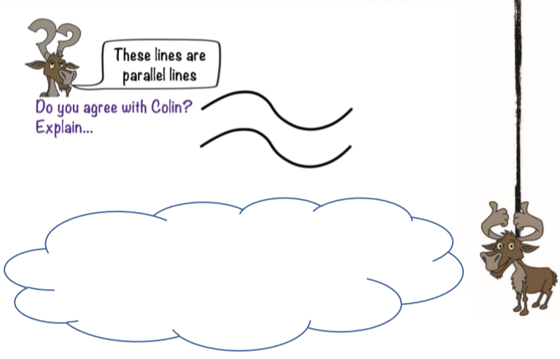
Twist it: Identify and draw parallel lines Date:______

Slide 19
Explore it: Identify and draw parallel lines Date:______

Slide 20
Step 4
identify and draw perpendicular lines

Slide 21
Do it: Identify and draw perpendicular lines Date:______

Slide 22
Do it: Identify and draw perpendicular lines Date:______

Slide 23
Twist it: Identify and draw perpendicular lines Date:______

Slide 24
Explore it: Identify and draw perpendicular lines Date:______

Slide 25
Step 5
Draw common 2D shapes

Slide 26
Do it: Draw common 2D shapes Date:______

Slide 27
Do it: Draw common 2D shapes Date:______
A Polygon is a shape where:
Each side is connected to the next one.
The sides don’t cross over each other.
It has at least 3 straight sides and 3 angles.
If it doesn’t follow all of these rules, then it is not a polygon.

Slide 28
Twist it : Draw common 2D shapes Date:______

Slide 29
Explore it: : Draw common 2D shapes Date:______

Slide 30
Step 6
Name and describe 3D shapes

Slide 31
Do it: : Name and describe 3D shapes Date:______

Slide 32
Do it: : Name and describe 3D shapes Date:______

Slide 33
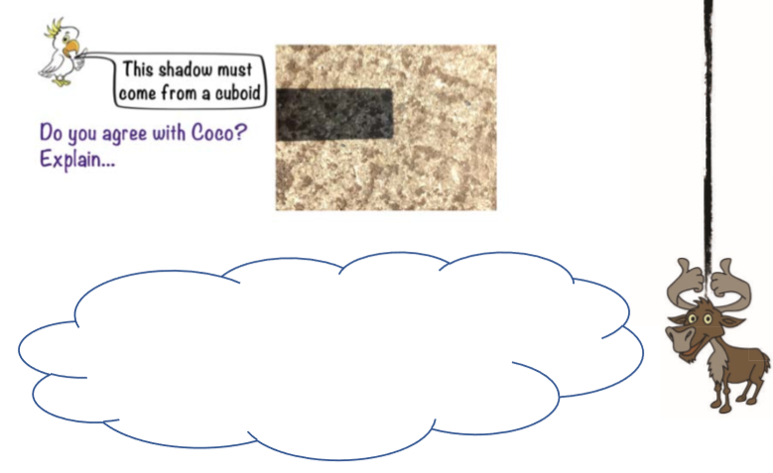
Twist it: : Name and describe 3D shapes Date:______

Slide 34
Explore it: : Make, name and describe 3D shapes Date:______
You could make your shapes using paper, plasticine, earth, clay, pastry, -whatever is to hand!
We’d love to see pictures if you have time!

Slide 35
Recap Properties of 2D and 3D shapes Date:______

