Slide 1
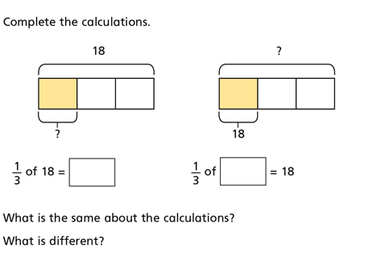
DO IT!

Slide 2
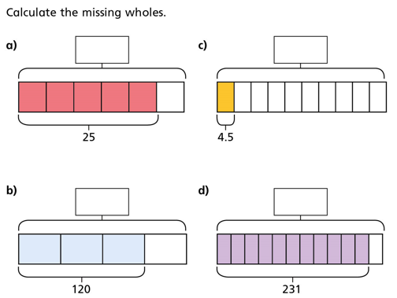
DO IT AGAIN!

Slide 3
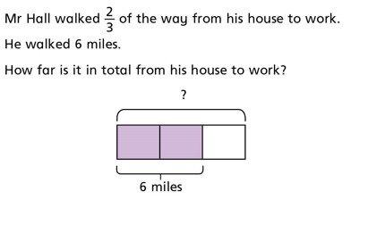
TWIST IT!
1. What marvellous mistake might somebody make with this question?
2. Why on earth did Mr Hall only walk $\frac{2}{3}$of the way?
3. What do you think he did after walking two thirds of the way there?

Slide 4
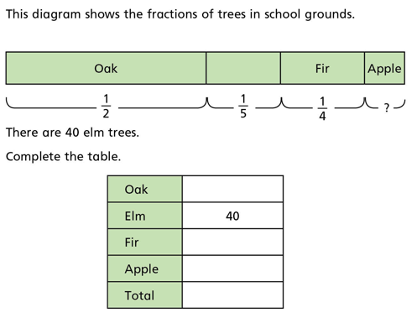
EXPLORE IT!

