Slide 1
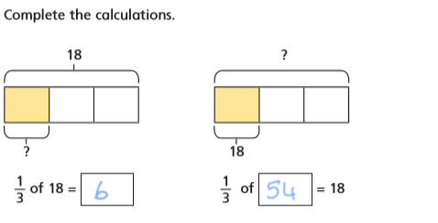
DO IT!

Slide 2
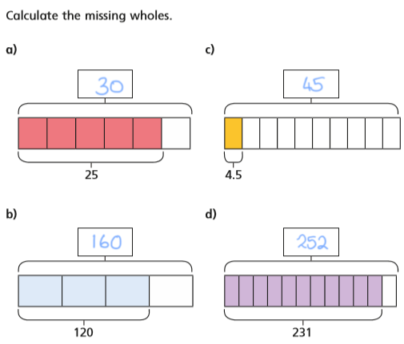
DO IT AGAIN!

Slide 3
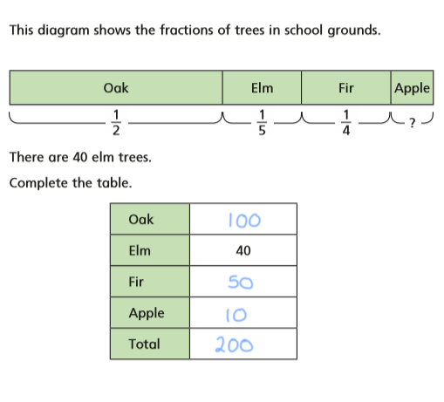
EXPLORE IT!

