Slide 3
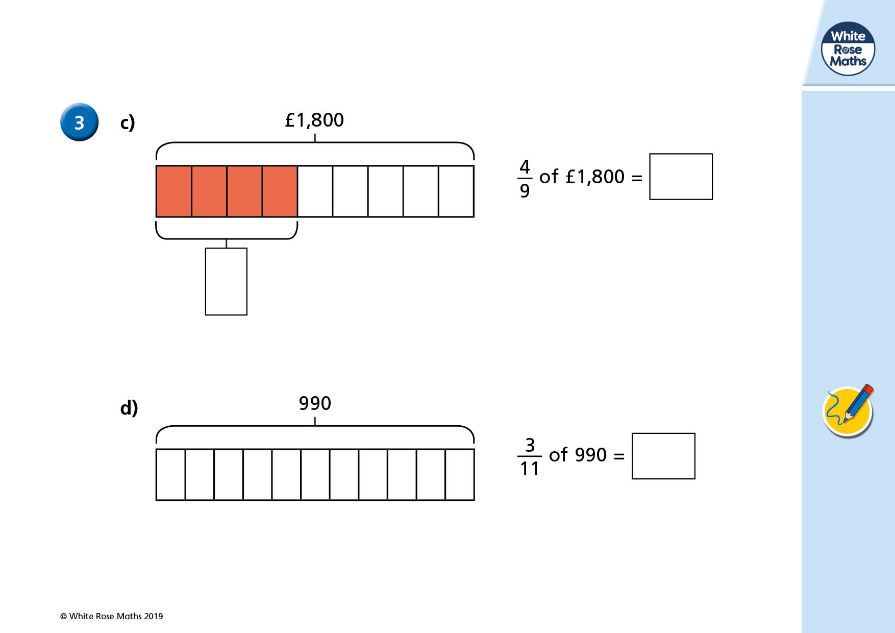

Slide 4
To work out fractions of amounts, you can draw a bar model like this, or if you understand that then the quickest way would be divide the total amount by the denominator then multiply that answer by the numerator. That is basically doing what the bar model shows, but quicker.
Here’s how:
1800 ÷ 9 = 200 (you could use your multiplication knowledge for this or short division).
200 is $\frac{1}{9}$ of 1800.
But we want to know what $\frac{4}{9}$ is so we need to multiply 200 by 4:
200 x 4 = 800 so $\frac{4}{9}$ of 1800 = 800

Slide 5
DO IT!

Slide 6
TWIST IT!
Gary says that there are 160 juniors because 480 ÷ 3 = 160.
Is he correct? Explain your answer.

Slide 7
EXPLORE IT!

Slide 8
EXPLORE IT!

Slide 9
EXPLORE IT!

