Slide 1
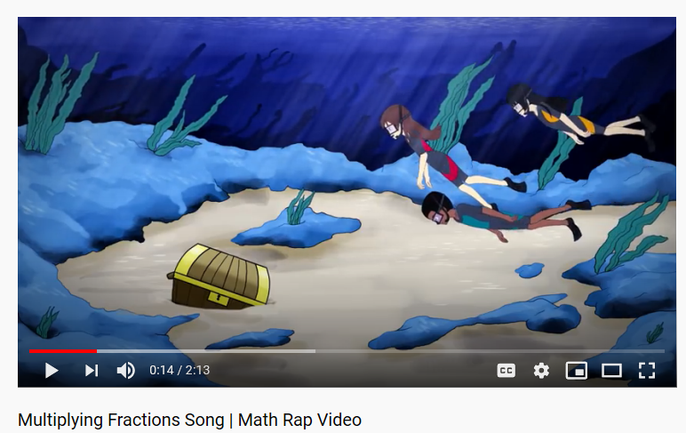
LOCKDOWN EARWORM IT! Remember this?
If you and your family have completely lost the plot, why not perform this song like that family who did One More Day from Les Miserables and release it on to the internet for evermore. You could become briefly famous.
Or infamous.
(https://www.youtube.com/watch?v=CcDGRLosAf0)

Slide 2
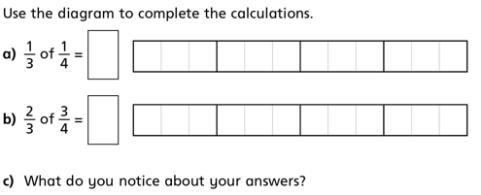

Slide 3
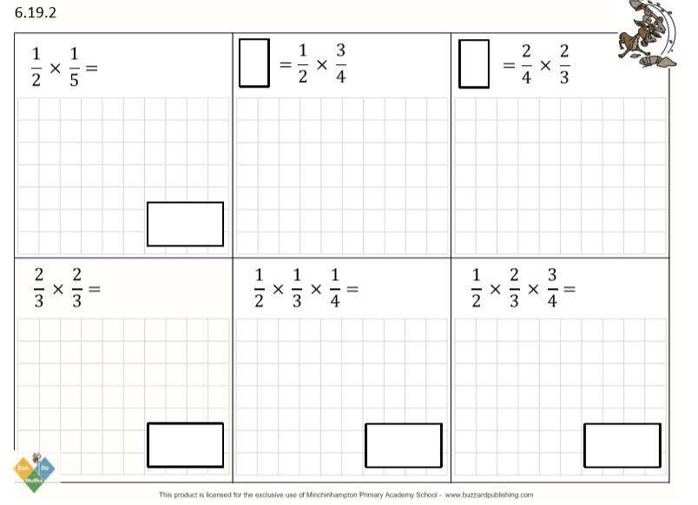
DO IT!

Slide 4
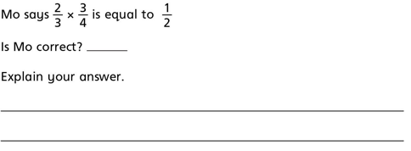
TWIST IT!

Slide 5
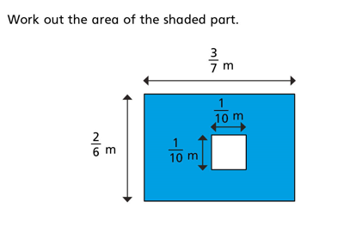
EXPLORE IT!

Slide 6
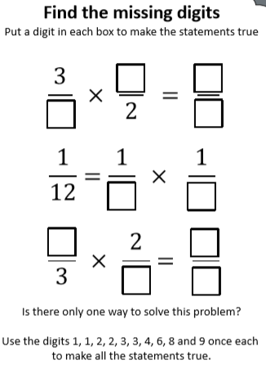
EXPLORE IT!

