Slide 1
Subracting fractions is very similar to adding them - we need to make sure the pieces of each fraction are the same size (the denominators must be the same). To do this you need to work out the highest common factor or lowest common multiple of the denominators.
For example:$\frac{8}{12}− \frac{3}{9}$
Both fractions here can be converted so that the denominator is three (thirds) because 3 is the HCF.
$\frac{8}{12}− \frac{3}{9}$ = $\frac{?}{3}$ $− \frac{?}{3}$
Whatever you do to the denominator you do to the numerator, so
$\frac{8}{12}− \frac{3}{9}$ = $\frac{2}{3} − \frac{1}{3}$then you simply subtract the numerators so $\frac{2}{3} − \frac{1}{3}$ = $\frac{1}{3}$
÷ 4
÷ 3
÷ 4
÷ 3

Slide 2
Subracting fractions is very similar to adding them - we need to make sure the pieces of each fraction are the same size (the denominators must be the same). To do this you need to work out the highest common factor or lowest common multiple of the denominators.
For example: $\frac{7}{8}\text{ − }\frac{4}{5}$
Both fractions here can be converted so that the denominator is three (thirds) because 3 is the HCF.
$\frac{7}{8}\text{ − }\frac{4}{5}$ = $\frac{?}{40}$ $− \frac{?}{40}$
Whatever you do to the denominator you do to the numerator, so
$\frac{7}{8}\text{ − }\frac{4}{5}$ = $\frac{35}{40} − \frac{32}{40}$then you simply subtract the numerators so $\frac{35}{40} − \frac{32}{40}$ = $\frac{3}{40}$
X 5
X 8
X 5
X 8

Slide 3
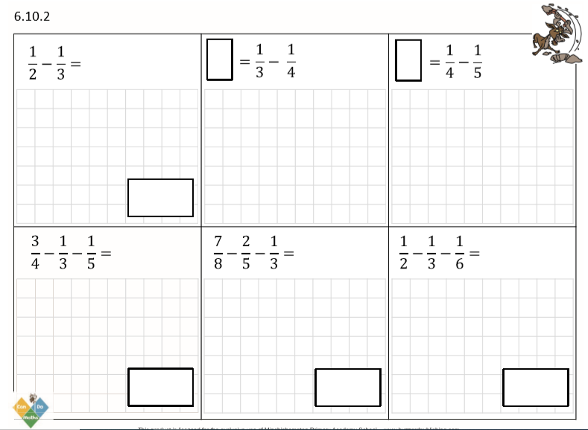
DO IT!

Slide 4
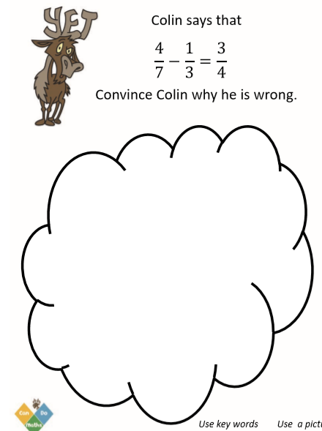
TWIST IT!

Slide 5
EXPLORE IT!

Slide 6
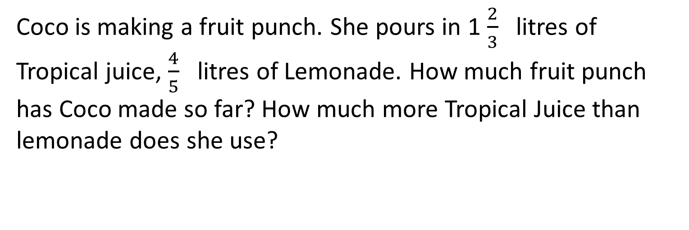
SOMETHING EXTRA?
Colin weighs 165 $\frac{2}{3}$ kg. Coco weighs $\frac{5}{8}$ kg. What is the difference between their weights?
Coco is making a fruit punch. She pours in 1 $\frac{2}{3}$ litres of Tropical juice, $\frac{4}{5}$ litres of Lemonade. How much fruit punch has Coco made so far? How much more Tropical Juice than lemonade does she use?
Create your own problem for 2 $\frac{1}{4}$ subtract 1 $\frac{1}{3}$

