Slide 1
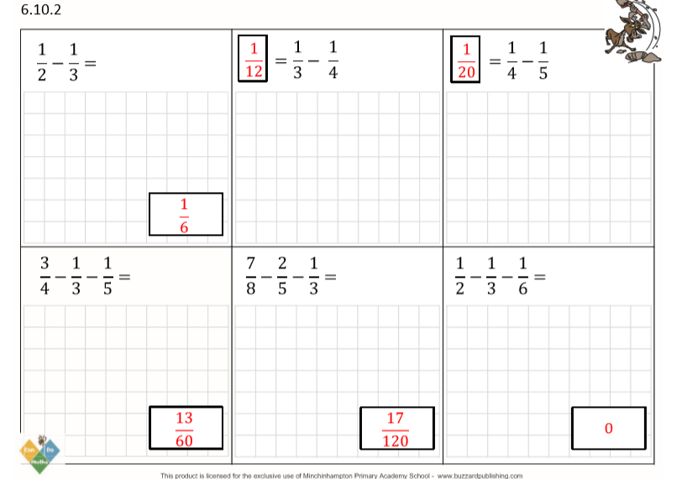

Slide 2
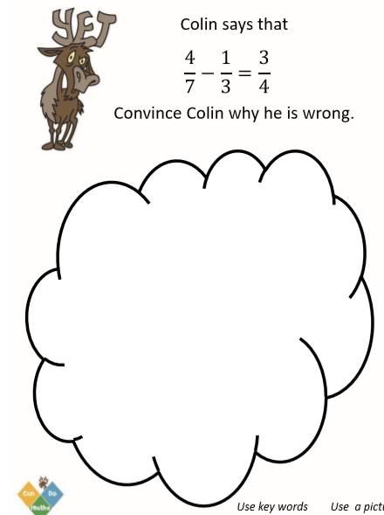
7 x 3 = 21
4 x 3 = 12
3 x 7 = 21
1 x 7 = 7
Colin didn’t convert the fractions so they had the same denominator.
He should have converted them to:
$\frac{4}{7}$-$\frac{1}{3}$=$\frac{12}{21}$-$\frac{7}{21}$=$\frac{5}{21}$

Slide 3
