Slide 1
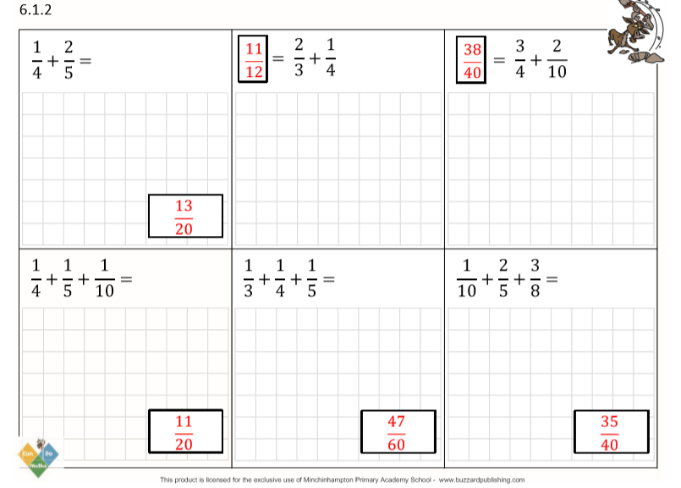

Slide 2
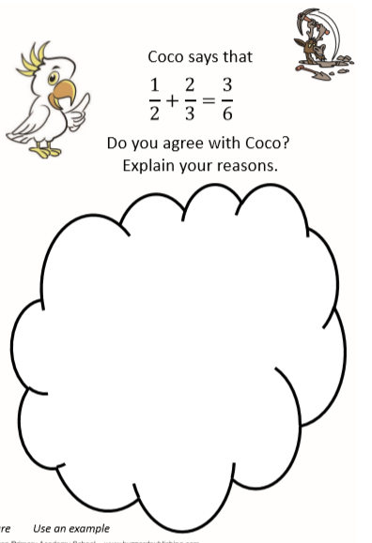
Coco made a mistake: she converted both fractions to sixths by multiplying the denominators (that was correct) but then she just added the numerators as they were without converting them.
The answer should have been:
$\frac{3}{6}$+$\frac{4}{6}=\frac{7}{6}=1\frac{1}{6}$

Slide 3
