Slide 1
To add two fractions we need to make sure the pieces of each fraction are the same size – the denominators must be the same. To do this you need to work out the highest common factor or lowest common multiple of the denominators.
For example:$\frac{3}{9}$ +$\frac{8}{12}$
Both fractions here can be converted so that the denominator is three (thirds) because 3 is the HCF.
$\frac{3}{9}$ +$\frac{8}{12}$ = $\frac{?}{3}$ +$\frac{?}{3}$
Whatever you do to the denominator you do to the numerator, so
$\frac{3}{9}$ +$\frac{8}{12}$ = $\frac{1}{3}$ +$\frac{2}{3}$then you simply add the numerators so $\frac{1}{3}$ +$\frac{2}{3}$ = $\frac{3}{3}$ = 1
÷ 3
÷ 4
÷ 3
÷ 4

Slide 2
To add two fractions we need to make sure the pieces of each fraction are the same size – the denominators must be the same. To do this you need to work out the highest common factor or lowest common multiple of the denominators.
For example:$\frac{4}{5}$ +$\frac{7}{8}$
Both fractions here can be converted so that the denominator is 40 because 40 is the LCM.
$\frac{4}{5}$ +$\frac{7}{8}$ = $\frac{?}{40}$ +$\frac{?}{40}$
Whatever you do to the denominator you do to the numerator, so
$\frac{4}{5}$ +$\frac{7}{8}$ = $\frac{32}{40}$ +$\frac{35}{40}$then you simply add the numerators so $\frac{32}{40}$ +$\frac{35}{40}$ =$\frac{67}{40}$ = 1 $\frac{27}{40}$
X 8
X 5
x8
X 5

Slide 3
Warm-up:
Biggest Wins - A Fraction Game
You need: 1 - 10 cards (At the back of the pack)
To play: Shuffle the cards. Deal four cards to each player.
Each player makes two proper fractions then adds them to find a total.
The player with the largest total scores a point.
To win: The winner is the first player to score five points.
Play again, but make improper fractions this time.

Slide 4
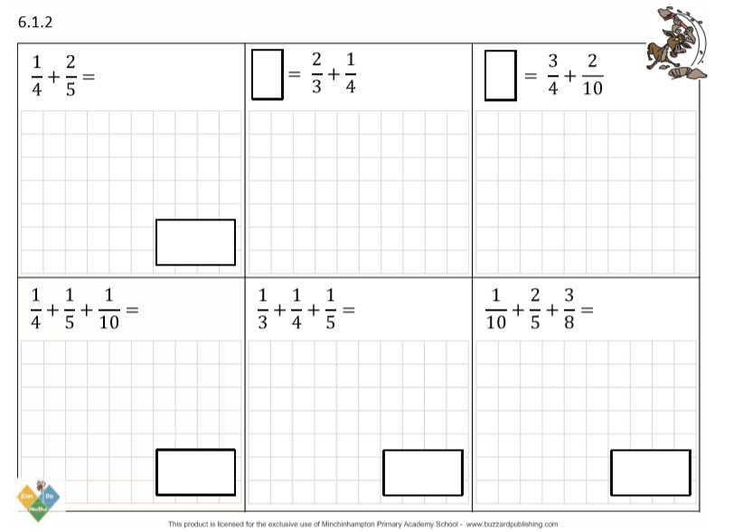
DO IT!

Slide 5
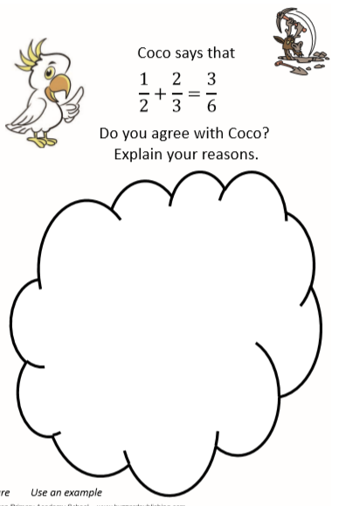
TWIST IT!

Slide 6
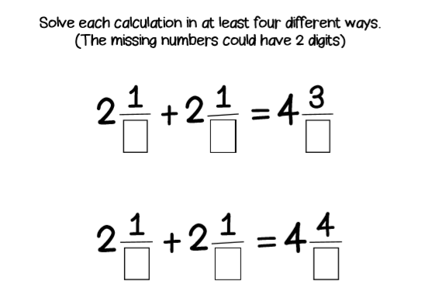
EXPLORE IT!

