Slide 1
Put$either<or >$ between these pairs of fractions.

Slide 4
To compare different fractions, we either need to draw a bar (or pizza) model OR convert the fractions so they have the same denominator (are divided into the same size pieces).
For example:
$\frac{4}{5}$ and $\frac{6}{8}$
Draw a bar model (the bars should be the same size and the pieces equal):
Or convert the fractions so they have the same denominator:
The lowest common multiple of 5 and 8 is 40 so $\frac{4}{5}$ and $\frac{6}{8}$ can be converted to:
$\frac{32}{40}$ and $\frac{30}{40}$ (remember that you multiply / divide the numerator by the same amount as the denominator).
$\frac{32}{40}$ $>\frac{30}{40} so \frac{4}{5}$ $>\frac{6}{8}$

Slide 6
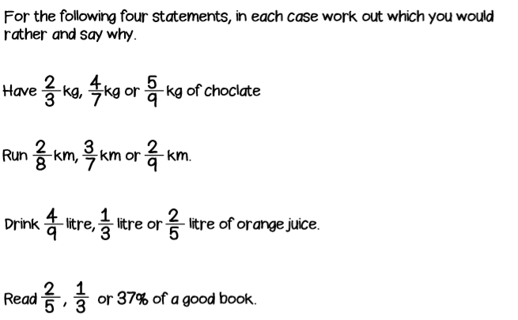
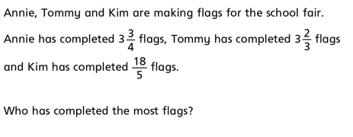
DO IT!
1.
2.
3.
4.
5.

Slide 7
TWIST IT!
>
To compare these two fractions, Gary converted $\frac{19}{5}$ and $\frac{19}{6}$ so they had the same denominator:
$\frac{19}{5}$ = $\frac{114}{30} and \frac{19}{6}$ = $\frac{95}{30}$
Was he right?
Do you agree with his method?
5 x 6 = 30
19 x 6 = 114
6 x 5 = 30
19 x 5 = 95

Slide 8
EXPLORE IT!
Can you solve this puzzle in several different ways?

Slide 9
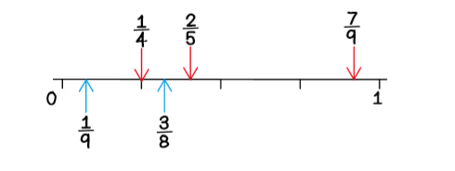
Want to do more? Play…
Plot It - A Fraction Game
You need: 1 - 10 cards (At the back of the pack) 0 - 1 blank number line
To play: Shuffle the cards and place them in a deck face down.
Player 1: Pick two cards from anywhere in the deck.
Make a proper fraction. Plot your fraction approximately on the number line.
Replace the cards in the deck and shuffle it.
Player 2: Pick two cards from anywhere in the deck.
Make a proper fraction. Plot your fraction approximately on the number line.
Continue taking turns to make and plot fractions.
To win: The winner is the first player to plot four points without their opponent’s points in between.
For example: After 3 turns for player 1 and 2 turns for player 2 it could look like the diagram below.

