Slide 1
Year 3
Summer Term
Maths Unit 2
PROPERTIES OF SHAPES:
Angles

Slide 2
Subject knowledge links:
What is an Angle? https://www.bbc.co.uk/bitesize/topics/zb6tyrd/articles/zg68k7h
What are parallel and perpendicular lines? https://www.bbc.co.uk/bitesize/topics/zb6tyrd/articles/zp327hv

Slide 3
Elicitation
What words do you know that link to angles?
Describe a shape.
Describe and angle.
What are the properties of angles?
What’s the difference between and angle and a shape?

Slide 4
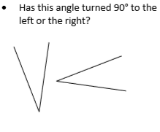
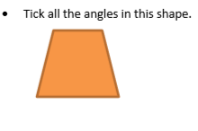
Do it: Understand that angle is a description of a turn Date:______
ACTIVITY:
Look at the labels on the walls.
NORTH, SOUTH, EAST and WEST.
Turn to the WEST
How many quarter turns have you made?
Try some questions out on your talk partner.

Slide 5
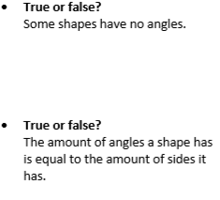
Twist it: Understand that angle is a description of a turn. Date:______

Slide 6
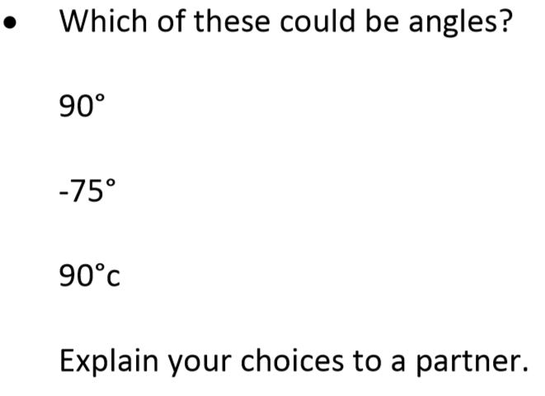
Discuss it: Understand that angle is a description of a turn. Date:______

Slide 7
Explore it: Understand that angle is a description of a turn. Date:______

Slide 8
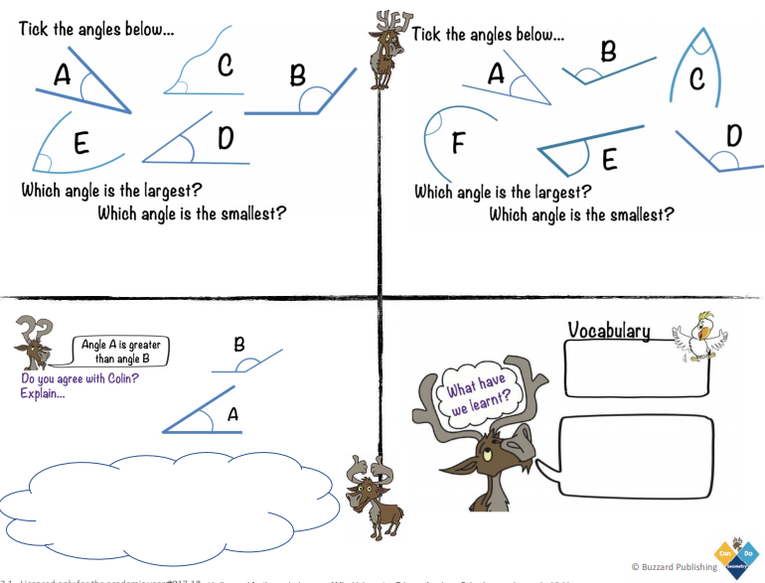
Do it: Understand that angles are a feature of shapes Date:______

Slide 9
Twist it: Understand that angles are a feature of shapes Date:___________

Slide 10
Explore it: Understand that angles are a feature of shapes Date:______

Slide 11
RECAP IT: Understand the angle outside Date:_______

