Slide 1
Year 3 and 4
Summer Term
Week 3
PROPERTIES OF SHAPES:
Angles

Slide 2
Subject knowledge links:
What is an Angle? https://www.bbc.co.uk/bitesize/topics/zb6tyrd/articles/zg68k7h
What are parallel and perpendicular lines? https://www.bbc.co.uk/bitesize/topics/zb6tyrd/articles/zp327hv
Use Year 3 Summer Term Maths Unit 2 as revision if needed.

Slide 3
GEOMETRY PROPERTIES OF SHAPES ANGLES
SUMMER TERM 2020
Suggested Manageable Steps
Step 1 Identify acute angles Step 2 Identify obtuse angles Step 3 Identify acute angles in shapes Step 4 Identify obtuse angles in shapes Step 5 Identify right angles in shapes Step 6 Compare angles up to two right angles in size Step 7 Order angles up to two right angles in size Use multiplication or division to solve scaling or correspondence problems

Slide 4
Elicitation
What words do you know that link to angles?
Describe a shape.
Describe and angle.
What are the properties of angles?
What’s the difference between and angle and a shape?

Slide 5
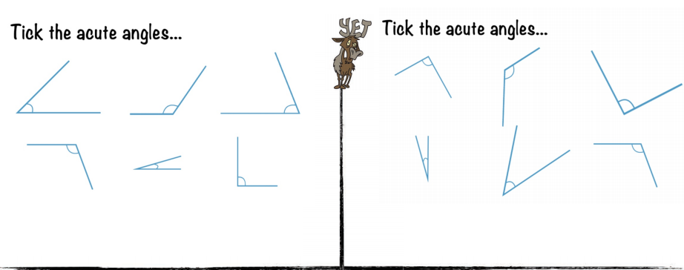
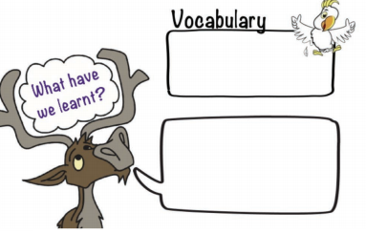
Do it: Identify acute angles Date:_____________

Slide 6
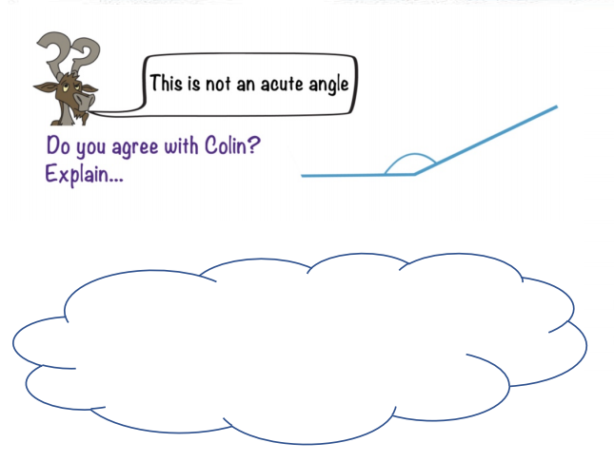
Twist it: Identify acute angles Date:_____________

Slide 7
Explore it: Identify acute angles Date:_____________

Slide 8
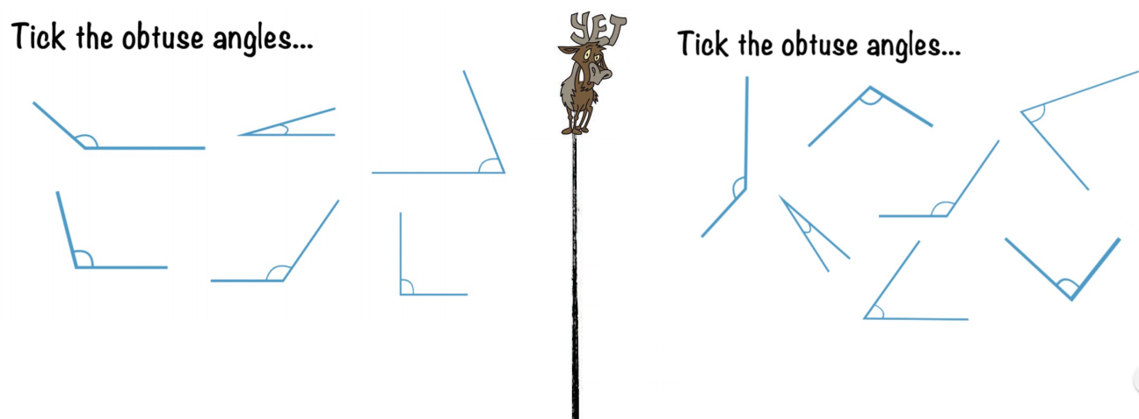
Do it: Identify obtuse angles Date:_____________

Slide 9
Twist it: Identify obtuse angles Date:_____________

Slide 10
Explore it: Identify obtuse angles Date:_____________

Slide 11
Do it: Identify acute angles in shapes Date:_____________

Slide 12
Do it: Identify acute angles in shapes Date:_____________

Slide 13
Twist it: Identify acute angles in shapes Date:_____________

Slide 14
Explore it: Identify acute angles in shapes Date:_____________

Slide 15
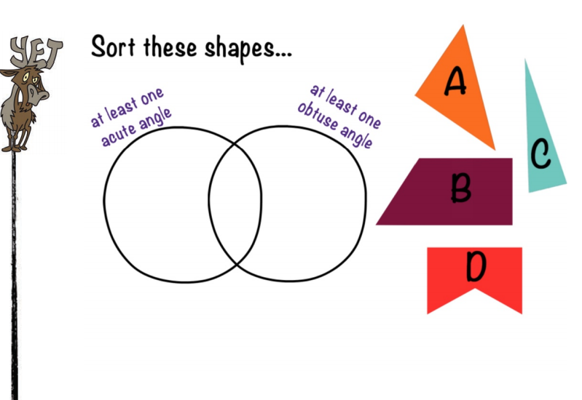
Do it: Identify obtuse angles in shapes Date:_____________

Slide 16
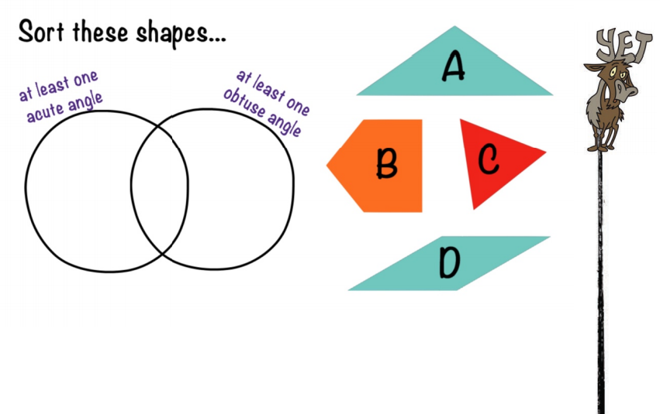
Do it: Identify obtuse angles in shapes Date:_____________

Slide 17
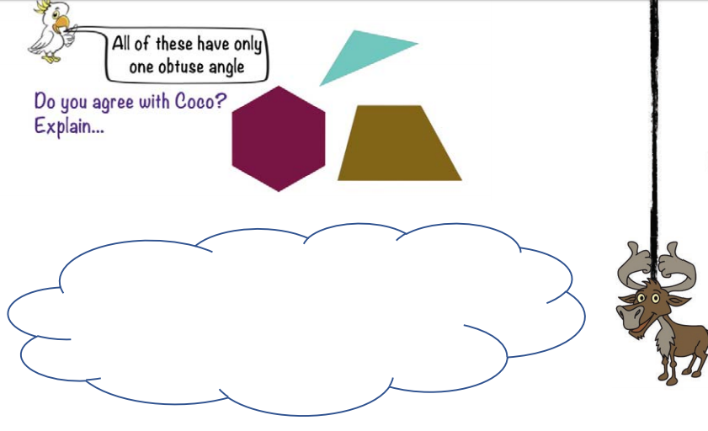
Twist it: Identify obtuse angles in shapes Date:_____________

Slide 18
Explore it: Identify obtuse angles in shapes Date:_____________

Slide 19
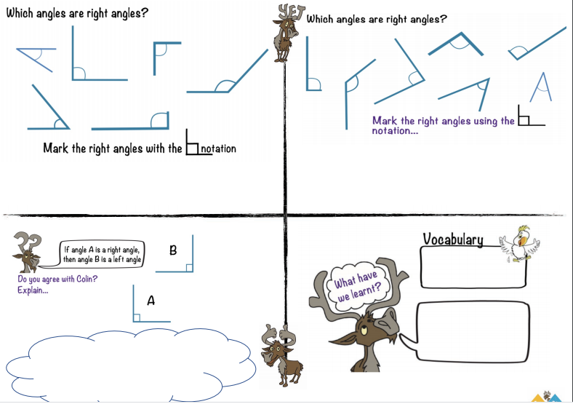
Do it: Properties of right angles Date:______

Slide 20
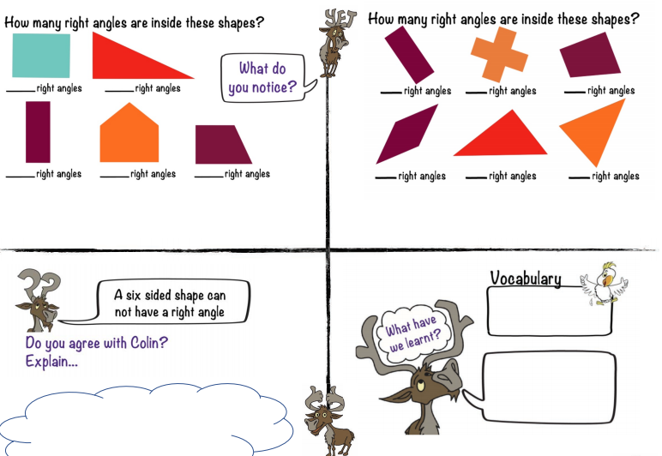
Twist it: Properties of right angles Date:___________

Slide 21
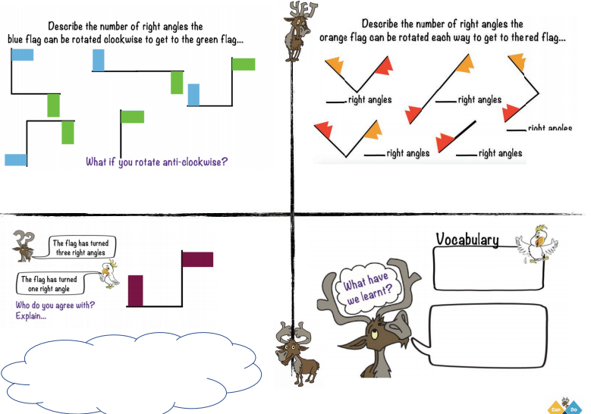
Explore it: Properties of right angles Date:______

Slide 22
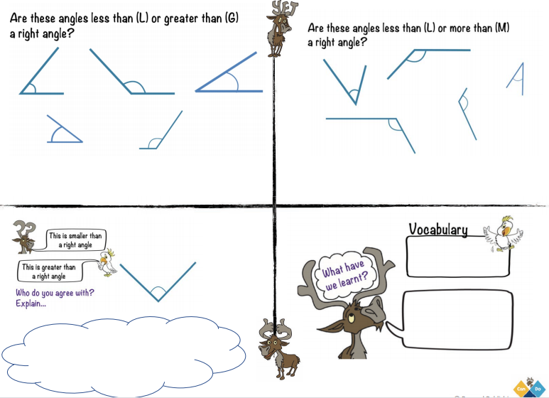
RECAP IT: Identify angles that are less than or greater than a right angle Date:_______

Slide 23
Extra Explore it: Properties of right angles Date:______

Slide 24
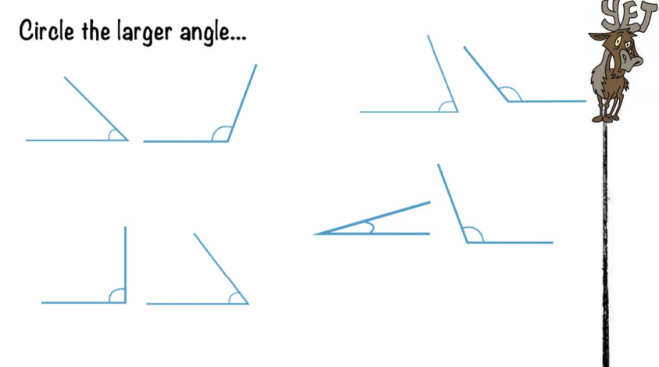
Do it: Compare angles up to two right angles in size Date________

Slide 25
Do it: Compare angles up to two right angles in size Date________

Slide 26
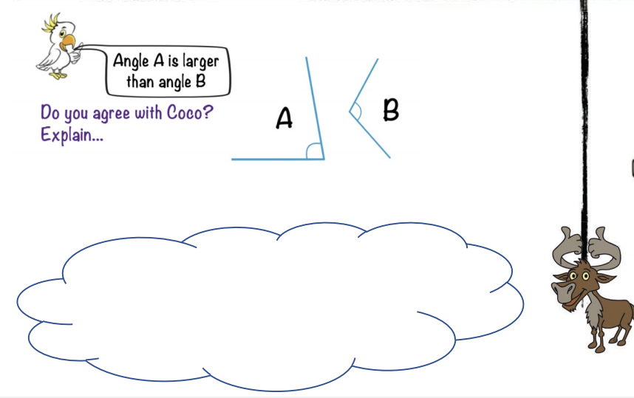
Twist it: Compare angles up to two right angles in size Date________

Slide 27
Explore it: Compare angles up to two right angles in size Date________

Slide 28
Do it: Order angles up to two right angles in size Date________

Slide 29
Do it: Order angles up to two right angles in size Date________

Slide 30
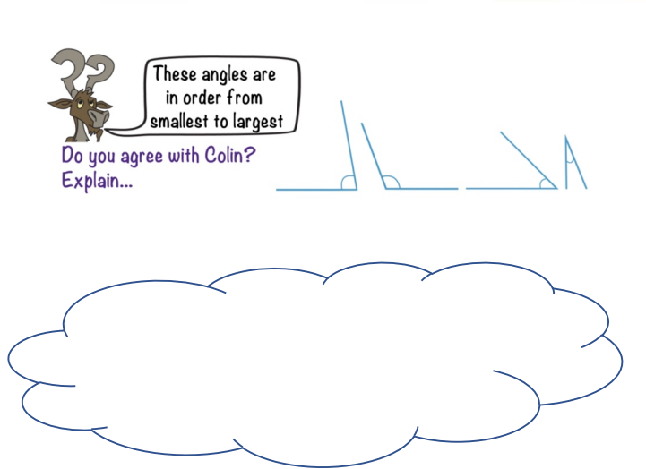
Twist it: Order angles up to two right angles in size Date________

Slide 31
Explore it: Order angles up to two right angles in size Date________

Slide 32
Recap Geometric Properties of Angles Date:______

