Slide 1
https://www.youtube.com/watch?v=9dYXfZZsbzc (watch this fun song to remind you of the strategy )
Long Multiplication

Slide 2
Long Multiplication
How do I answer....
23 x 19 ?

Slide 3
Long Multiplication
Complete the questions:
23 x 18
42 x 27
118 x 4
123 x 24
1. 414
2. 1134
3. 472
4. 2952

Slide 4
Decimal Numbers
Have a go first (on scrap paper) 2.34 x 1.2=

Slide 5
Multiplying
How would we do?
8 x 0.4?
0.9 x 0.6?
0.18 x 2.4?

Slide 6
Questions- choose at least 5 from across the colours
Green
7 x 0.6
4.2
2. 3 x 0.9
2.7
3. 11 x 0.5
5.5
4. 12 x 1.3
15.6
9 x 0.14
1.26
Amber
0.9 x 0.5
0.45
2. 1.3 x 2.5
3.25
3. 0.7 x 3.4
2.38
4. 4.2 x 3.6
15.12
5. 5.3 x 7.2
38.16
Red
0.11 x 0.3
0.033
2. 1.32 x 2.2
2.904
3. 0.27 x 1.11
0.2997
4. 2.34 x 0.18
0.4212
1.08 x 0.12
0.1296

Slide 7
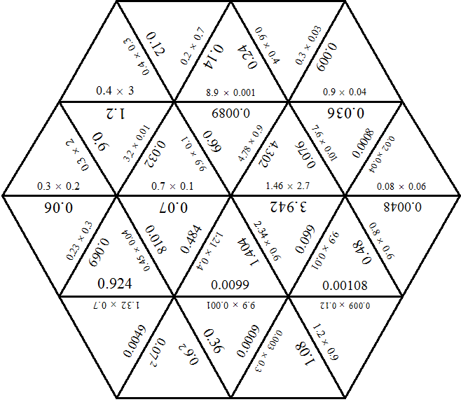
Notes:
You could print this off – cut up and try to put back together again …… if you fancy it?

Slide 8
RIGHT OR WRONG?
Question 1
0.8 x 0.4 = 0.32
RIGHT

Slide 9
RIGHT OR WRONG?
Question 2
0.3 x 0.5 = 1.5
WRONG

Slide 10
RIGHT OR WRONG?
Question 3
0.5 x 0.6 = 30
WRONG

Slide 11
RIGHT OR WRONG?
Question 4
0.1 x 0.1 = 0.01
RIGHT

Slide 12
RIGHT OR WRONG?
Question 5
0.7 x 0.9 = 0.63
RIGHT

Slide 13
RIGHT OR WRONG?
Question 6
0.8 x 0.2 = 1.6
WRONG

Slide 14
RIGHT OR WRONG?
Question 7
0.3 x 0.3 = 0.09
RIGHT

Slide 15
RIGHT OR WRONG?
Question 8
0.8 x 0.7 = 0.056
WRONG

