Slide 1
Spot the difference!
Can you remember what it means?

Slide 2
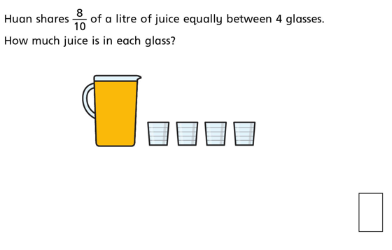
$$\frac{1}{5}$$
$\frac{8}{10}$ ÷ 4 $=$ $\frac{8}{10}$ ÷ $\frac{4}{1}=\frac{8}{10} \text{x} \frac{1}{4 }=\frac{8}{40}\text{= }\frac{2}{10}\text{= }\frac{1}{5}$
$$Keep the first fraction the same, change the divide to multiply and flip the second fraction$$

Slide 3
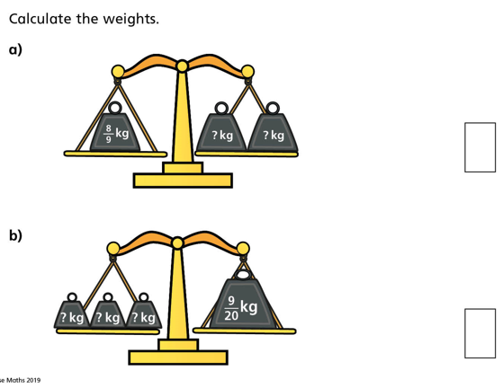

Slide 4
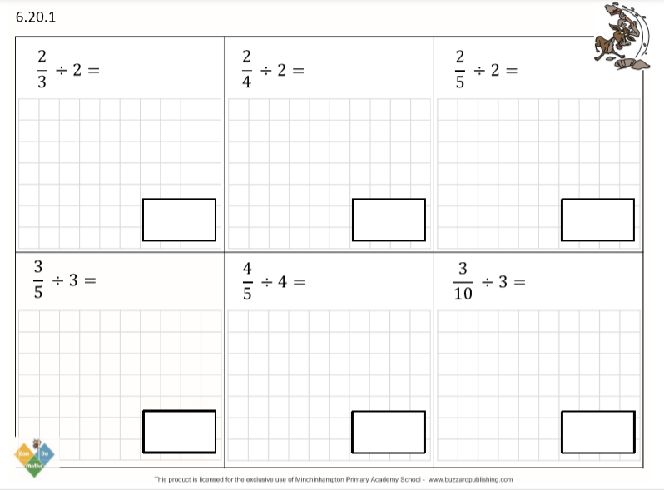
DO IT!

Slide 5
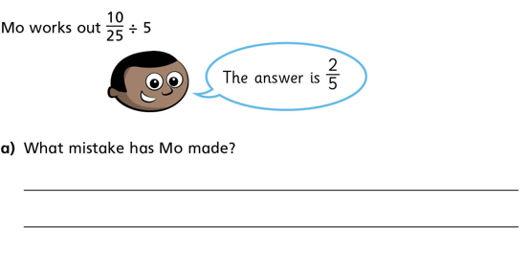
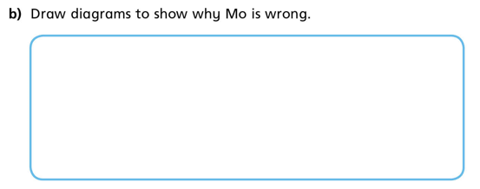
TWIST IT!

Slide 6
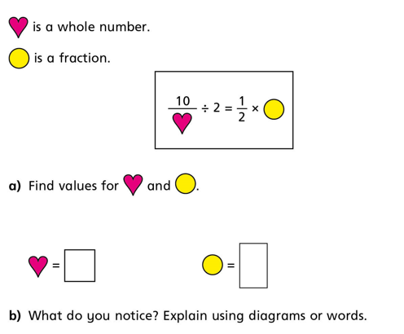
EXPLORE IT!

Slide 7
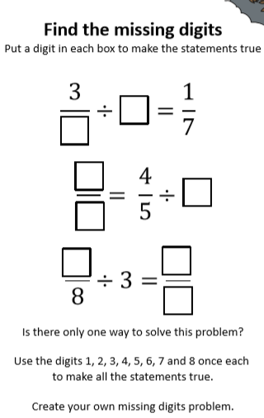
EXPLORE IT!

