Slide 1
Chris Ofili
This PowerPoint is all about Chris Ofili. We would usually spend 45 minutes to an hour a week doing art in school. Often we start something one week and continue it the next. Therefore, when you reach the last slide, it doesn’t look like there is a lot to do but we would expect each task to take 2-3 weeks! We look forward to seeing your artwork!
Enjoy learning about Chris Ofili!

Slide 2
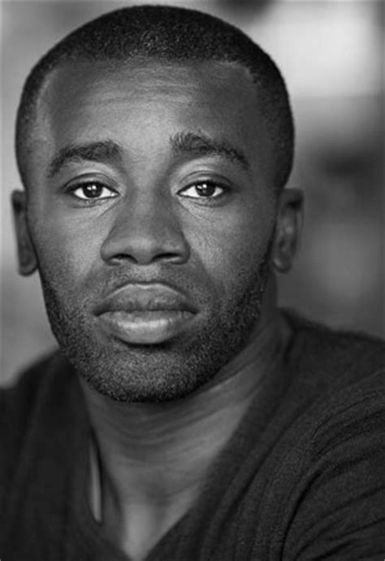
Chris Ofili
turner prize winner 1998

Slide 3
Chris Ofili is a British painter who was born in Manchester, October 1968; he has Nigerian heritage. Chris studied at the Chelsea school of art, and then from 1991-93, at the royal college of art. In 1992 Chris was awarded a scholarship to Zimbabwe, which deeply influenced his painting.

Slide 4
When chris ofili won the turner prize there was some controversy… Some people found his art shocking, and expressed that art had become ‘a pile of poo’!

Slide 5
This is partly because Chris ofili used elephant dung in, & often to support, his paintings.

Slide 6
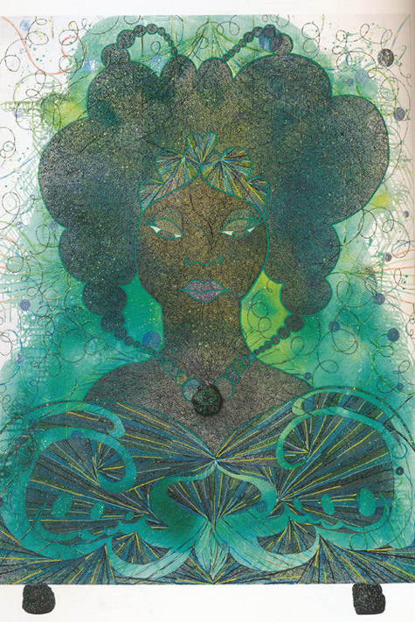

Slide 7
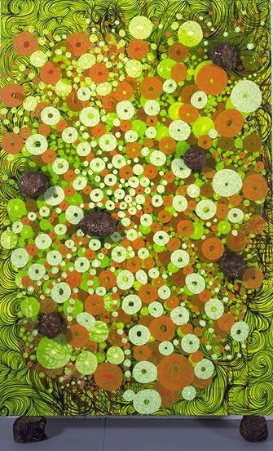
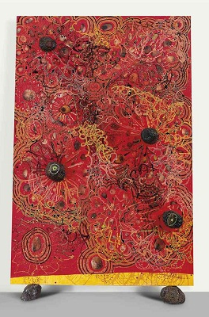
Chris felt that supporting his paintings on balls of dung linked them to the Earth, and was a more relaxed approached.
He felt that pinning his paintings to walls was like a crucifixion.

Slide 8
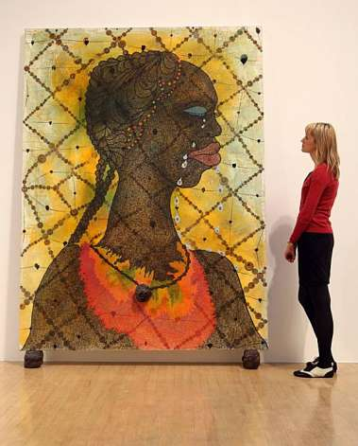
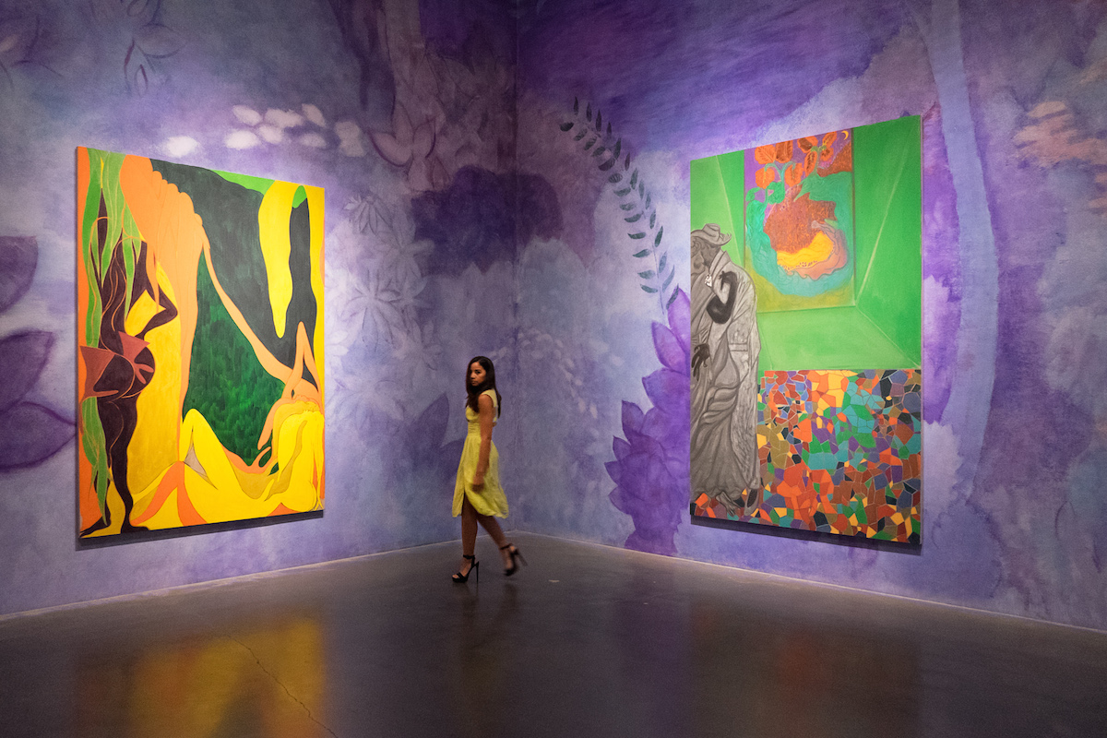
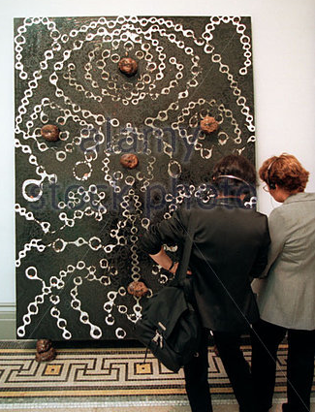
The dung used by ofili was CAREFULLY prepared to reduce smell and decomposition.
Ofili’s paintings are very large.

Slide 9
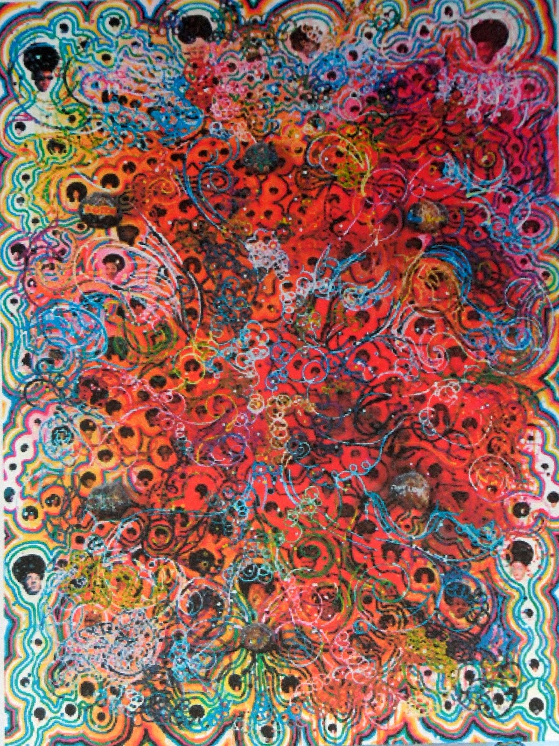
Chris’ art is very varied, but often large and brightly coloured, using paint, glitter and collage.
Much of his art is inspired by African culture, stereotypes, religion and identity.

Slide 10
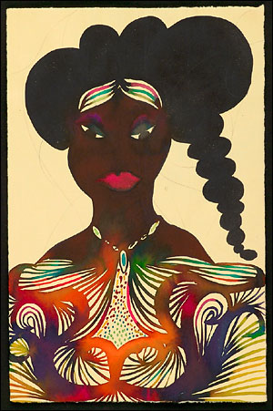
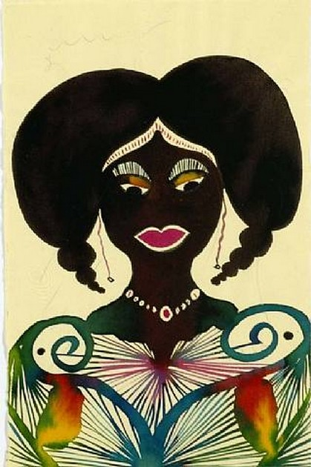
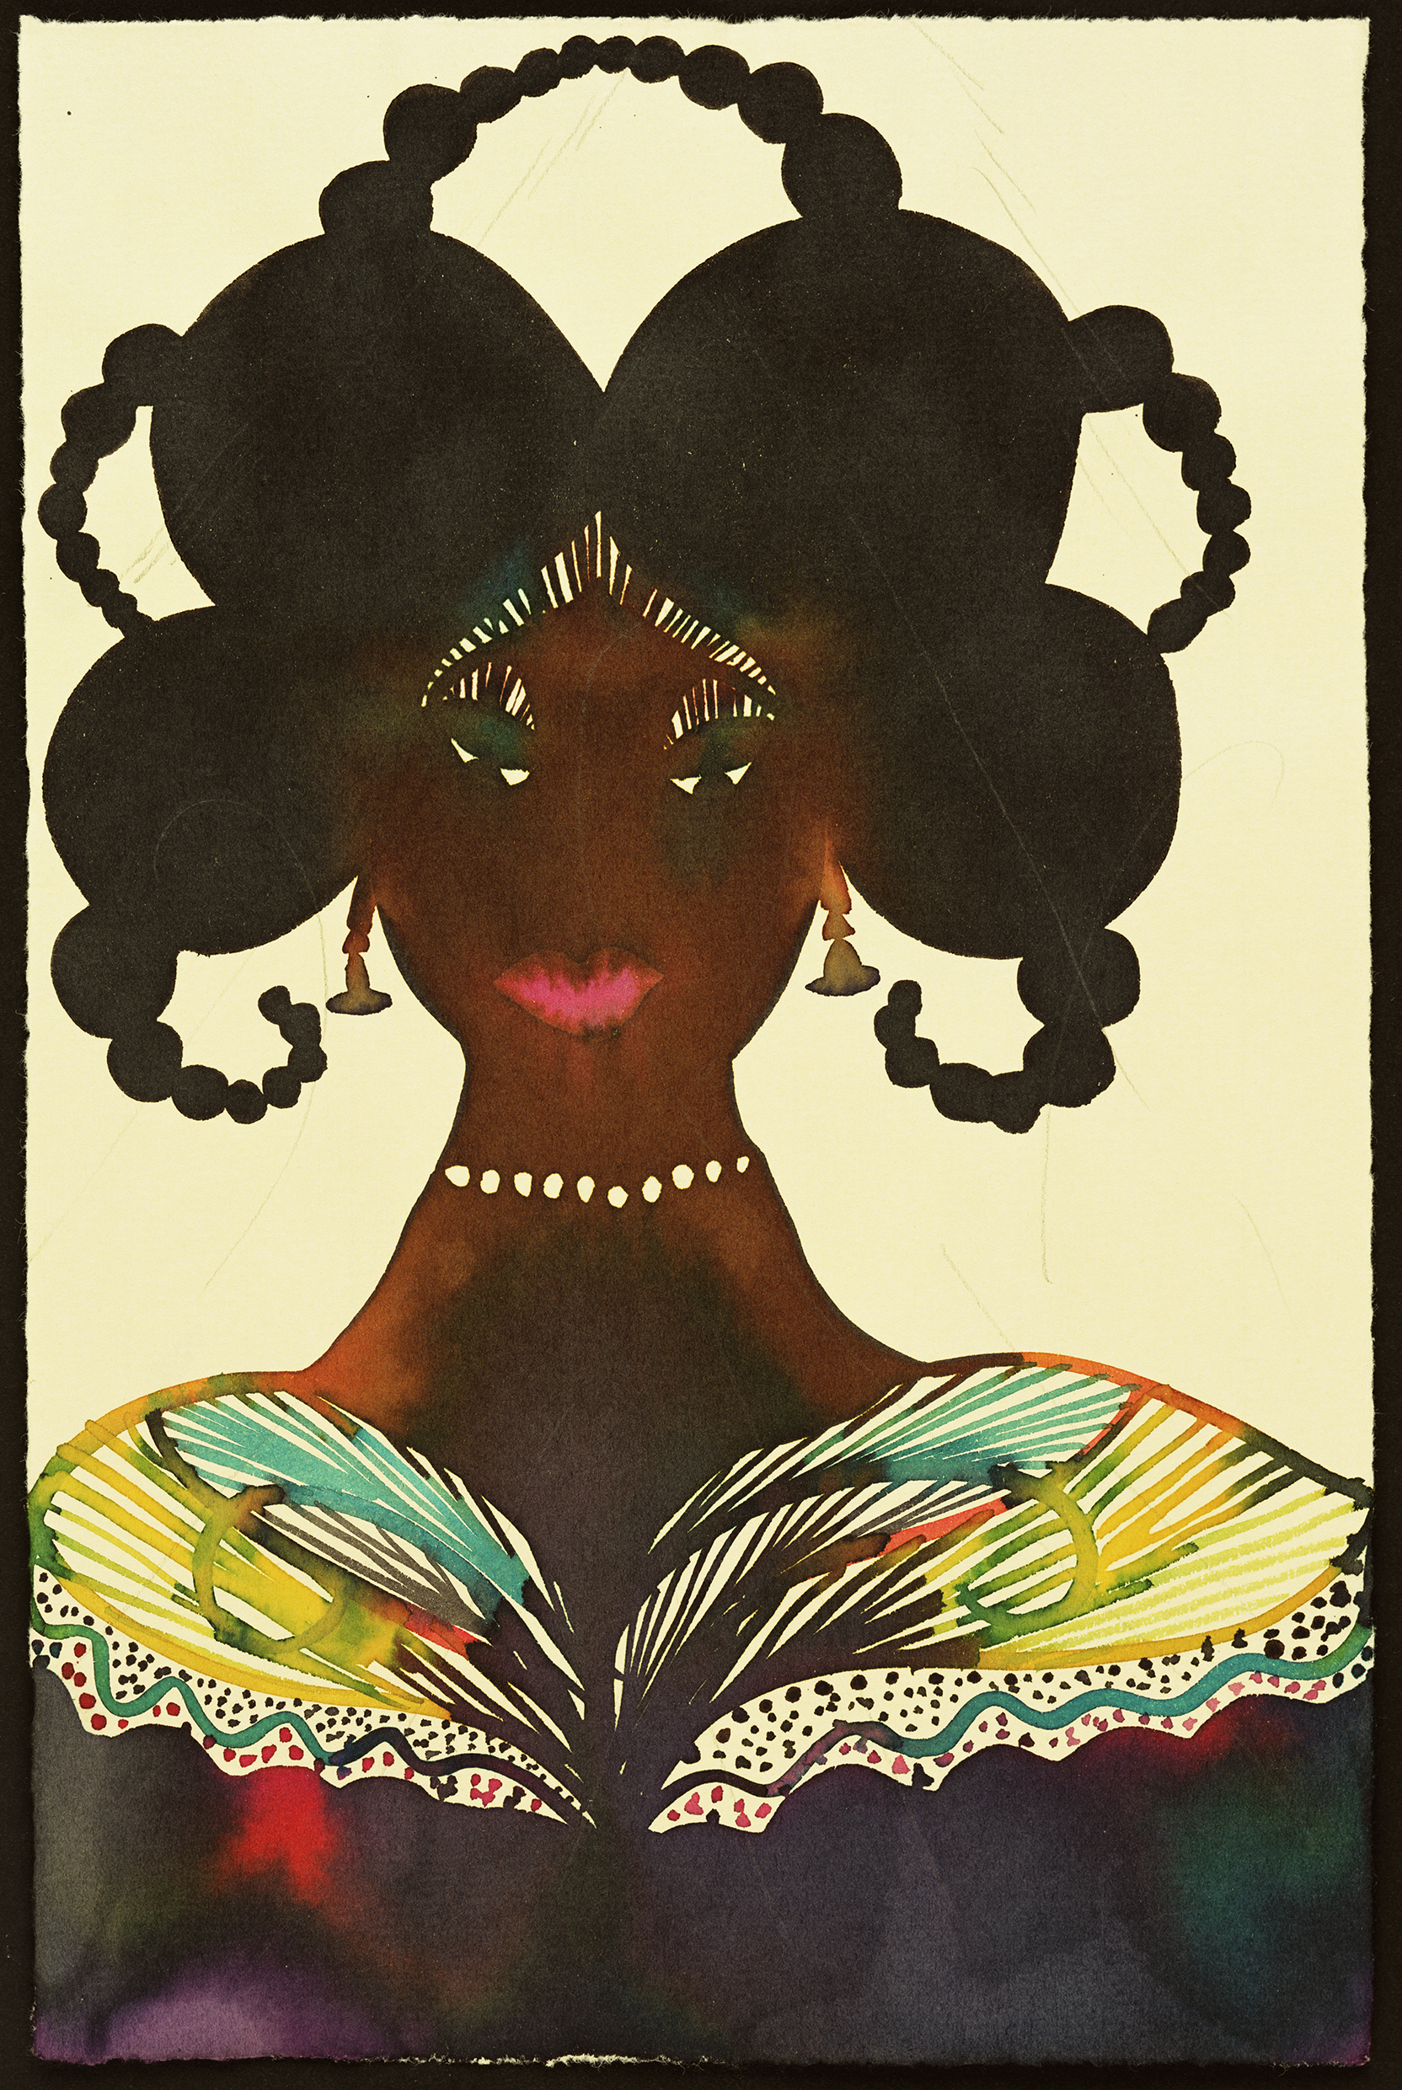

Slide 11
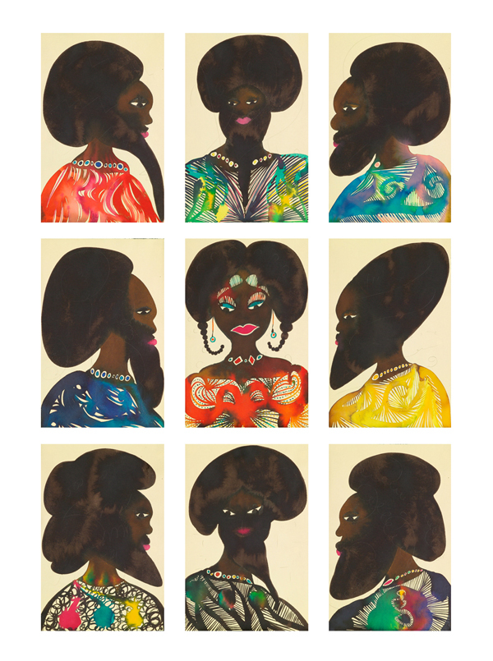

Slide 12
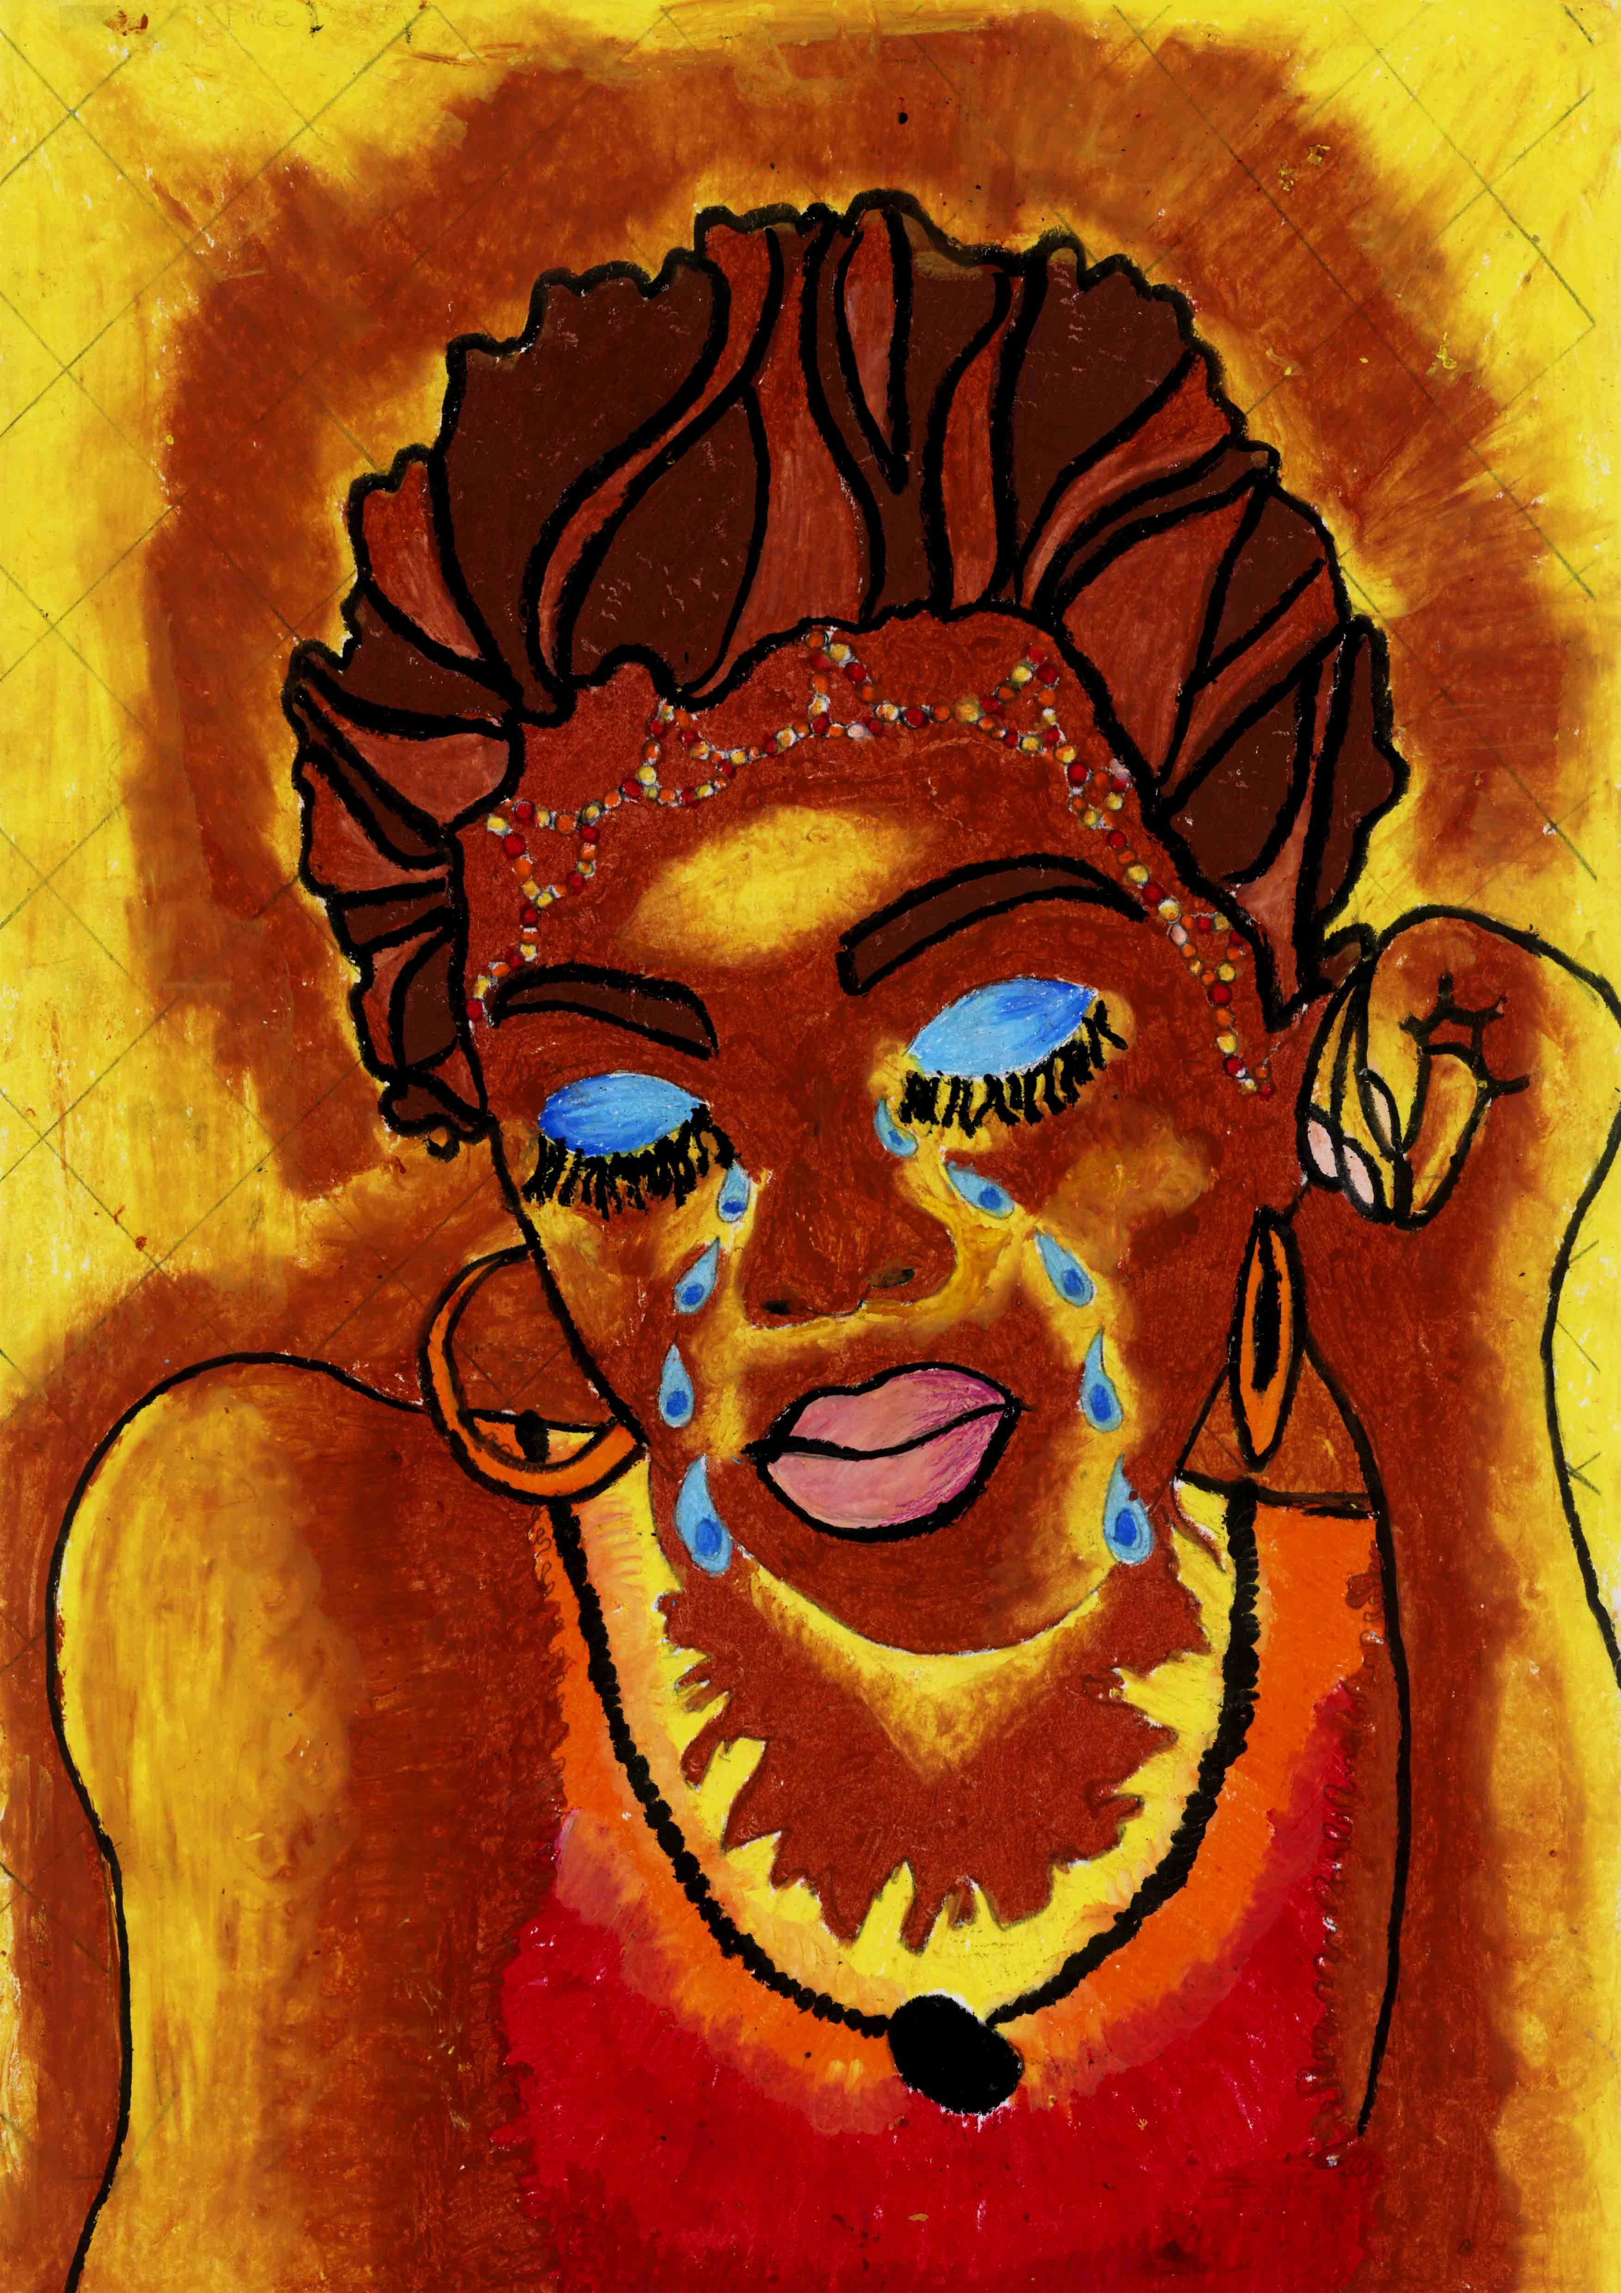
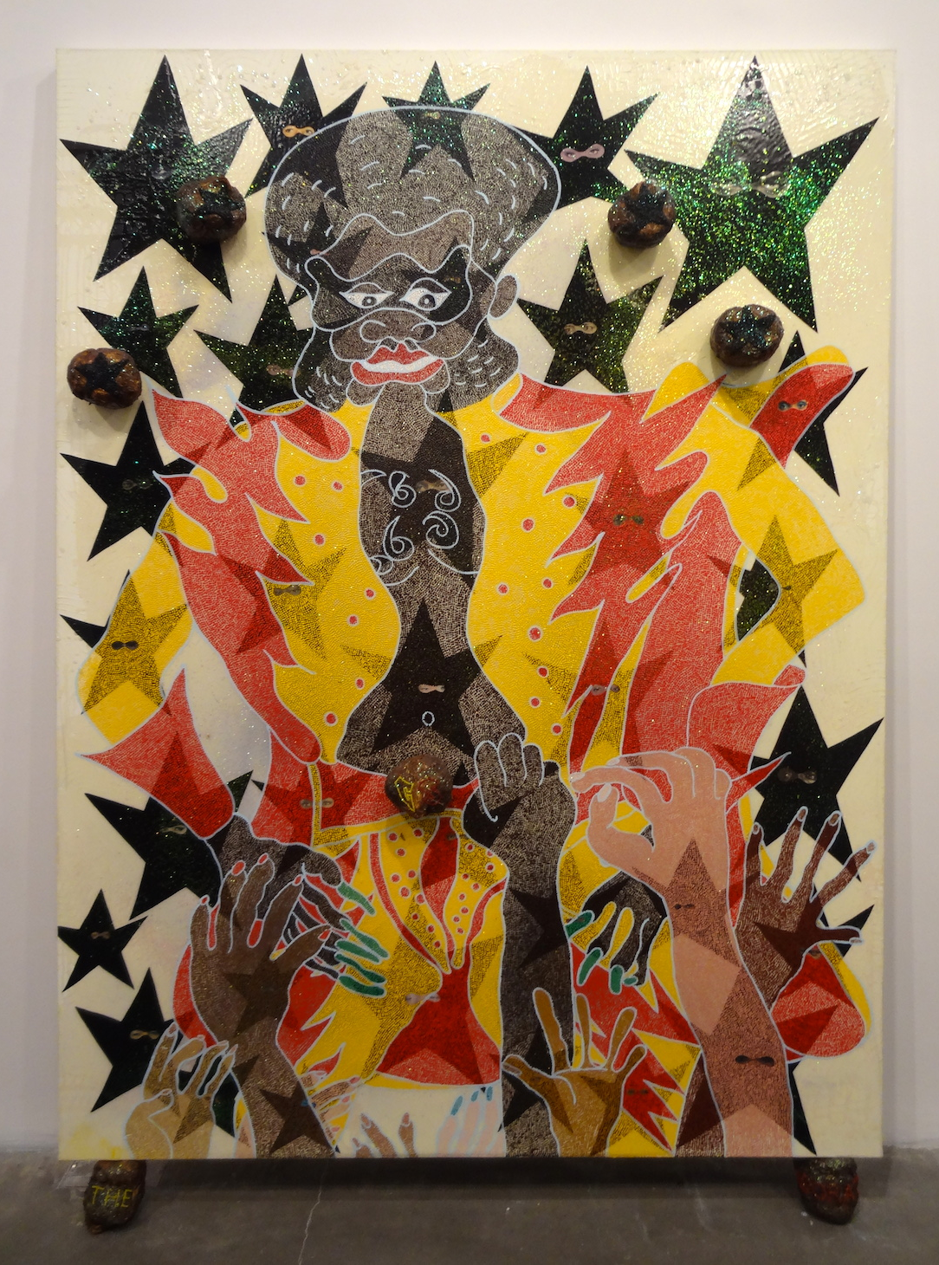

Slide 13
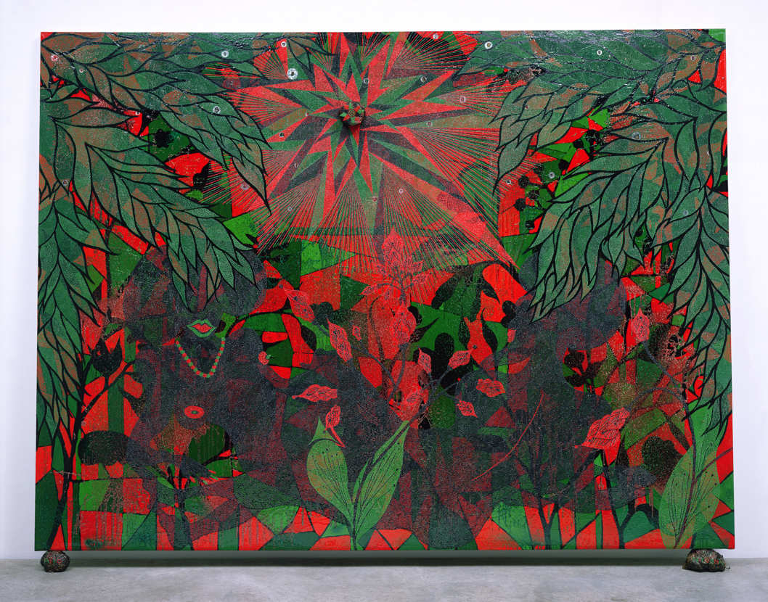

Slide 14
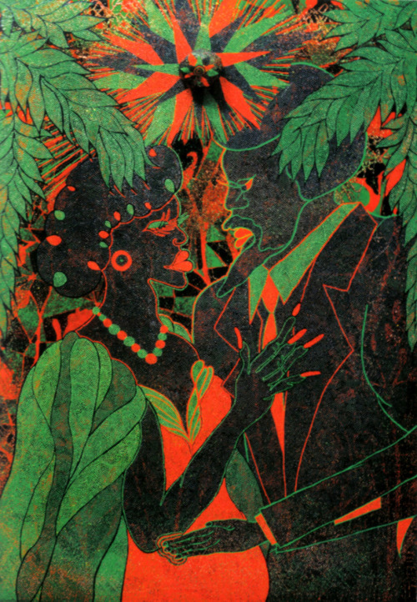
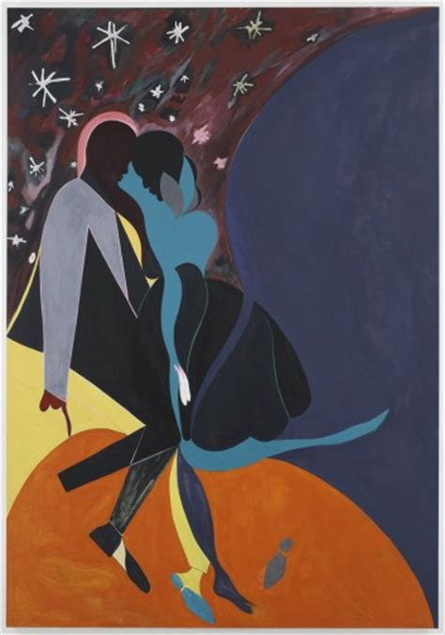
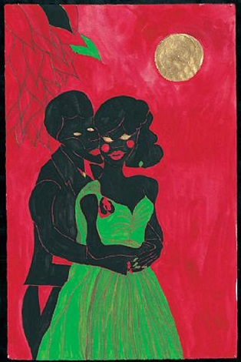

Slide 15
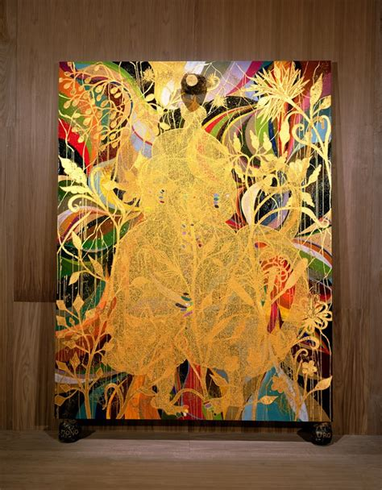
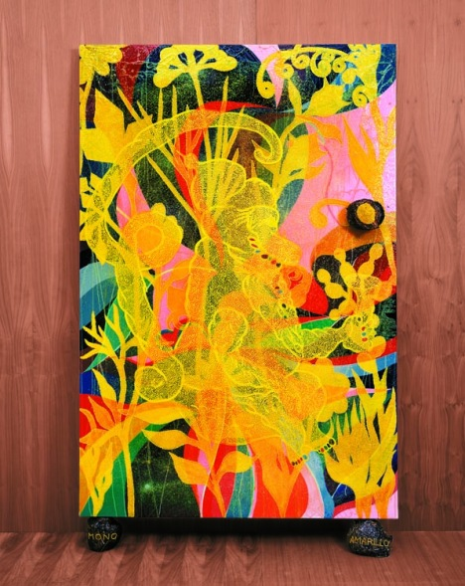

Slide 16
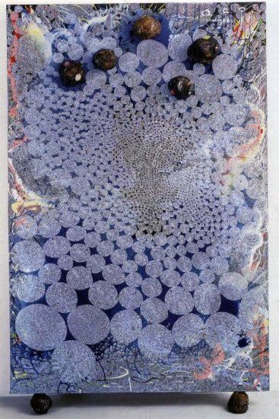
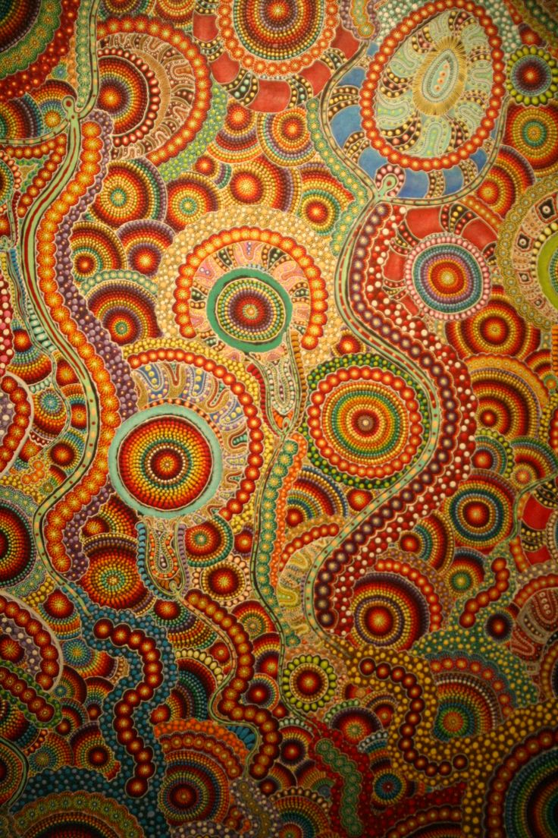

Slide 17
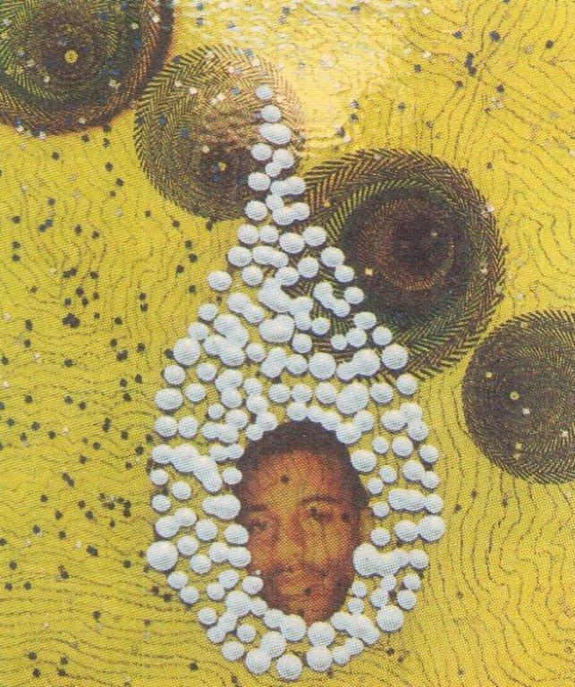
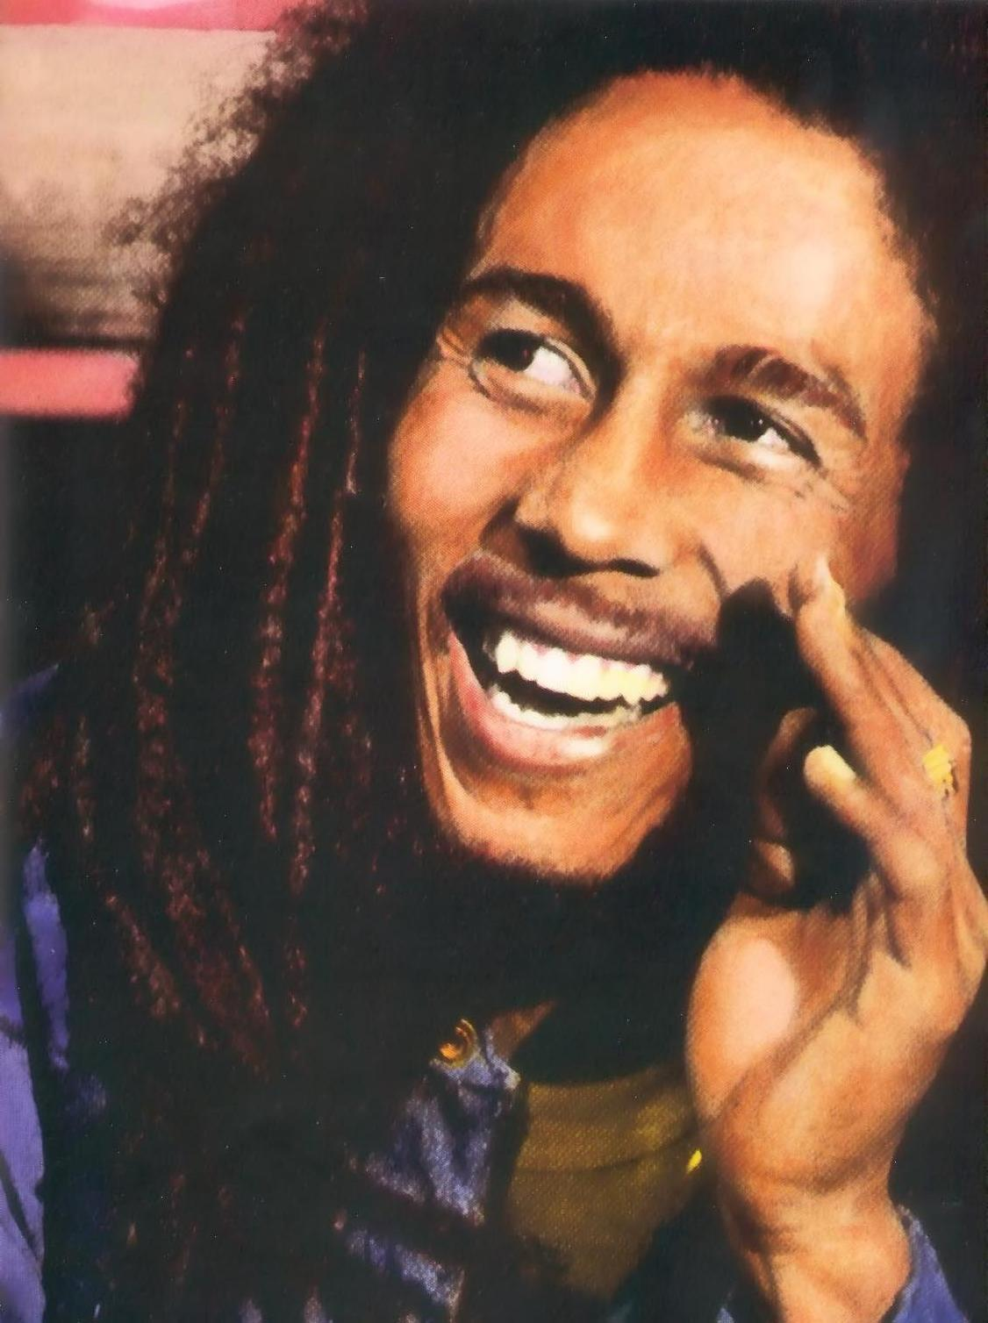
No woman no cry 1998, Mixed media on canvas.
This painting was featured in the exhibition that won him the Turner Prize. ‘No woman, no cry’ was created to symbolise melancholy and grief. Within the tears are photos of Stephen Lawrence who was killed in 1993.
The name comes from a song by Bob Marley – a Jamaican musician very popular, particularly in black culture.

Slide 18
Paradise by Night
Lithograph print, 2010
Chris Ofili now lives in Trinidad. His painting style has developed and changed further.

Slide 19
In 1998, at age 30, Chris Ofili was the first black person to win the prestigious art award known as ‘The Turner Prize’ at the Tate Gallery in London, but his success and achievements have not ended there. In April 2017 Chris Ofili, then aged 48, was awarded a CBE for services to art, at Buckingham Palace.
CBE = “Commander of the Most Excellent Order of the British Empire”

Slide 20
Follow the link below – it should take you to the video we have taken a screen shot of. http://www.youtube.com/watch?v=k0ztLFtL2Yk&safe=active

Slide 21
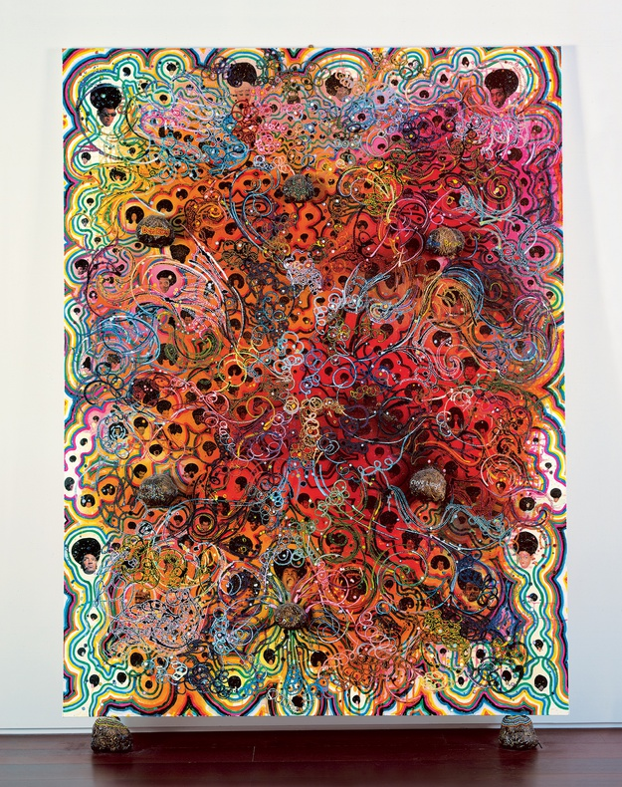
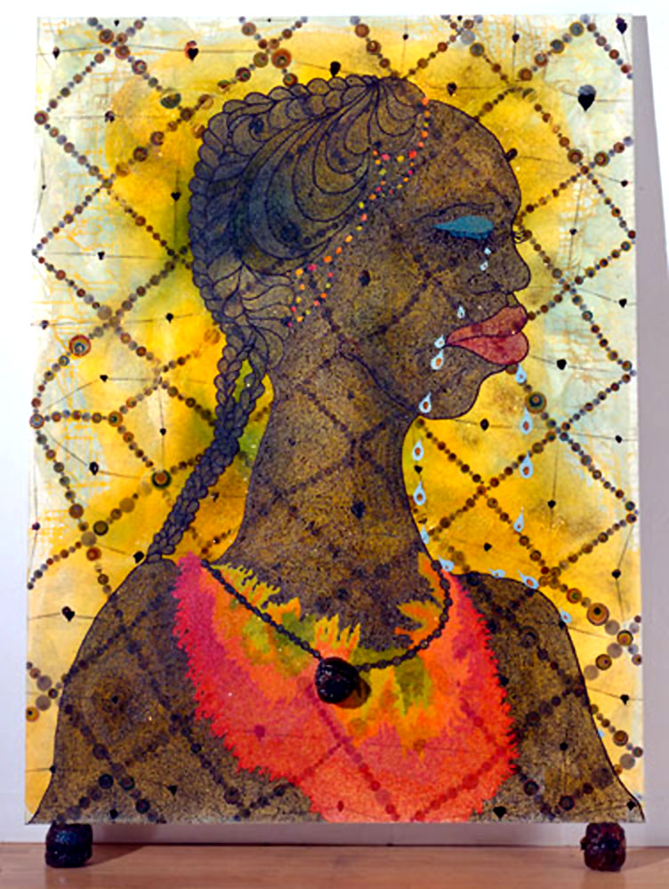
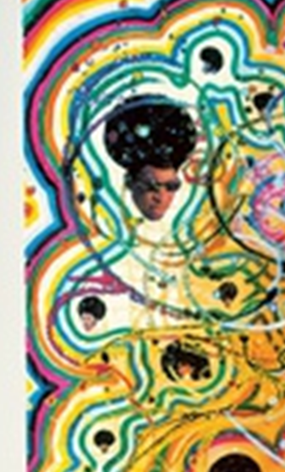
Your taskS
1) Cut out pictures of important / famous people and stick them on a piece of paper.
Then use patterns, lines, shapes and techniques inspired by Chris Ofili to link them together. You could use pencils, pens, paints, crayons...whatever media you have available.
Look closely at the pictures in this PowerPoint to get inspiration about his patterns.
2) Make a Chris Ofili style portrait. This could be done by drawing someone that you know or a famous person, or you could print out a picture and trace them. Then adapt the art into Chris Ofili’s style.
On the following slides are some of the people that inspired Y5/6 art last time we studied Chris Ofili.
On the last slides are some pieces of children’s art.

Slide 22
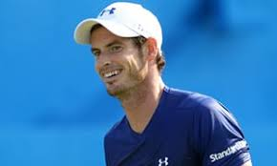
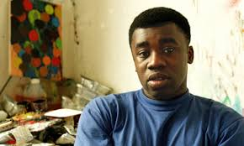

Slide 23
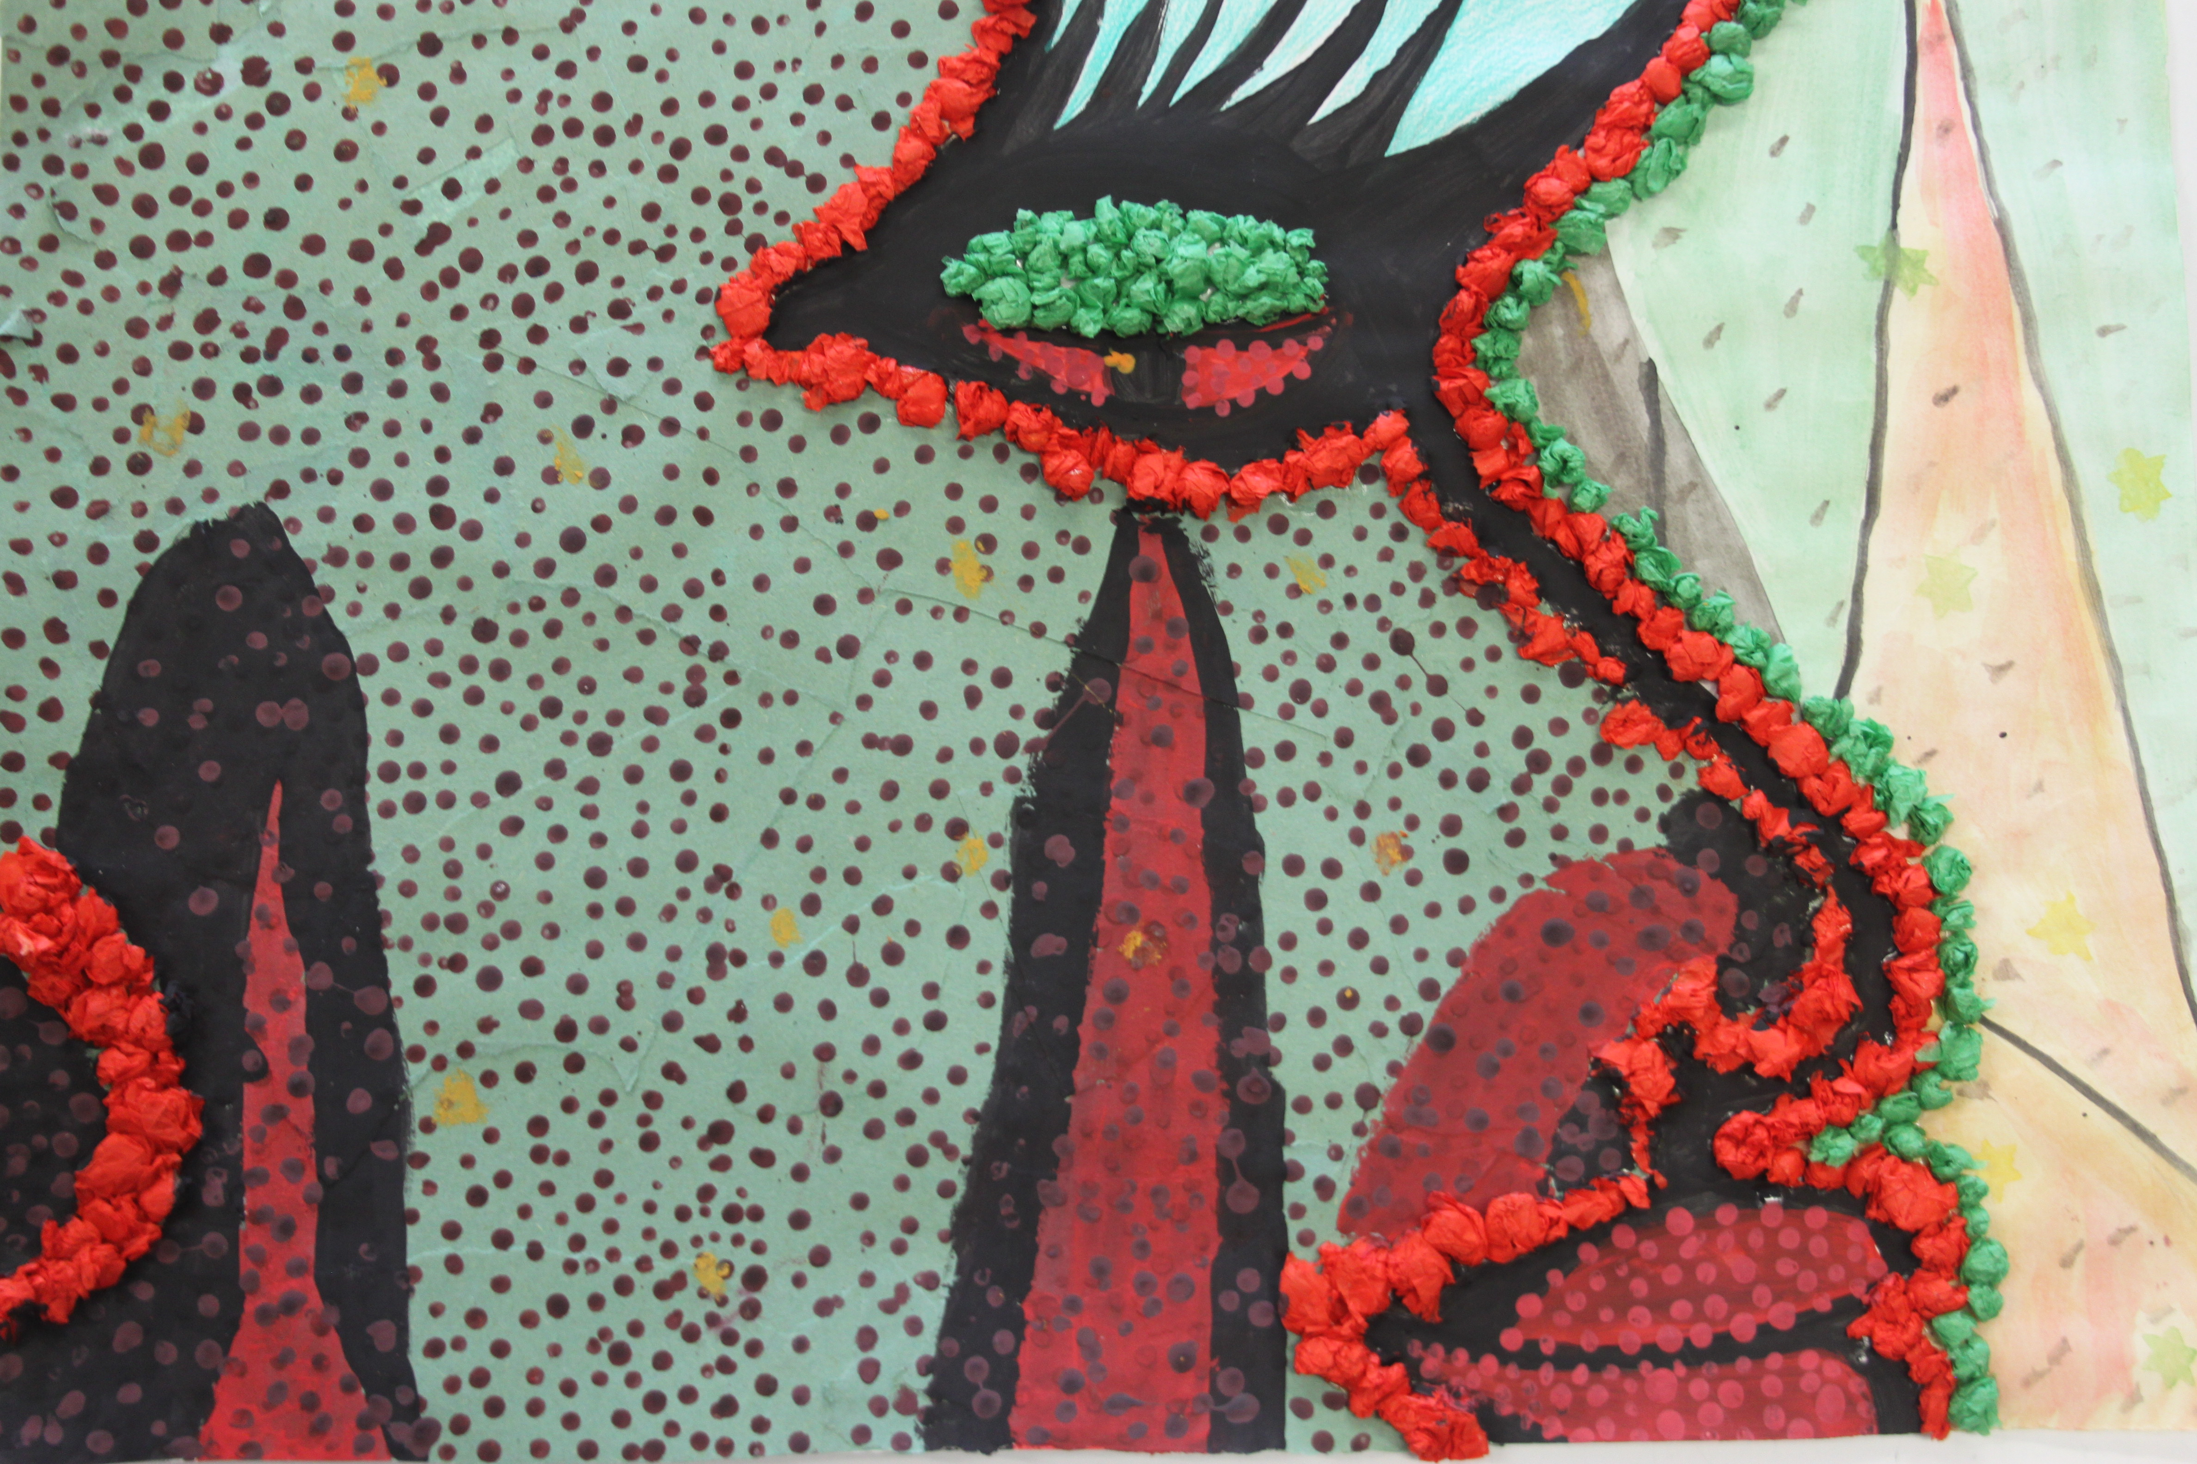
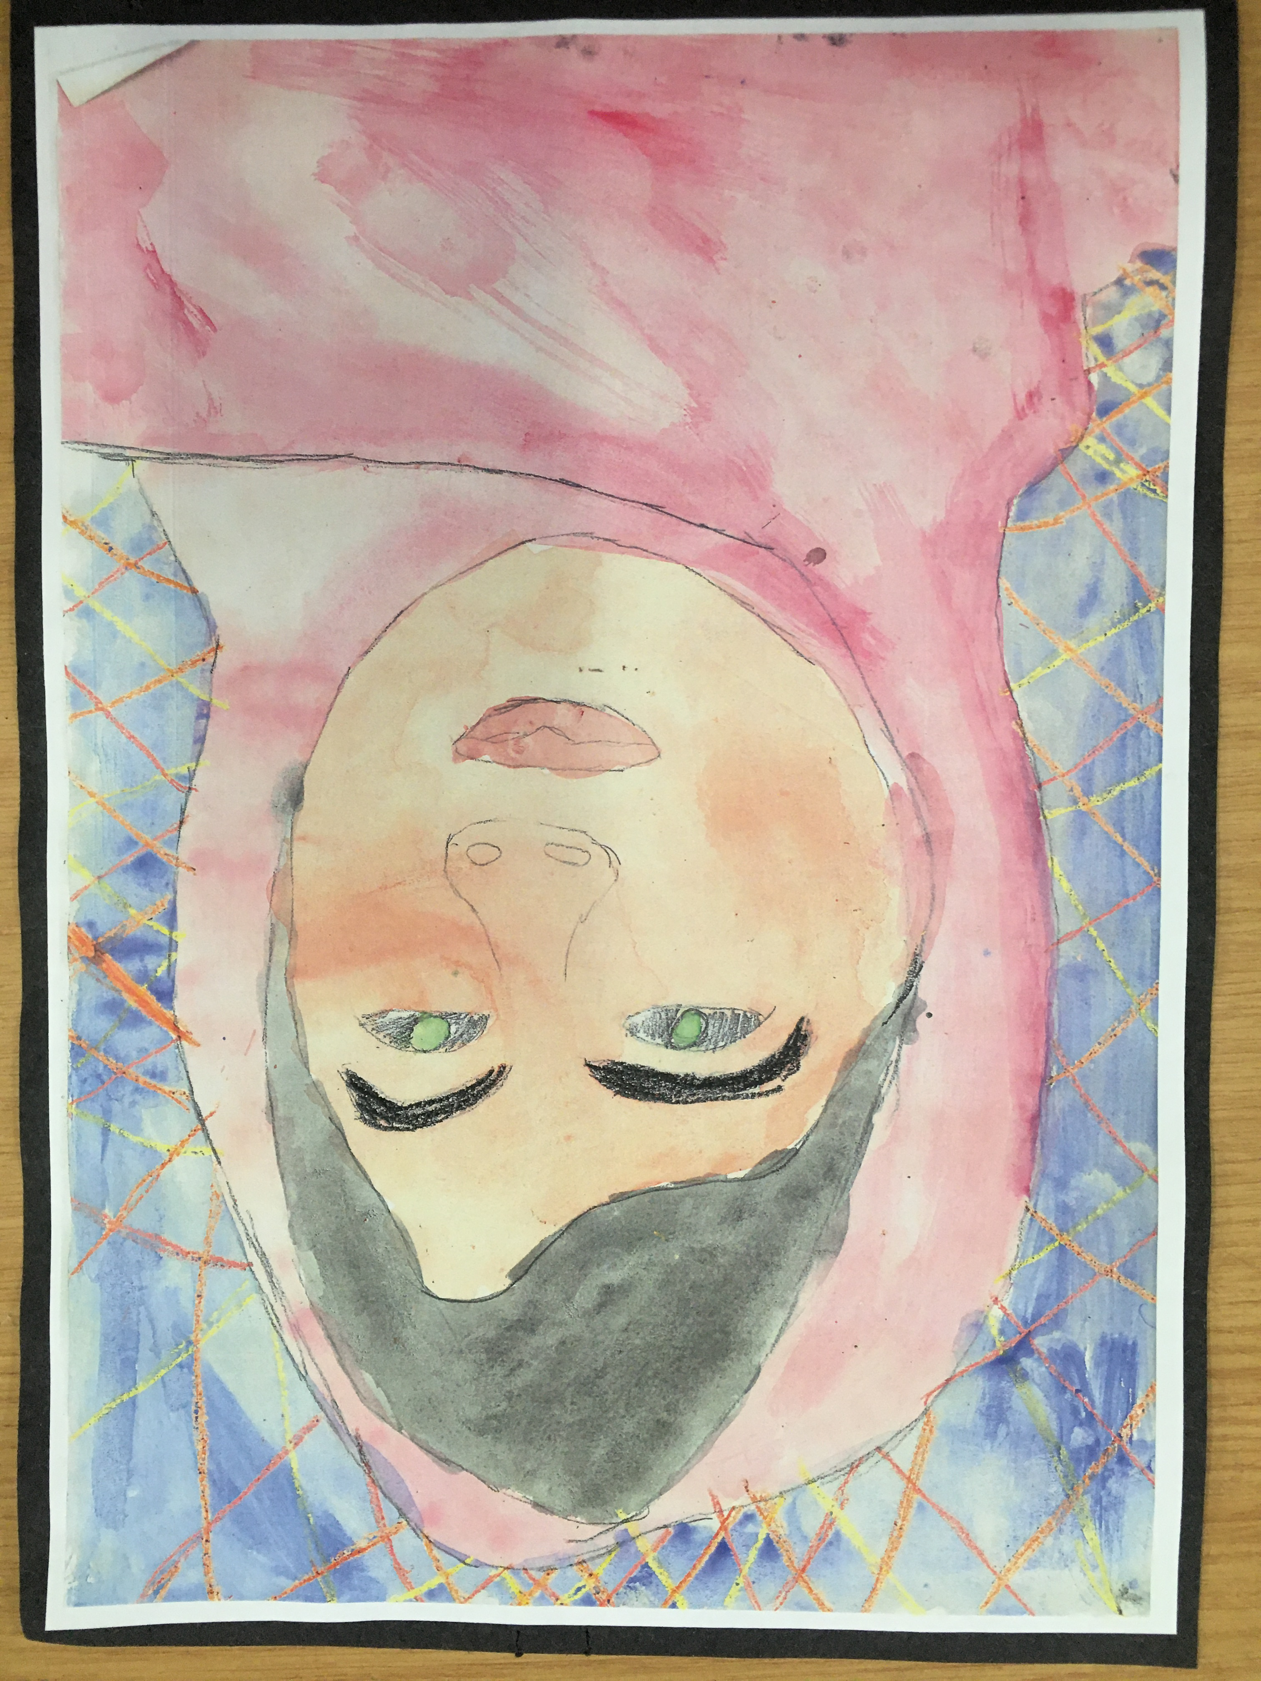
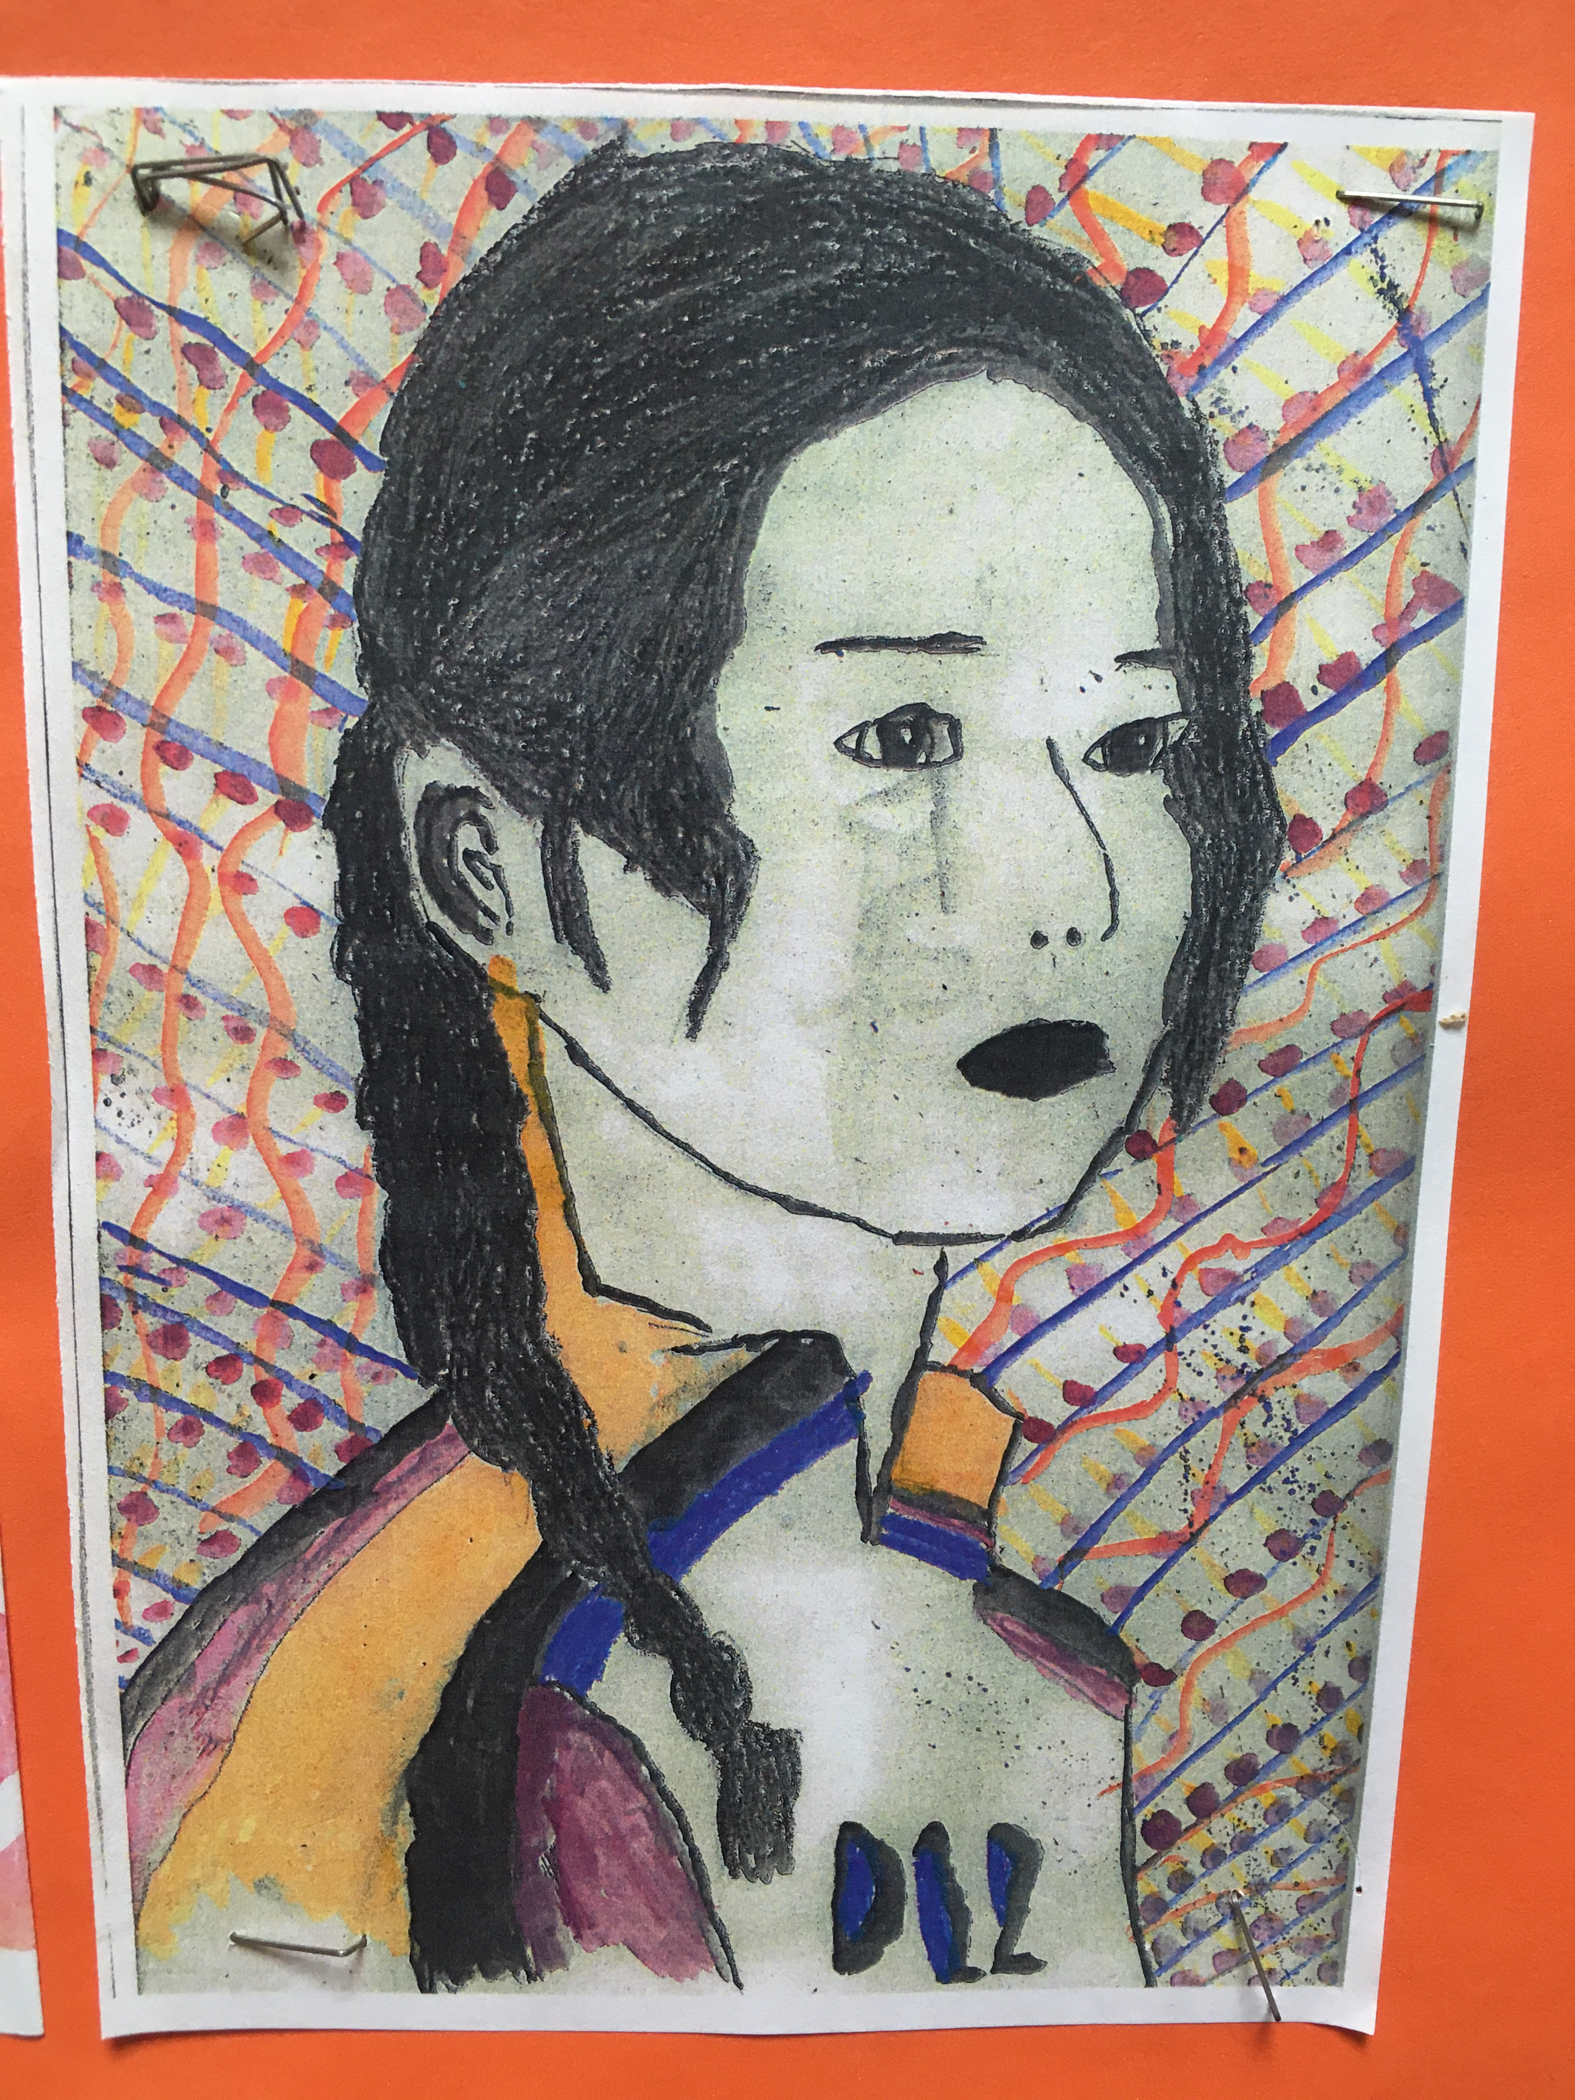
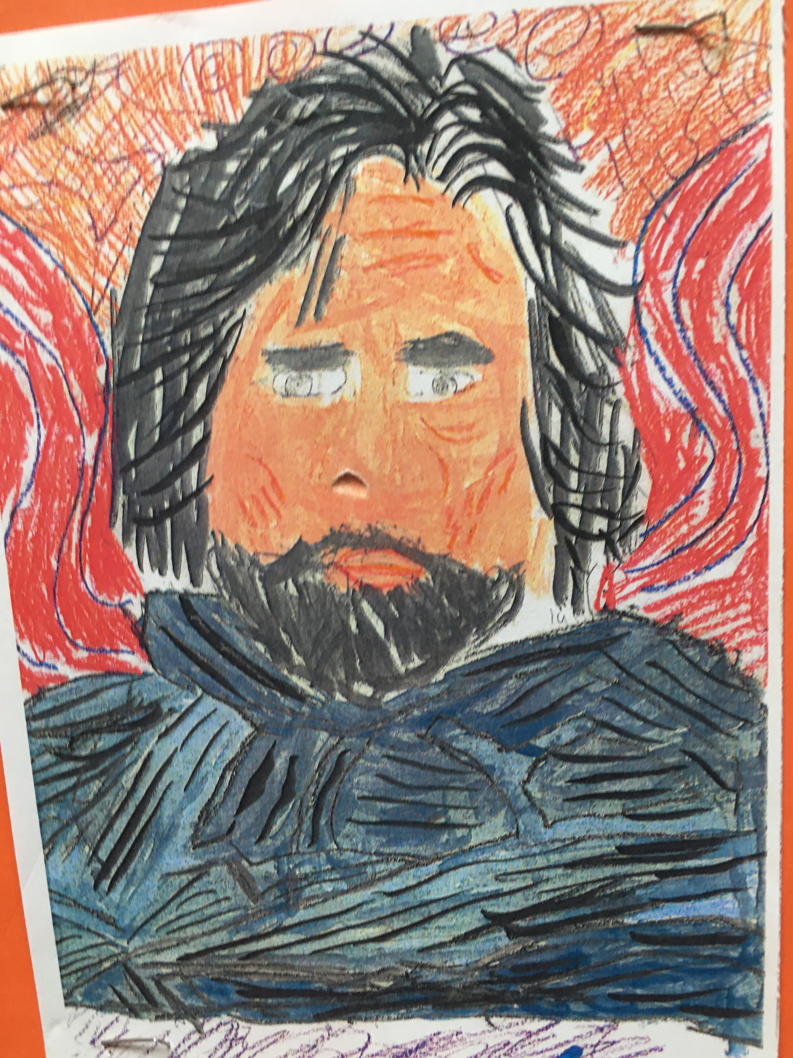
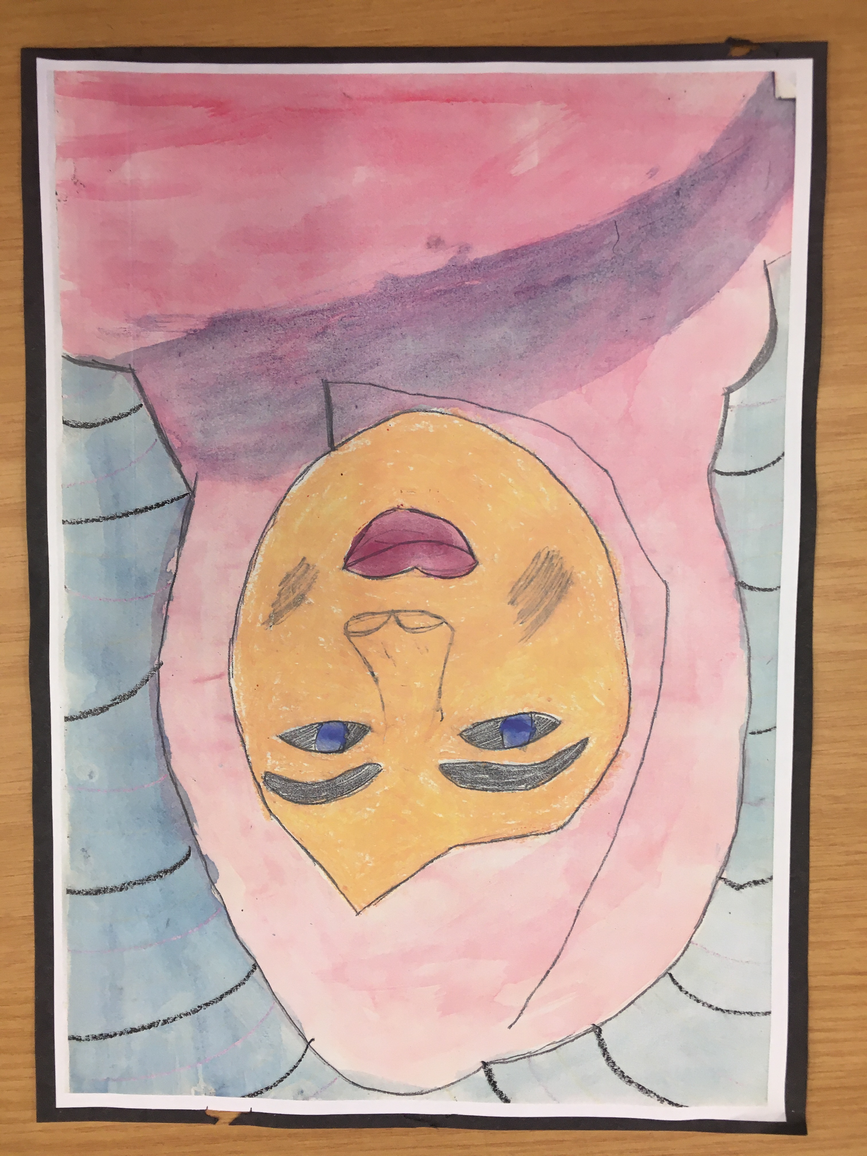

Slide 24
